Slide 1
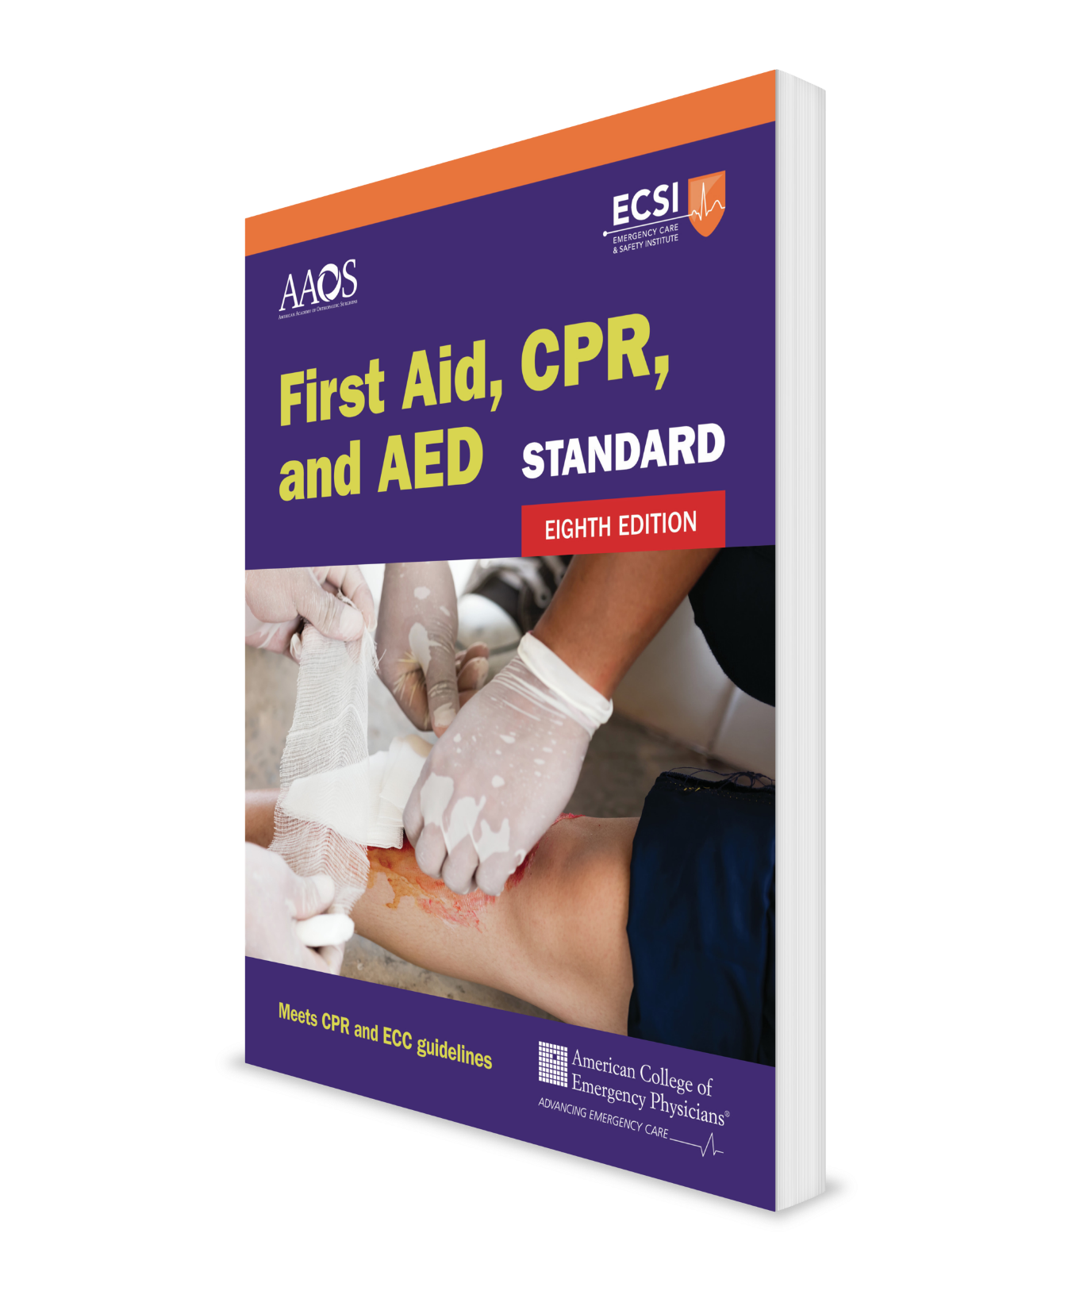
Injury Emergencies
First Aid Course
CHAPTER 4
Notes:
Standard First Aid, CPR, and AED, Eighth Edition

Slide 2
Support Materials
Lecture Outline
Worksheet
Videos
Skill Sheets
Skill Checkoff Sheets
CHAPTER 4 Opener photo.
Courtesy of Rhonda Hunt.

Slide 3
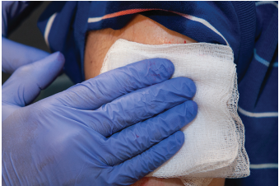
Bleeding Control: Bandages and Dressings
Use dressings and bandages to control non-life-threatening bleeding.
  A dressing directly touches and covers an open wound.
  A bandage holds a dressing in place.
Use a tourniquet to control massive bleeding (hemorrhage).
FIGURE 4-1: Dressing.
© Jones & Bartlett Learning.

Slide 4
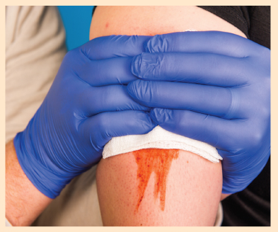
Bleeding Control (1 of 4)
Put on disposable latex-free gloves and expose the wound.
Cover the wound with a sterile or clean dressing and apply direct pressure until the bleeding stops.
If the bleeding is not a massive, life-threatening hemorrhage and direct pressure does not stop it within 5–10 minutes, add more dressings onto the first one and press harder over a wider area.
SKILL SHEET 4-1: Bleeding Control. Step 2.
© Jones & Bartlett Learning.

Slide 5
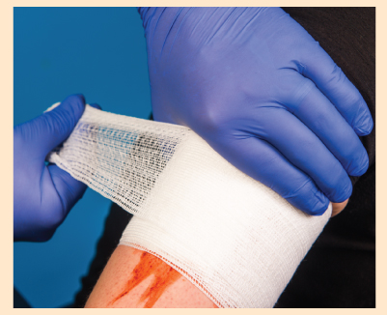
Bleeding Control (2 of 4)
When bleeding has stopped or you are unable to keep pressure on the wound, apply a bandage firmly over the dressing to maintain pressure on the wound and hold the dressing in place.
SKILL SHEET 4-1: Bleeding Control. Step 4.
© Jones & Bartlett Learning.

Slide 6
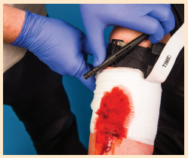
Bleeding Control (3 of 4)
If direct pressure fails to immediately stop bleeding from an arm or leg, apply a tourniquet (discussed later).
For other body areas where a tourniquet placement is impossible or when a tourniquet is ineffective or not available, insert a hemostatic gauze dressing directly into the wound (discussed later).
SKILL SHEET 4-1: Bleeding Control. Step 5.
© Jones & Bartlett Learning.

Slide 7
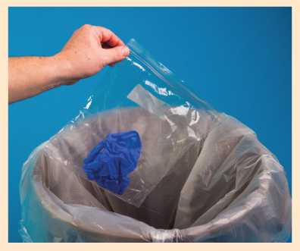
Bleeding Control (4 of 4)
After the bleeding stops:
  Care for the wound.
  Properly dispose of the gloves and any blood-contaminated clothing.
  Wash your hands.
  If needed, seek professional medical care for cleaning, sutures, or a tetanus immunization. For massive, life-threatening bleeding call EMS.
SKILL SHEET 4-1: Bleeding Control. Step 6.
© Jones & Bartlett Learning.

Slide 8
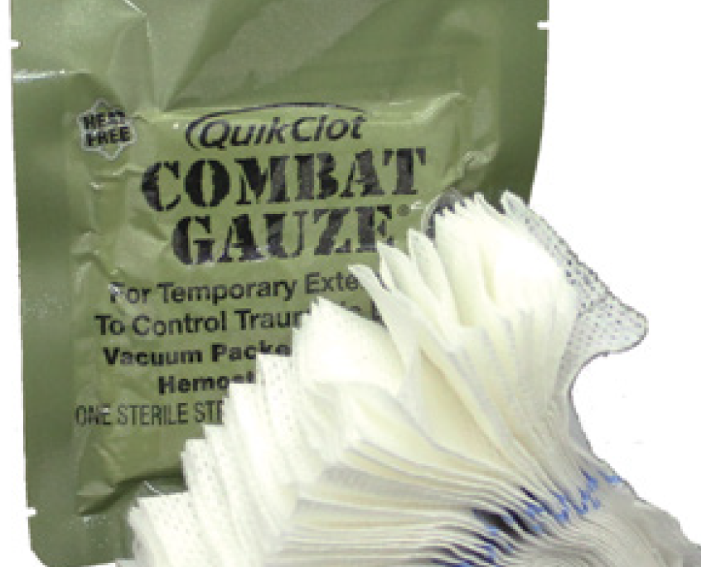
Hemostatic Dressings
Apply a hemostatic dressing if:
  Direct pressure is not effective in controlling bleeding.
  A manufactured tourniquet is not available, is ineffective, or cannot be applied.
Apply a hemostatic dressing in combination with direct pressure followed by a pressure bandage.
If still bleeding, consider using an improvised tourniquet.
FIGURE 4-3 Hemostatic dressings are gauze-style dressings saturated with an agent that stops bleeding.
Courtesy of Z-Medica

Slide 9
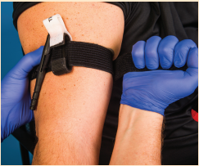
Applying a Manufactured Tourniquet (1 of 5)
If direct pressure fails to control bleeding on an arm or a leg, apply a manufactured tourniquet about 2 inches (5 cm) above the wound.
  DO NOT apply anywhere other than an arm or leg
  DO NOT apply over a joint
    If applying a tourniquet 2 to 3 inches above the wound places it over a joint, place the tourniquet even higher.
SKILL SHEET 4-2: Massive Bleeding Control: Applying a Manufactured Tourniquet. Step 1.
© Jones & Bartlett Learning.

Slide 10
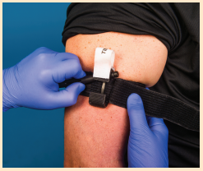
Applying a Manufactured Tourniquet (2 of 5)
Tighten the tourniquet by twisting the rod in one direction until bleeding stops.
Secure the twisting rod using the Velcro or holder so that the rod does not unwind.
SKILL SHEET 4-2: Massive Bleeding Control: Applying a Manufactured Tourniquet. Step 3.
© Jones & Bartlett Learning.

Slide 11
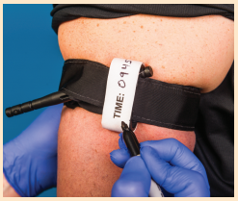
Applying a Manufactured Tourniquet (3 of 5)
Write the time the tourniquet was applied on the tourniquet’s tag.
If a tag is not available, write “TQ” or “TK” (for tourniquet) and the time it was applied on a piece of tape and stick it on the person’s forehead.
DO NOT cover, release, or remove the tourniquet.
SKILL SHEET 4-2: Massive Bleeding Control: Applying a Manufactured Tourniquet. Step 4.
© Jones & Bartlett Learning.

Slide 12
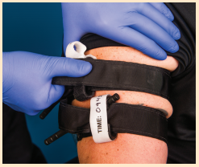
Applying a Manufactured Tourniquet (4 of 5)
If massive hemorrhage continues, the tourniquet is not tight enough.
  Tighten the tourniquet.
If still ineffective, apply a second tourniquet near the first, above it, if possible.
  A second tourniquet is rarely needed.
SKILL SHEET 4-2: Massive Bleeding Control: Applying a Manufactured Tourniquet. Step 5.
© Jones & Bartlett Learning.

Slide 13
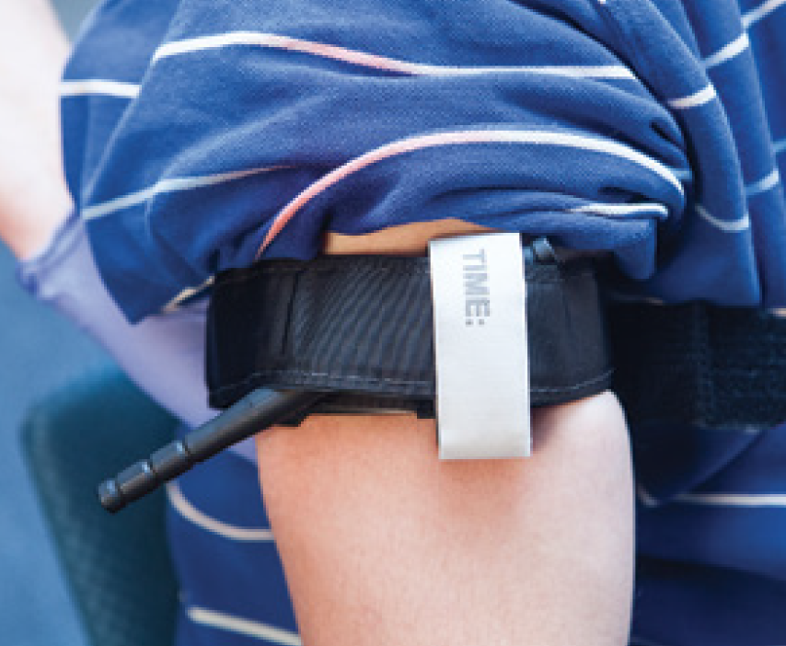
Applying a Manufactured Tourniquet (5 of 5)
DO NOT cover, release, or remove a tourniquet.
Manufactured tourniquets are preferred over improvised tourniquets that often fail to stop the bleeding.
Manufactured tourniquets are designed to be applied with one hand, if necessary, for self-rescue.
FIGURE 4-2 A tourniquet is a device wrapped tightly around an extremity to stop blood flow.
© Jones & Bartlett Learning.

Slide 14
Applying an Improvised Tourniquet (1 of 5)
Improvise a tourniquet to save a life when direct pressure cannot stop the bleeding and a manufactured tourniquet or a hemostatic dressing is not available or is ineffective.

Slide 15
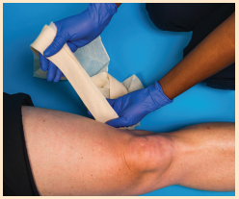
Applying an Improvised Tourniquet (2 of 5)
Expose the wound.
Use a folded triangle bandage, wide roller bandage, or similar cloth folded into a long band about 2 inches (5 cm) wide and several layers thick.
DO NOT use narrow materials, elastic materials, or bungee-type devices.
SKILL SHEET 4-3: Massive Bleeding Control: Applying an Improvised Tourniquet. Step 1.
© Jones & Bartlett Learning.

Slide 16
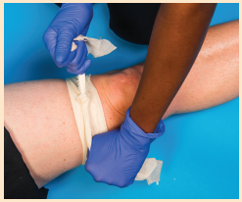
Applying an Improvised Tourniquet (3 of 5)
Wrap the folded band twice above the wound, about 2 to 3 inches (5 to 8 cm) and tie an overhand knot.
DO NOT apply it anywhere other than the arm or leg.
DO NOT apply it over a joint.
SKILL SHEET 4-3: Massive Bleeding Control: Applying an Improvised Tourniquet. Step 2.
© Jones & Bartlett Learning.

Slide 17
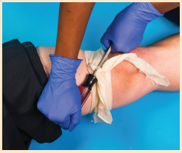
Applying an Improvised Tourniquet (4 of 5)
Place a short, rigid object (eg, screwdriver, stick) on top of the knot.
Tie a square knot over the rigid object with the ends of the cloth band.
Twist the rigid object in one direction until the bleeding stops.
Secure the rigid object in place with another cloth band or tape.
SKILL SHEET 4-3: Massive Bleeding Control: Applying an Improvised Tourniquet. Step 4.
© Jones & Bartlett Learning.

Slide 18
Applying an Improvised Tourniquet (5 of 5)
Write on a piece of tape “TQ” or “TK” for tourniquet and the time applied, and stick it on the person’s forehead.
If massive hemorrhage continues, the tourniquet is not tight enough.
  Tighten the tourniquet.
If still ineffective, apply a second tourniquet near the first, above it, if possible.
  A second tourniquet is rarely needed.

Slide 19
A Note on Tourniquets
The following can warrant placing a tourniquet as quickly as possible:
  Unsafe conditions (eg, active shooter, military combat)
  Inability to see the wound (eg, darkness)
  Large-scale events involving more than one person needing care (eg, natural disasters, explosions, motor vehicle and air crashes)
Placing a tourniquet in a “high and tight” location (near armpit for an arm and near the groin for the leg) allows for fast evacuation and caring for life-threatening injuries.

Slide 20
Common Tourniquet Mistakes
Not using a tourniquet when you should
Using a tourniquet for minimal bleeding
Placing the tourniquet on too far from the bleeding site
Not making the tourniquet tight enough to effectively stop bleeding
Not using a second tourniquet if needed
Using anything narrow such as rope, wire, string, cords, or belt
Waiting too long to put the tourniquet on
Periodically loosening the tourniquet to allow blood flow to the injured extremity
Not monitoring its effectiveness

Slide 21
Wound Care
A wound is an injury caused by external physical force.
Scrub your hands vigorously with soap and water before and after cleaning a wound.
  If water is not available, use an alcohol-based hand sanitizer gel.
Wear disposable medical exam gloves if available.

Slide 22
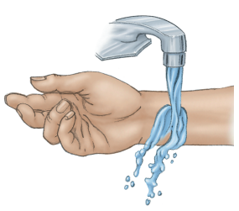
Shallow Wounds: What to Do (1 of 2)
Gently wash inside and around the wound with warm or room-temperature running water, with or without soap.
  Cold water is as effective as warm water but can be uncomfortable.
  If running water is not available, use any source of clean water.
Flush with flowing water inside the wound.
Pat the area dry.
FIGURE 4-4: Flush the wound.
© Jones & Bartlett Learning.

Slide 23
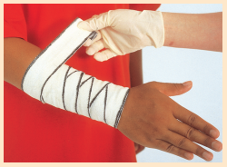
Shallow Wounds: What to Do (2 of 2)
If bleeding restarts, apply direct pressure.
Apply a thin layer of antibiotic ointment over the wound if the person is not sensitive to medication.
  DO NOT apply hydrogen peroxide, alcohol, or iodine.
Cover the wound with a sterile or clean dressing and bandage.
SKILL SHEET 4-4: Applying a Roller Bandage on a Forearm (Spiral Method). Step 3.
© Jones & Bartlett Learning.

Slide 24
Severe Wounds: What to Do (1 of 2)
Clean as best you can.
Cover with a sterile or clean dressing held in place by a bandage.
Care for shock; keep the person from getting chilled or overheated.

Slide 25
Severe Wounds: What to Do (2 of 2)
Severe wounds have a greater risk for infections and require professional medical care:
  Bite wounds
  Very dirty or contaminated wounds
  Crushing, ragged wounds
  Open fractures
  Wounds over a joint or tendon
  Deep puncture wounds

Slide 26
Infected Wounds: What to Look For
Swelling and redness around wound
Feeling of increased temperature compared to surrounding area
Throbbing pain
Pus discharge

Slide 27
Infected Wounds: What to Do
Soak the wound in warm water, or apply warm, wet packs over the infected wound.
  Separate the wound edges to allow pus to escape.
Apply an antibiotic ointment.
Give pain medication
  Be aware that lowering a fever could mask a more serious infection.
Seek professional medical care if the infection becomes worse.

Slide 28
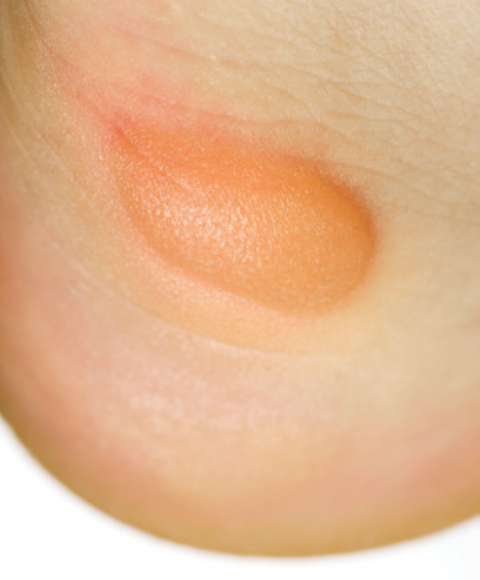
Blisters: What to Do (1 of 4)
Hot spot (painful, red area caused by rubbing)
  Depending upon availability and the blister’s location, apply one of the following:
    Blister bandage (Blist-O-Ban)
    Surgical tape (Micropore paper tape)
    Elastic tape (Elastikon)
  Trim and round the edges of the tape to prevent it from peeling off.
© Maximillian Weinzierl/Alamy.
FIGURE 4-5 Friction blister (closed).
© Maximillian Weinzierl/Alamy

Slide 29
Blisters: What to Do (2 of 4)
Blister that is closed and not very painful
  Depending upon availability and the location of the blister, use the most appropriate method previously discussed for a hot spot.

Slide 30
Blisters: What to Do (3 of 4)
Blister that is closed and very painful
  Clean the blister and a needle with an alcohol pad.
  Make several small holes at the base of the blister with the needle.
    DO NOT make one large hole.
    Gently press the fluid out.
    DO NOT remove the blister roof unless it is torn.
  Apply paper tape to protect the blister roof from being torn away when other overlying tape is removed.
  Cover paper tape with elastic or adhesive tape.
  Trim and round the edges of the tape to prevent it from peeling off.
  Watch for signs of an infection.

Slide 31
Blisters: What to Do (4 of 4)
Blister that is very painful and open or torn
  Use scissors to carefully trim off the dead skin.
  Place a blister pad over the raw skin.
  Cover the blister pad with paper tape.
  Cover paper tape with elastic or adhesive tape. Trim and round the edges of the tape.
  Watch for signs of an infection.

Slide 32
Broken Nose: What to Do
If bleeding, care for the nosebleed.
  Flush with flowing water (eg, from a faucet) inside the wound.
  Pat the area dry.
Apply an ice pack for 15 minutes.
Professional medical care can be delayed.
DO NOT try to straighten a crooked nose.

Slide 33
Nosebleed: What to Look For
Swelling
Bleeding
Difficulty breathing

Slide 34
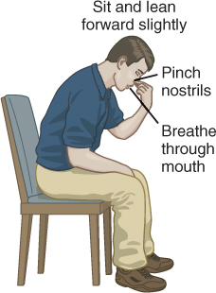
Nosebleed: What to Do (1 of 2)
Have the person sit leaning slightly forward.
  DO NOT tilt the head back or lie the person down.
Pinch the nostrils shut for 10 minutes.
Tell the person to breathe through the mouth and not swallow any blood.
FIGURE 4-7 Positioning of person pinching the nose to stop a nosebleed.
© Jones & Bartlett Learning.

Slide 35
Nosebleed: What to Do (2 of 2)
If bleeding has not stopped, have the person gently blow their nose to get rid of ineffective blood clots.
Pinch the nostrils together again for 10 minutes.
If bleeding continues, try other methods in addition to nose pinching, such as applying an ice pack or spraying decongestant spray in nostrils.
Professional medical care is not usually needed unless bleeding continues, a foreign object is in the nose, or if the nose is broken.

Slide 36
Foreign Object in Nose: What to Do
Mainly occurs in small children
Try one or more of the following methods to remove an object:
  Have the person gently blow their nose while compressing the opposite nostril.
  If an object is visible, pull it out with tweezers.
    DO NOT push the object deeper.
  Seek professional medical care if the object cannot be removed.

Slide 37
Toothache: What to Do
Rinse the person’s mouth with warm water.
Use dental floss to remove any trapped food.
Place an ice pack on the outside of the cheek to reduce swelling.
DO NOT place aspirin on the aching tooth or gum tissue.
Give pain medication (eg, acetaminophen, ibuprofen).
Seek a dentist.

Slide 38
Broken Tooth: What to Do (1 of 2)
Collect all the tooth or teeth fragments. Depending upon the severity of injury, a dentist may be able to reattach them.
Rinse the person’s mouth with warm water.
For swelling over the injured area, place an ice pack on the outside of the cheek.
For pain, have the person keep air exposure to a minimum by keeping the mouth closed. Additionally, consider providing pain medication, which should be swallowed.

Slide 39
Broken Tooth: What to Do (2 of 2)
If a jaw fracture is suspected, stabilize the jaw by wrapping a bandage under the chin and over the top of the head.
Seek a dentist as soon as possible.
Transport the fragments as you would a knocked-out tooth (see next section).

Slide 40
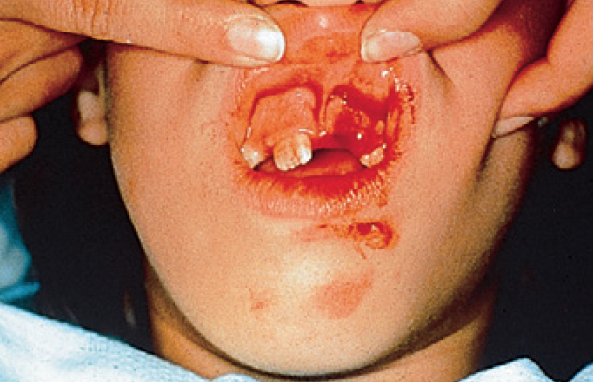
Knocked-Out (Avulsed) Tooth: What to Do (1 of 3)
Attempt to reimplant the tooth (only if it is a permanent [adult] tooth):
  DO NOT touch the root
  Hold the tooth by the crown (tooth part normally seen when looking into a mouth), not the root.
FIGURE 4-9 Knocked-out tooth
© American Academy of Orthopaedic Surgeons.

Slide 41
Knocked-Out (Avulsed) Tooth: What to Do (2 of 3)
If the tooth is dirty, rinse it in a bowl of water.
  DO NOT scrub or remove any of the attached tissue fragments.
Gently push the tooth down into the socket so the top is even with adjacent teeth.
  The person can bite down gently on gauze or a handkerchief placed between the teeth.

Slide 42
Knocked-Out (Avulsed) Tooth: What to Do (3 of 3)
If unable to reimplant, keep the knocked out tooth viable by storing it in a solution (listed in order of preference):
  Hank’s Balanced Salt Solution
  Clear plastic wrap
  Cow’s milk (any percent fat)
If none of these storage solutions are available, have the person spit saliva in a small container into which the tooth can be placed.
  DO NOT place the tooth in the mouth.
  DO NOT store it in water.
Seek a dentist as soon as possible.

Slide 43
Infected or Abscessed Tooth: What to Do
Have the person rinse their mouth several times a day with warm water.
Give pain medication.
  DO NOT have the person suck an aspirin
  DO NOT place an aspirin on the tooth or gum tissue
An ice pack on the cheek may help.
Use dental floss to remove any trapped food.
Seek a dentist.

Slide 44
Cavity
What to look for:
  Sensitivity to heat, cold, or sweets
  Sensitivity to touch
What to do:
  Have the person rinse their mouth with warm water.
  If available, apply a temporary filling with cavity dental filling paste.
    Other options include sugarless chewing gum, candle wax, or ski wax.
  Seek a dentist.

Slide 45
Bleeding From Mouth: What to Do
Allow blood to drain out of the mouth.
For a bleeding tongue, put a dressing on the wound and apply pressure.
For a cut through a lip, place a rolled dressing between the lip and gum and press another dressing against the outer lip.
Seek professional medical care.

Slide 46
Eye Injuries
Seek professional medical care for all eye injuries.
  DO NOT assume that an eye injury is minor.
  Some eye injuries require calling 9-1-1 as soon as possible.
Professional medical care should also be sought for double vision, pain, or reduced vision.

Slide 47
Blow to the Eye
What to look for:
  Person reports being hit by a fist, elbow, ball, or other blunt object
What to do:
  Apply an ice pack around the eye for 15 minutes.
    DO NOT place the pack on the eye.
  Have the person keep their eyes closed.
  Seek professional medical care.

Slide 48
Loose Object in Eye: What to Look For
Severe pain
Tearing

Slide 49
Loose Object in Eye: What to Do
Try, in order, each of the following:
  Have the person blink the eye several times.
  Using the eyelashes, gently pull the upper eyelid out and over the lower lid.
  Gently irrigate with clean, warm water, and the unaffected eye tilted upward, above the affected eye.
  Have the person look down. Using the eyelashes, lift the eyelid up and over a cotton swab. If object is seen, remove it with the corner of a wet gauze pad.
  If successful, professional medical care is usually not needed unless there is continued pain or itching to the eye

Slide 50
Object Stuck in Eye: What to Do
DO NOT remove the object.
For a long object, place padding around the object to stabilize against movement, and place a paper cup over the object for protection.
For a short object, place a donut-shaped pad around the eye, and wrap a bandage around the head to hold it in place.
Cover both eyes; movement of the uninjured eye will cause movement of the injured eye.
Keep the person flat on their back.
Call 9-1-1 as soon as possible.

Slide 51
Cut on Eyeball: What to Do
DO NOT apply pressure to the eye.
Cover both eyes with gauze pads, and lightly wrap a bandage around the head to hold the pads in place.
Call 9-1-1 or drive the injured person to a medical facility as soon as possible.

Slide 52

Chemical in Eye: What to Do (1 of 2)
Hold the eye wide open below the unaffected eye; flush with warm water for at least 15 minutes or until emergency medical services (EMS) arrive.
If tap water is not available, normal saline or other eye irrigation solution may be used.
FIGURE 4-10 For chemical burns, rinse the eyes with water, with the injured eye on the bottom to avoid exposing the uninjured eye to the chemical.
© Jones & Bartlett Learning.

Slide 53
Chemical in Eye: What to Do (2 of 2)
The eye(s) may need to be loosely bandaged.
For a chemical eye injury, contact Poison Control (1-800-222-1222).
If Poison Control is not available, seek professional medical care as soon as possible or call 9-1-1.

Slide 54
Chemical, Smoke, or Irritant in Eye: What to Do
Hold the affected eye wide open and below the unaffected eye; flush with warm water for at least 15 minutes or until emergency medical services (EMS) arrive.
  If tap water is not available, normal saline or other eye irrigation solution may be used.
The eye(s) may need to be loosely bandaged.
For a chemical eye injury, contact Poison Control (1-800-222-1222).
If Poison Control is not available, seek professional medical care as soon as possible or call 9-1-1.

Slide 55
Burn on Eye Caused by Light: What to Do
Cover both eyes with moist, cool cloths.
Give pain medication if needed.
Seek professional medical care.

Slide 56
Object Stuck in Ear: What to Do (1 of 2)
DO NOT use tweezers or try to pry an object out.
Seek professional medical care to remove the object.
  Except for disc batteries and live insects, few foreign bodies need to be removed immediately.

Slide 57
Object Stuck in Ear: What to Do (2 of 2)
For a live insect in the ear canal, shine a small light into the ear.
  The insect may crawl out toward the light.
  If the insect does not crawl out, pour warm water into the ear and then drain it.
    This may drown the insect; regardless of whether it is dead or alive, it should wash out.
    When draining the water, turn the head to the side. If the insect cannot be removed, seek professional medical care.

Slide 58
Head injury with Fluid Coming from Ear:
What to Do
Head injuries with fluids coming from the ear (blood or clear fluid draining from the ear may indicate a skull fracture)
  DO NOT attempt to stop flow of blood or clear fluid (known as cerebrospinal fluid [CSF]), with or without blood, coming from an ear.
    Doing so could increase pressure on the brain, causing permanent damage.
  Place a sterile gauze dressing over the ear and loosely bandage it in place to prevent bacteria getting into the brain.
  Stabilize the head and neck against movement.
  Call 9-1-1.

Slide 59
Impaled (Embedded Objects)
Treatment for impaled or embedded objects will vary depending on how big the object is.

Slide 60
Sliver (Splinter): What to Do
Remove with tweezers (you may need to use a sterile needle to tease the sliver into a better position for removal).
Wash the area with soap and water.
Apply antibiotic ointment.
Apply an adhesive bandage.

Slide 61
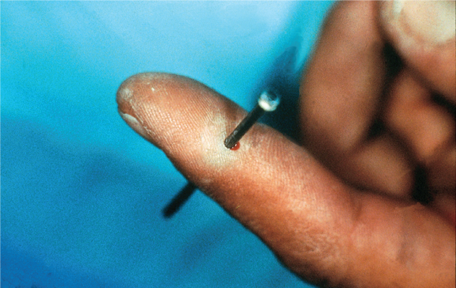
Large Impaled Object: What to Do (1 of 2)
DO NOT remove or move the object.
Stabilize the object with bulky dressings or padding placed around the base of the object to keep it from moving.
If bleeding, apply direct pressure around the base of the object.
FIGURE 4-11 Impaled (embedded) object
© American Academy of Orthopaedic Surgeons.

Slide 62
Large Impaled Object: What to Do (2 of 2)
DO NOT apply pressure on the object or on the skin next to the sharp edges of the object.
If necessary, reduce the length or weight of the object by cutting or breaking it.
Call 9-1-1.

Slide 63
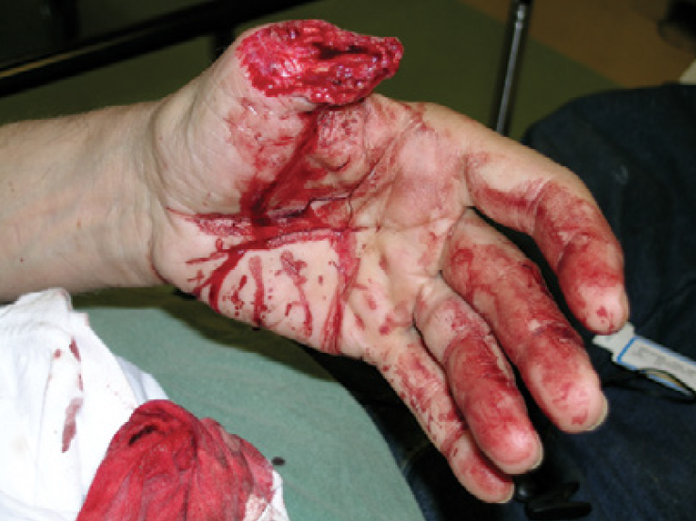
Amputations: What to Do (1 of 2)
Call 9-1-1.
Control the bleeding by using direct pressure.
If unsuccessful, apply a tourniquet or a hemostatic dressing, if available.
FIGURE 4-12 Amputation
© E. M. Singletary, M.D. Used with permission.

Slide 64
Amputations: What to Do (2 of 2)
Care for the amputated part:
  Wrap the severed part in a sterile gauze or a clean cloth that has been wet with water or saline (make sure the excess water has been squeezed out).
  Put the wrapped part in a waterproof container (eg, plastic bag, plastic wrap).
  Keep the part cool by placing the wrapped part in a container of ice. DO NOT bury the part in ice or allow it to touch the ice. DO NOT submerge it in water.
If the amputated part was not found, ask others to search for it and, if located, to take it to the medical facility where the injured person is going.

Slide 65
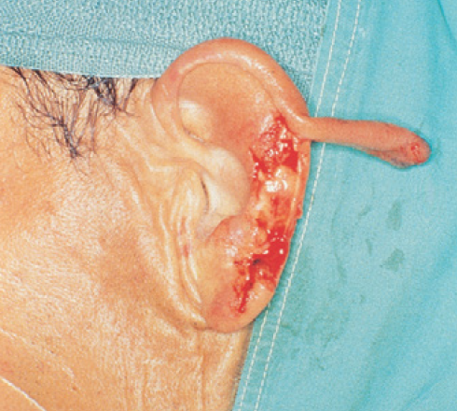
Avulsions: What to Do
Gently move the skin back to its normal position.
Cover with a sterile or clean dressing.
Control bleeding.
FIGURE 4-13 Avulsion
© American Academy of Orthopaedic Surgeons.

Slide 66
Head Injuries
Suspect a spinal cord injury in a person with a head injury.
Head injuries can vary in severity from a small cut or bruise to serious brain injury.
  Includes any damage to the scalp, skull, or brain.

Slide 67
Scalp Wound: What to Do (1 of 2)
Control bleeding by pressing on wound.
  Replace any skin flap to its original position and apply pressure.
  Another option is applying an ice pack or instant cold pack to control bleeding.
Press on the edges of the wound to help control bleeding.
  If you suspect a skull fracture, DO NOT apply excessive pressure.
  This may push bone pieces into the brain.
Apply a dry, sterile or clean dressing.
Keep the head and shoulders raised if no spinal injury is suspected.

Slide 68
Scalp Wound: What to Do (2 of 2)
If bleeding continues, DO NOT remove the first blood-soaked dressing; instead, add another dressing over it.
Call 9-1-1 if:
  The wound is extensive.
  There is significant facial damage.
  Signs of concussion occur (eg, nausea and vomiting, headache, drowsiness).

Slide 69
Skull Fracture: What to Look For
Pain
Skull deformity
Bleeding from an ear or the nose
Leakage of clear, watery fluid from an ear or the nose
Discoloration around the eyes or behind the ears that appears several hours after the injury
Unequal-sized pupils of the eye
Heavy scalp bleeding (skull and/or brain tissue may be exposed)
Penetrating or impaled object

Slide 70
Skull Fracture: What to Do (1 of 2)
Apply a sterile or clean dressing over the wound and hold it in place with gentle pressure.
Control bleeding by pressing on the edges of the wound and gently on the center of it to avoid pressing bone pieces into the brain. A doughnut-shaped pad is useful in applying pressure around the edges of a suspected skull fracture.
Call 9-1-1.

Slide 71
Skull Fracture: What to Do (2 of 2)
Cautions:
  DO NOT move the head, neck, or spine.
  DO NOT clean the wound.
  DO NOT remove an embedded object.
  DO NOT stop blood or clear fluid that is draining from an ear or the nose.
  DO NOT press on the fractured area.

Slide 72
Brain Injury (Concussion): What to Look For
A concussion is considered a mild traumatic brain injury and is caused by a bump, blow, or jolt to the head that can change the way the brain normally works.
Recognition of a concussion is difficult.
Signs of concussion or mild traumatic brain injury, which may worsen over minutes or hours include:
  Thinking/remembering symptoms
  Physical symptoms
  Emotional/mood symptoms
  Sleep disturbance symptoms

Slide 73
Brain Injury (Concussion): What to Do (1 of 3)
If unresponsive, check for breathing.
If breathing is absent, call 9-1-1 and give cardiopulmonary resuscitation (CPR).
If a neck injury is suspected, or if the person is unresponsive:
  DO NOT move the head, neck, or spine.
  Tell the person to remain as still as possible.
  Call 9-1-1.

Slide 74
Brain Injury (Concussion): What to Do (2 of 3)
Seek professional medical care as soon as possible if the person:
  Looks very drowsy or cannot be awakened
  Has one pupil (the black part in the middle of the eye) that is larger than the other
  Has a seizure
  Cannot recognize people or places
  Becomes more and more confused, restless, or agitated
  Exhibits unusual behavior
  Becomes unresponsive
  Has a headache that gets worse and/or does not go away
  Has repeated vomiting or nausea
  Has slurred speech

Slide 75
Brain Injury (Concussion): What to Do (3 of 3)
Following the injury, the person should:
  Get plenty of sleep at night and rest during the day.
  Avoid visual and sensory stimuli (eg, video games and loud music).
  Ease into normal activities slowly, not all at once.
  Avoid strenuous physical activities that increase the heart rate or require a lot of concentration.
  Avoid driving, cycling, operating machinery, or playing sports until assessed by a health care provider.
  Avoid anything that could cause another blow to the head or body.
  Use acetaminophen for postconcussion headaches.
    DO NOT use aspirin or anti-inflammatory medications

Slide 76
Spinal Injuries: What to Look For
Suspect a spinal injury if a person:
  Was in a motor vehicle crash involving ejection, a rollover, high speeds, or pedestrians
  Was involved in other types of motorized vehicle crashes (eg, motorcycle, scooter, all-terrain vehicle, snowmobile)
  Was involved in a bicycle or skateboard crash
  Fell greater than their standing height, especially if older
  Dove into shallow water
  Received a hit or blow to the head

Slide 77
Spinal Injuries: What to Do (1 of 3)
Test for sensation and movement in all four extremities:
  Pinch several fingers/toes while the person has their eyes closed, and ask, “Can you feel this?” and “Which finger/toe am I touching?”
  Ask, “Can you wiggle your fingers/toes?”
  Have the person squeeze your hand/push and pull a foot against your hand.

Slide 78
Spinal Injuries: What to Do (2 of 3)
Call 9-1-1.
Wait for trained rescuers with proper equipment to move the person.
DO NOT attempt to move the person.
Leave the person in the position in which found.
Tell the person to remain as still as possible.
Consider moving a person only for the following:
  To provide CPR
  To open a blocked airway
  To control life-threatening bleeding
  To reach a safe location

Slide 79
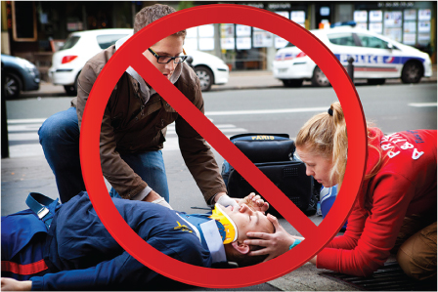
Spinal Injuries: What to Do (3 of 3)
  DO NOT apply a cervical (neck) collar.
  Cover with a blanket or coat to prevent heat loss.
FIGURE 4-14 Do not place a cervical collar on a person with a suspected spinal injury.
© BSIP SA/Alamy Stock Photo

Slide 80
Chest Injuries: What to Do
For all chest injuries, look for and ask about:
  DOTS: Deformity, Open wound, Tenderness, Swelling
  Abnormal breathing rate and/or sounds (eg, gurling)
  Guarding (protecting an area during movement)

Slide 81
Rib Fracture: What to Look For
Sharp pain when the person takes deep breaths, coughs, or moves
Guarding (protecting an area during movement)
Tenderness
Shallow breathing due to pain that occurs from normal or deep breathing
Bruising of skin over the injury (usually occurs along the side of the chest)

Slide 82
Rib Fracture: What to Do
Help the person find a comfortable position.
Stabilize the chest by:
  Having the person hold a pillow or other similarly soft material against the area, or
  Placing arm on the injured side in a sling and binder swathe, if necessary, for pain control.
DO NOT apply tight bandages around the chest.
Give pain medication.
Take the person to a hospital emergency department or call 9-1-1.

Slide 83
Penetrating Object in Chest
What to look for:
  Impaled object (usually easy to see)
What to do:
  Stabilize the object in place with bulky dressings or clothes.
  DO NOT try to remove the object.
  Call 9-1-1.

Slide 84
Open Chest Wound
What to look for:
  Blood bubbling out of a chest wound during exhalation
  Sucking sound heard during inhalations
What to do:
  If bleeding does not occur, leave the wound exposed to air without a dressing or any airtight material.
  If bleeding occurs, apply direct pressure with a dry gauze dressing to control bleeding.
    If the dressing becomes blood-soaked, replace it to avoid trapping air in the chest, which can result in death.
  Call 9-1-1.

Slide 85
Penetrating Object in Abdomen: What to Do
DO NOT remove a penetrating object.
Stabilize the object against movement by placing bulky dressing or packing around it.
Call 9-1-1.

Slide 86
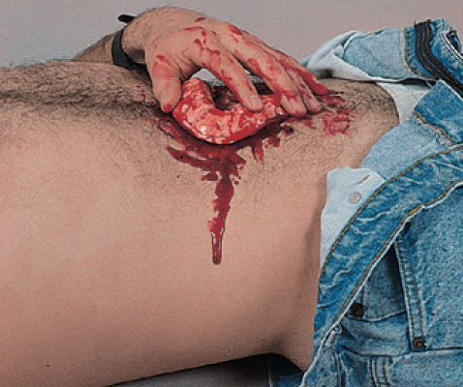
Protruding Organs: What to Do (1 of 2)
Place the person on their back with legs pulled up toward their abdomen.
DO NOT try to push protruding organs back into the abdomen.
DO NOT touch organs.
FIGURE 4-15A Protruding organs.
© Jones & Bartlett Learning. Courtesy of MIEMSS.

Slide 87
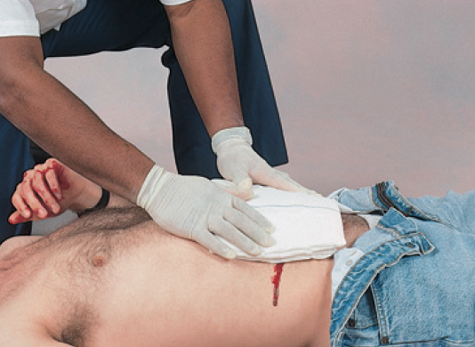
Protruding Organs: What to Do (2 of 2)
Cover with a moist, clean dressing.
Loosely tape the dressing in place.
DO NOT apply any material that clings or disintegrates when wet.
Call 9-1-1.
FIGURE 4-15B Cover protruding organs with a moist, clean dressing.
© Jones & Bartlett Learning. Courtesy of MIEMSS.

Slide 88
Internal Injuries from Hard Blow to Abdomen
What to look for:
  Pain that gradually increases and may become severe
  Pain that markedly increases with slight movements
What to do:
  Place the person onto one side with legs bent and expect vomiting.
  Seek professional medical care if any signs of possible internal injuries occur.

Slide 89
Bone, Joint, and Muscle Injuries
For bone, joint, and muscle injuries, use the RICE procedure:
  R = Rest
  I = Ice
  C = Compression
  E = Elevation

Slide 90
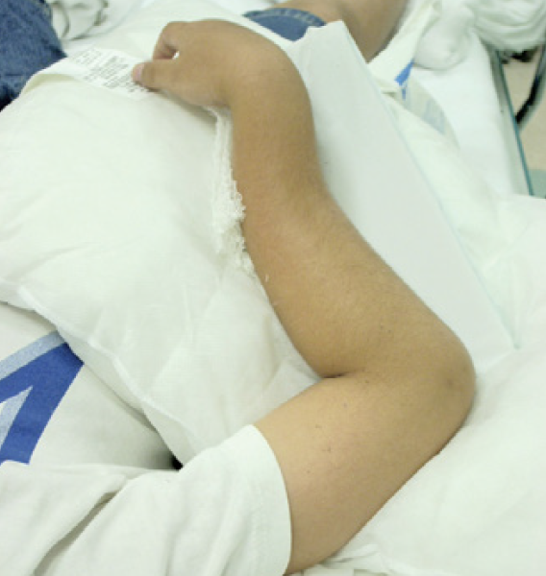
Fractures: What to Look For
Look for and ask about DOTS:
  D = Deformity (Compare the injured part with the uninjured part on the other side)
  O = Open wound
  T = Tenderness and pain
  S = Swelling that happens quickly
FIGURE 4-16A Closed forearm fracture.
© E. M. Singletary, M.D. Used with permission.

Slide 91
Fractures: What to Do (1 of 2)
The part can be held when transporting a short distance to a medical facility or until EMS arrives.
If EMS is delayed or if you are transporting the person a long distance:
  Use the RICE procedure.
  Use a splint to stabilize the part against movement.

Slide 92
Fractures: What to Do (2 of 2)
DO NOT move or try to straighten an injured extremity (an exception may be made in wilderness or remote locations).
Call 9-1-1 for a blue or extremely pale extremity, open wound, or suspected femur (thigh) or pelvic bone fractures.
If bleeding from an open wound is at the injured area:
  Control bleeding by applying pressure on the wound edges.
  Cover the exposed bone with a sterile dressing.
    DO NOT push on the bone.

Slide 93
Splinting (1 of 2)
All broken bones and dislocations should be stabilized before the person is moved.
A broken arm, in addition to being splinted, should be placed in an arm sling and binder.
To apply a splint:
  Cover open wounds with a dry, sterile or clean dressing.
  Ask the person to close their eyes and ask whether they feel you lightly squeezing their toes or fingers and ask the person to wiggle their toes or fingers unless injured.

Slide 94
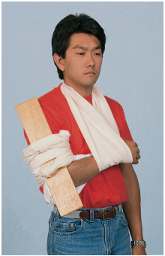
Splinting (2 of 2)
To apply a splint (cont.)
  Apply splints firmly, but not tightly enough to affect blood flow and pad splints with clothing or other material for comfort.
  DO NOT attempt to replace a dislocated joint.
  DO NOT move a person with a suspected spinal injury unless absolutely necessary.
FIGURE 4-17 Rigid splint (wood board) on the upper arm with sling, swathe, and padding between the arm and the chest.
© Jones & Bartlett Learning.

Slide 95
Dislocation: What to Look For
Anterior shoulder
  Inability to touch the opposite shoulder with the hand of the injured arm
  Arm is held away from the body
  Deformity compared to opposite shoulder
  Extreme pain
Patella (kneecap)
  The kneecap has moved to the outside of the knee joint (large bulge seen under the skin)
  Deformity compared with opposite kneecap
Finger
  Deformity compared with the finger on the opposite hand
  Inability to use

Slide 96
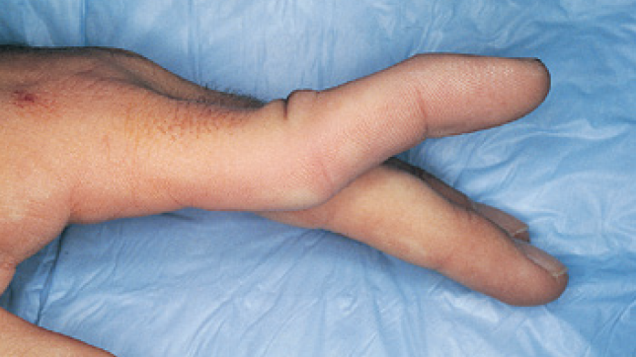
Dislocation: What to Do (1 of 2)
Call 9-1-1 of seek professional medical care.
The part can be held when transporting a short distance to a medical facility or until EMS arrives.
If EMS is delayed or if you are transporting the person a long distance:
  Use the RICE procedure.
  Use a splint to stabilize the part against movement.
FIGURE 4-24 Finger dislocation
© Jones & Bartlett Learning.

Slide 97
Dislocation: What to Do (2 of 2)
DO NOT try to reduce or reset a dislocation.
  You may learn in a wilderness first aid course that the following three dislocations may be reset: anterior shoulder, kneecap, and fingers.
If bleeding from an open wound is at the injured area:
  Control bleeding by applying pressure on the wound edges.
  DO NOT push on the bone.

Slide 98
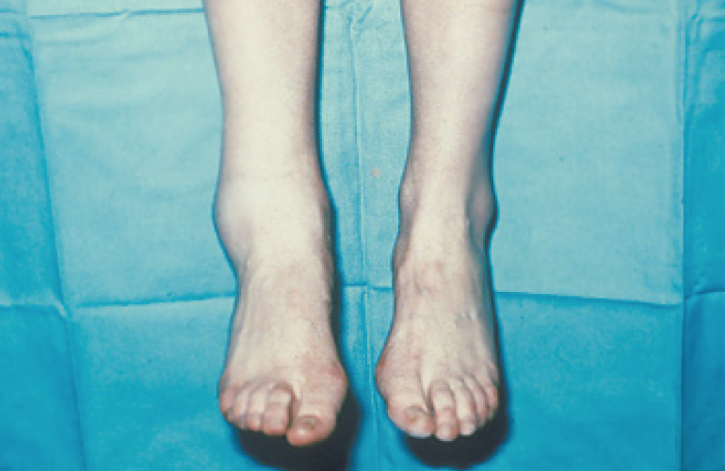
Sprain
What to look for:
  Tenderness
  Pain
  Swelling
What to do:
  Most sprains do not require professional medical care. If recuperation seems long, consult a physician.
  Use the RICE procedure.
FIGURE 4-25 Sprained ankle
© American Academy of Orthopaedic Surgeons.

Slide 99
Muscle Cramp: What to Look For
Sudden muscle pain
A muscle, often the calf muscle, that feels hard because of muscle contraction
Residual discomfort, which may last for a few hours

Slide 100
Muscle Cramp: What to Do
Try one or more of these methods to relax the muscle:
  Gently stretch the affected muscle.
  Press on the muscle.
  Apply a cold pack or an ice pack to the muscle, with a thin cloth between the skin and the cold or ice pack.
  If cramping occurs during exertion in a hot environment, drink lightly salted cool water (one-fourth teaspoon [1.25 mL] salt in 1 quart [about 1 L] of water) or a commercial sports drink.
DO NOT give salt tablets.

Slide 101
Muscle Bruise
What to look for:
  Blow to a muscle
  Swelling
  Tenderness and pain
  Black and blue mark appearing hours later
What to do:
  Use the RICE procedure.

Slide 102
Muscle Strain
What to look for:
  Occurs during physical activity
  Sharp pain
  Extreme tenderness
  Inability to use injured part
What to do:
  Use the RICE procedure.

Slide 103
Thermal Burns: What to Do (1 of 3)
Stop the burning!
  If clothing is on fire, have the person roll on the ground using the “stop, drop, and roll” method.
  Smother the flames with a blanket or douse the person with water.
  Remove clothing and all jewelry, especially rings, from the burn area.
Check and monitor breathing if the person inhaled heated air or was in an explosion.
Determining the depth of the burn will help determine what first aid to give.

Slide 104
Thermal Burns: What to Do (2 of 3)
Determine the size of the burn by using the Rule of the Hand.
  The person’s hand (including the palm, closed fingers, and thumb) equals about 1% of their total body surface area (TBSA).
Determine which parts of the body are burned.
Burns on the face, hands, feet, and genitals are more severe than burns on other body parts.

Slide 105
Thermal Burns: What to Do (3 of 3)
Seek professional medical care or call 9-1-1 for the following:
  Burns on the face, neck, hands, feet, or genitals
  Breathing difficulty
  Blistering or broken skin
  Large area burned (eg, back, trunk)
  All third- and large second-degree burns
  Other concerns (eg, coughing, wheezing, hoarse voice, or carbon monoxide exposure)

Slide 106
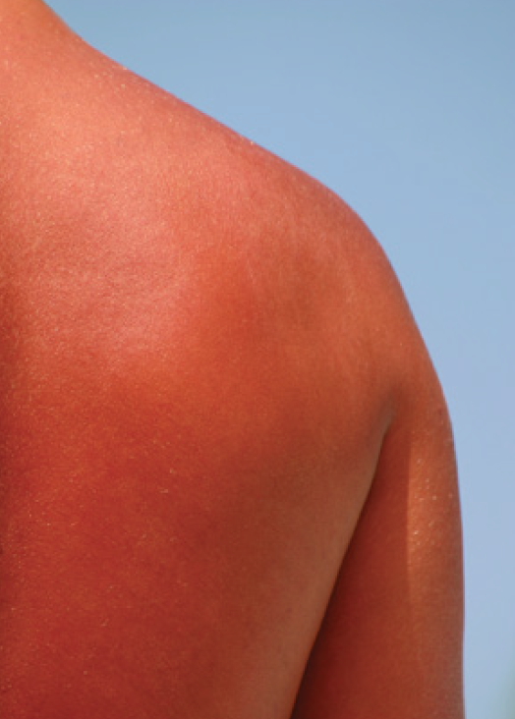
First-Degree Burns: What to Look For
Redness
Mild swelling
Tenderness
Pain
FIGURE 4-26 First-degree burn.
© Suzanne Tucker/ShutterStock.

Slide 107
First-Degree Burns: What to Do (1 of 2)
Immerse the burned area in cool or cold water, place it under running cold water, or apply a wet, cool, or cold compress for at least 10 minutes as soon as possible.
If cold water is unavailable, use any other available cold liquid.
DO NOT apply ice, ice water, or salt water.
Give ibuprofen (for children and teenagers, give acetaminophen).

Slide 108
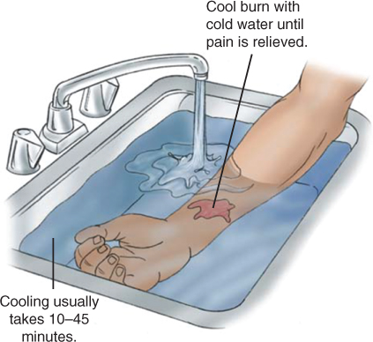
First-Degree Burns: What to Do (2 of 2)
Have the person drink as much water as possible without becoming nauseated.
Keep the burned arm or leg raised and remove any jewelry.
After burn has been cooled, apply aloe vera gel or an inexpensive skin moisturizer.
First-degree burns do not need to be covered.
FIGURE 4-27 Run the burned area under water to cool the burn.
© Jones & Bartlett Learning.

Slide 109
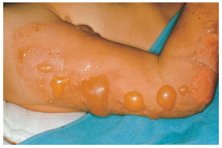
Second-Degree Burns: What to Look For
Blisters
Swelling
Weeping of fluids
Severe pain
FIGURE 4-28 Second-degree burn.
© American Academy of Orthopaedic Surgeons.

Slide 110
Second-Degree Burns: What to Do (1 of 2)
Small second-degree burns:
  Follow Steps 1 through 4 for first-degree burns, with the following additions:
    After burn has been cooled, apply a thin layer of antibacterial ointment.
    Cover the burn with a loose, dry, nonstick, sterile or clean dressing.
    DO NOT break any blisters.

Slide 111
Second-Degree Burns: What to Do (2 of 2)
Large second-degree burns
  Follow Steps 1 through 4 for first-degree burns, with the following additions:
    Apply cold, but monitor, as it may cause hypothermia.
    DO NOT break any blisters.
    Call 9-1-1.

Slide 112
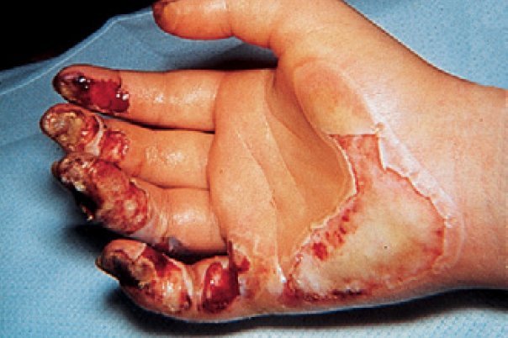
Third-Degree Burns: What to Look For
Dry, leathery, gray-colored, or charred skin
FIGURE 4-29 Third-degree burn
© American Academy of Orthopaedic Surgeons.

Slide 113
Third-Degree Burns: What to Do
Cover the burn with a dry, nonstick, sterile or clean dressing.
DO NOT apply cold.
DO NOT apply gel or ointment to the burn.
Call 9-1-1.

Slide 114
Electrical Burns When Still in Contact With Electricity: What to Do
Call 9-1-1 to have the electricity turned off or wires cut.
DO NOT touch or move power lines or the person.
DO NOT try to move electrical wires or devices with a wooden pole, rope, or any other item.
Keep people away from the area.

Slide 115
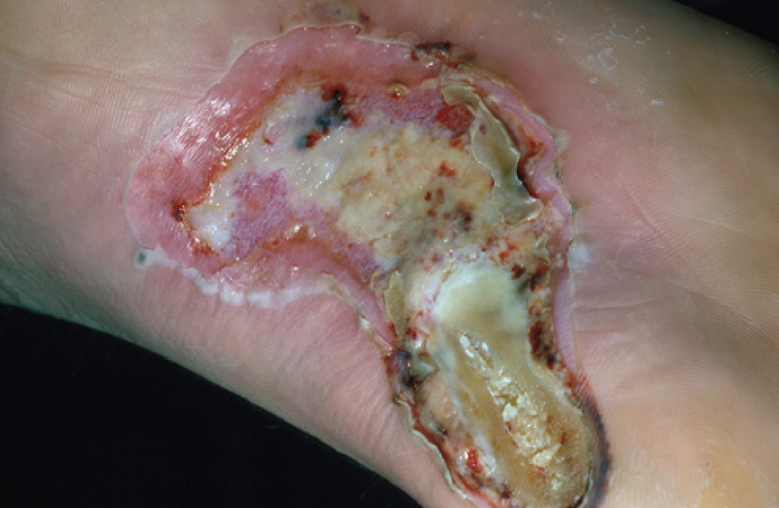
Electrical Burns: What to Look For
Burn wound, which might appear small
Entrance and exit wounds
Multiple burns
  Most electrical burns are third-degree burns
Absent breathing/pulse
  Electricity can cause a person’s breathing or heart to stop
FIGURE 4-30 Electrical burn
© Charles Stewart MD, EMDM, MPH

Slide 116
Electrical Burns: What to Do
Once the area is safe:
  Check breathing of any motionless and unresponsive person, and if absent, begin CPR.
  Call 9-1-1 immediately. Every person who has been electrocuted needs professional medical care.
  If the person fell, check for broken bones and a spinal injury.
  Most electrical burns are third-degree burns, so cover all burn wounds with sterile dressings. Treat as you would a third-degree burn.

Slide 117
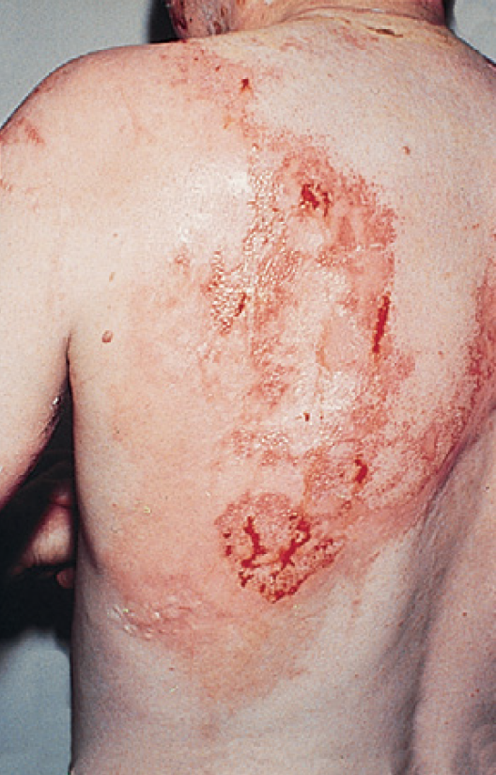
Chemical Burns: What to Look For
Pain
Burning
Breathing difficulty
Eye pain or vision changes
© American Academy of Orthopaedic Surgeons.
FIGURE 4-31 Chemical burn
© American Academy of Orthopaedic Surgeons.

Slide 118
Chemical Burns: What to Do
Once the area is safe:
  Brush a dry or powder chemical off the skin with a gloved hand or piece of cloth before flushing with water.
  Flush the burn with large amounts of cool running water for at least 20 minutes or until EMS arrives.
  Call 9-1-1 immediately for all chemical burns.
  DO NOT try to neutralize the chemical.
  For a chemical in an eye:
    Tip the head so the affected eye is below the nose
    Wash the eye with warm water (which is tolerated in the eye better than cold water) from the nose out to the side of the face for at least 20 minutes.

Slide 119
Shock
Shock happens when body tissues do not get enough oxygen-rich blood.
Do not confuse shock with an electrical shock or “being shocked,” as in scared or surprised.
Shock is life-threatening.

Slide 120
Shock: What to Look For
Massive external or internal bleeding
A severe infection
Multiple severe broken bones
Signs of a heart attack
Abdominal or chest injury
Severe allergic reaction

Slide 121
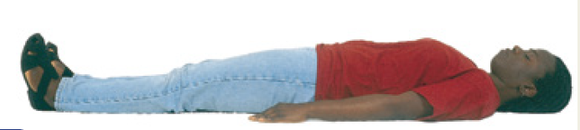
Shock: What to Do (1 of 2)
For a person in shock who is responsive and breathing normally:
  Keep the person flat (horizontal) on their back.
  If there is no sign of a leg injury and it does not cause pain then feet can be raised 6 to 12 inches (15 to 30 cm).
  DO NOT give anything to eat or drink unless medical help is delayed over 1 hour, in which case, sips of water can be given if fluids do not cause nausea and/or vomiting.
FIGURE 4-33A Shock positions. If responsive and breathing normally, keep the person flat on their back.
© Jones & Bartlett Learning.

Slide 122
Shock: What to Do (2 of 2)
For a person in shock who is unresponsive and breathing:
  Place the person on their side (recovery position).
  DO NOT move them if there is a neck, back, hip, or pelvic injury; leave in the position found unless it is unsafe.
  Call 9-1-1.
  Prevent heat loss by putting blankets or coats under and over the person.

