Slide 1
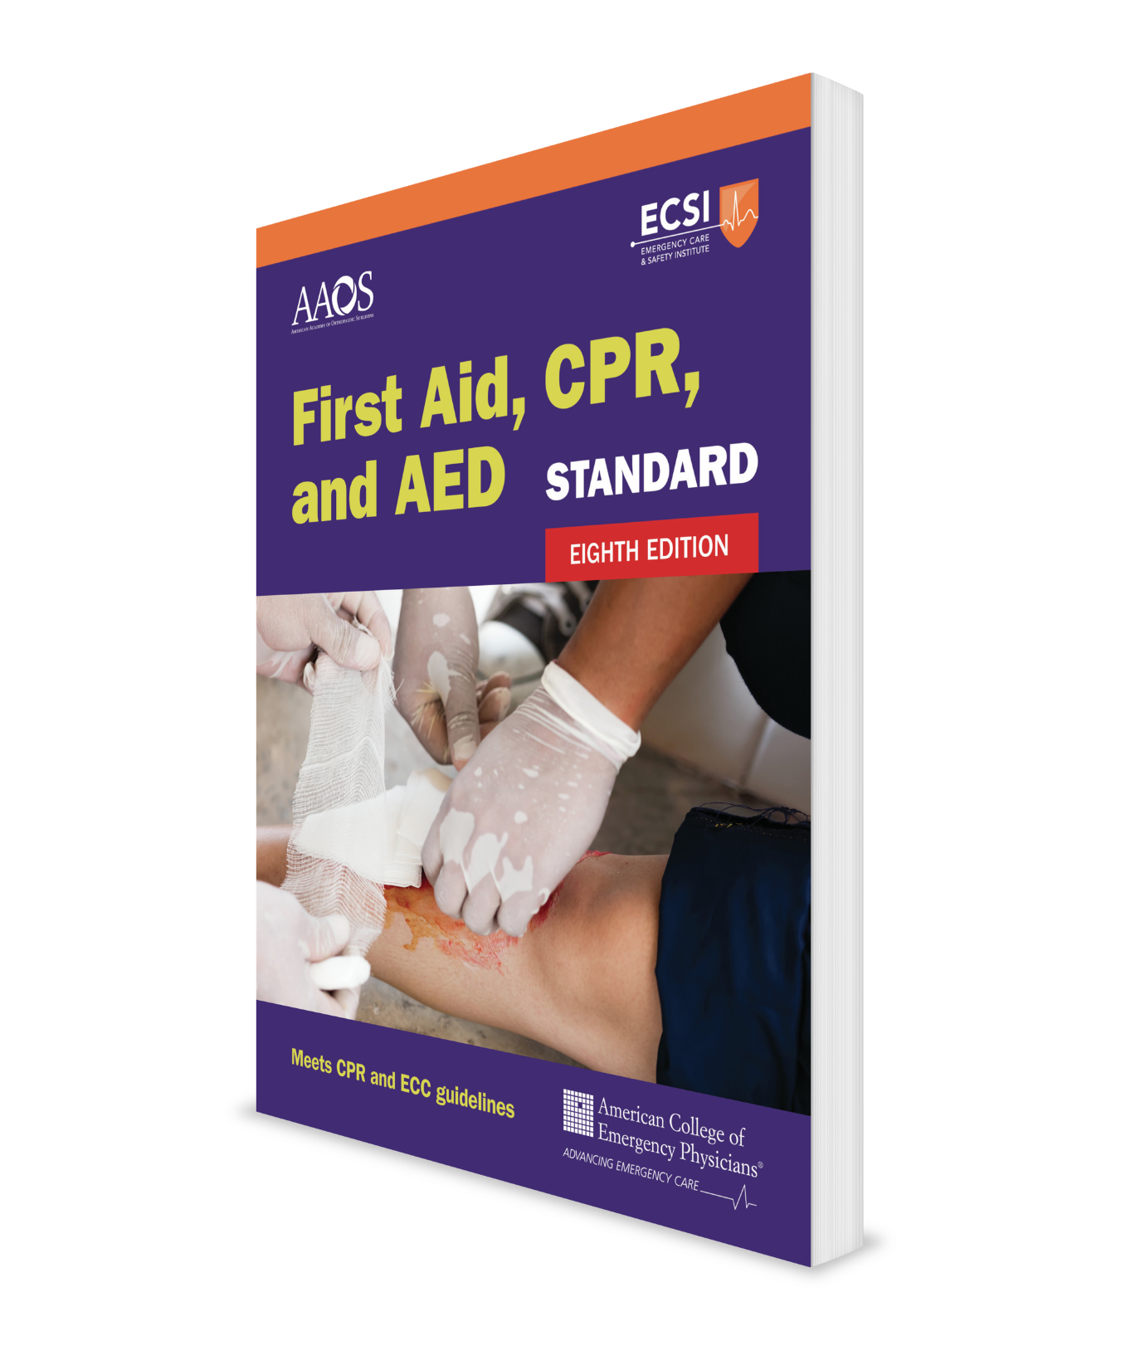
Environmental Emergencies Core Course + Infants
CHAPTER 6
Notes:
Standard First Aid, CPR, and AED, Eighth Edition

Slide 2
Support Materials
Lecture Outline
Worksheet
Videos
CHAPTER 6 Opener photo.
© MaryAnne Nelson/Moment/Getty Images.

Slide 3
Heatstroke (1 of 3)
Heatstroke is life-threatening.
Untreated heatstroke results in death.
There are two types of heatstroke:
Classic heatstroke
Exertional heatstroke

Slide 4
Heatstroke (2 of 3)
Classic heat stroke
Occurs in:
Older people
People who are chronically ill or sedentary
People who take certain prescription medications
People who are abusing drugs or alcohol
Common during heat waves
Affected people do not sweat
Exertional heatstroke
Affects young, healthy people who are not acclimatized to the heat.
Usually occurs during strenuous activity.
Sweating is prevalent in about 50% of affected people

Slide 5
Heatstroke (3 of 3)
People often confuse the difference between heatstroke and heat exhaustion.
The chief difference is those with heatstroke have an altered mental status, skin that is hot to the touch, and a body temperature of 140°F or higher.
Heatstroke is life-threatening and must be treated immediately

Slide 6
Heatstroke: What to Look For
Extremely hot skin
Skin is usually dry, but may be wet from sweating related to strenuous work or exercise.

Slide 7
Heatstroke: What to Do (1 of 4)
Move the person from the hot environment to a cooler, shaded area.
Call 9-1-1 immediately.
A person who cannot be taken to a medical facility quickly should be cooled by any means possible.

Slide 8
Heatstroke: What to Do (2 of 4)
The order of effective cooling is:
Whole body cold-water immersion. First, remove clothing down to the person’s underwear and then:
Submerge the person’s body and extremities up to the neck in a bath of cold water or tub of ice water. The colder the water, the faster the rate of cooling.
OR
Have the person sit or lay down on a plastic sheet or tarp. Hold the sides up and apply water and crushed ice. Keep the sides upright to keep the mixture in place and move the tarp to keep the water moving around the person.
OR

Slide 9
Heatstroke: What to Do (3 of 4)
Use a natural body of water (eg, stream, pond, river, or lake) to submerge a person and help cool them off. DO NOT leave someone suffering from heatstroke in a body of water alone because it is dangerous.
Spraying or dousing cold water repeatedly on the person’s skin and vigorously fanning. The method is half as fast as immersion cooling.
Ice packs. Ice packs should cover the entire body. If chemical cold packs are used, they should be applied to the cheeks, palms, and soles rather than the skin covering the neck, armpits, and groin. Ice packs have greater cooling capacity than chemical cold packs.

Slide 10
Heatstroke: What to Do (4 of 4)
Stop cooling when mental status improves, after 20 minutes, or when emergency medical services (EMS) arrives.
DO NOT give ibuprofen or aspirin. While helpful in cases of high body temperatures caused by infectious diseases, they are not effective in heat-related illnesses.

Slide 11
Heat Exhaustion
Heat exhaustion differs from heatstroke because the person has no altered mental status and their skin is clammy, not hot.
Like heatstroke, you should still cool the person, just not as aggressively as for heatstroke.
Uncontrolled heat exhaustion can evolve into heatstroke.

Slide 12
Heat Exhaustion: What to Look For
Pale or ashen skin
Clammy or sweaty skin, but not hot
Severe thirst
Fatigue
Dizzy
Flulike symptoms (headache, body aches, nausea, and sometimes vomiting)
Shortness of breath
Rapid heart rate

Slide 13
Heat Exhaustion: What to Do (1 of 2)
Move the person from the hot environment to a cooler, shaded place.
Remove excess clothing.
Spray or douse cold water on the person’s skin and fan vigorously.

Slide 14
Heat Exhaustion: What to Do (2 of 2)
If the person is able to swallow, give a commercial sports drink, fruit juice, or lightly salted water; if none of these options are available, give cold water. DO NOT give salt tablets.
Call 9-1-1 if improvement does not occur within 30 minutes.

Slide 15
Heat Cramps
What to look for:
Painful cramps in abdominal muscles or extremities
Heavy sweating
What to do:
Have the person rest in a cool place.
What to do (cont.)
Give lightly salted cool water
Dissolve a quarter teaspoon salt in 1 quart of water or a commercial sports drink.
DO NOT give salt tablets.
Lightly stretch and massage the cramped muscles.
Apply an ice pack to the cramped muscles.

Slide 16
Heat Syncope
What to look for:
Dizziness
Fainting
What to do:
If the person is unresponsive, check their breathing. A person with heat syncope will usually recover quickly.
If the person fell, check for injuries.
What to do (cont.)
Have the person rest and lie down in a cool area.
Wet the skin with a cool, damp cloth or by splashing water on the face.
If the person is not nauseated and is alert and able to swallow, give lightly salted cool water
DO NOT give salt tablets.

Slide 17
Heat Edema
What to look for:
Swollen ankles and feet that occur during the first few days in a hot environment
What to do:
Have the person wear support stockings.
Elevate the person’s legs.

Slide 18
Heat Rash
What to look for:
Itchy rash on skin that is wet from sweating
What to do:
Dry and cool the person’s skin.
Limit heat exposure.

Slide 19
Hyponatremia: What to Look For
The person drank too much water (>1 quart [about 1 L] per hour)
Vomiting clear fluid
Profuse sweating for long periods
Frequent urination (clear urine)
Dizziness, weakness, nausea, headache
Altered mental status
Severe sodium loss may result in seizures or unresponsiveness and can be fatal

Slide 20
Hyponatremia: What to Do
Move the person to a cool location.
For a person with altered mental status, call 9-1-1 and seek immediate professional medical care.
DO NOT give more fluids.
Give salty foods. DO NOT give salt tablets because they can irritate the stomach and cause nausea and vomiting.

Slide 21
Poisoning
Most poisons have little toxic effect or are ingested in such small amounts that severe poisoning rarely occurs.
Still, the potential for severe or fatal poisoning is always present.

Slide 22
Swallowed Poisoning: What to Look For
Abdominal pain and cramping
Nausea or vomiting
Diarrhea
Burns, odor, or stains around and inside the mouth
Drowsiness or unconsciousness
Poison container nearby

Slide 23
Swallowed Poisoning: What to Do (1 of 3)
Try to determine:
Person’s age and weight
Person’s condition
What poison was swallowed
When the poison was taken
How much was taken
For an alert and awake person, call the Poison Control hotline at 1-800-222-1222, even if signs of poisoning are not present.

Slide 24
Swallowed Poisoning: What to Do (2 of 3)
Place the person lying down on their left side to delay the poison from moving into the intestines and to prevent inhalation of vomit, if vomiting occurs.
Monitor breathing, and if absent, begin CPR.

Slide 25
Swallowed Poisoning: What to Do (3 of 3)
Cautions:
DO NOT give anything to eat or drink unless advised to do so by Poison Control or a professional health care provider.
DO NOT try to cause vomiting by giving syrup of ipecac or by gagging or tickling the back of the person’s throat.
DO NOT give activated charcoal unless advised to do so by Poison Control or a professional health care provider.
DO NOT give water or milk to dilute poisons other than caustic or corrosive substances (acids and alkalis) unless instructed by staff at Poison Control.

Slide 26
Inhaled Poisoning: What to Look For
Headache
Ringing in the ears (tinnitus)
Chest pain (angina)
Muscle weakness
Nausea and vomiting
Dizziness and visual changes (blurred or double vision)
Unresponsiveness
Respiratory and cardiac arrest
Indications of possible carbon monoxide poisoning:
Symptoms that come and go
Symptoms that worsen or improve in certain places or at certain times of day
Similar symptoms in people around the person who is ill
Pets that seem ill

Slide 27
Inhaled Poisoning: What to Do
Call 9-1-1 as soon as possible.
Try to determine:
What substance was inhaled?
When the exposure occurred?
How long the substance was inhaled for?
The person’s condition
Place the person in a sitting or reclining position, or in whatever position best facilitates breathing and is comfortable. Support the back for easier breathing.
Monitor breathing, and if it stops, give CPR.

Slide 28
Drug Emergencies (1 of 2)
Opioids are a classification of drugs that relieve pain.
They also trigger the release of endorphins, natural chemicals that boost happiness, and are highly addictive.
Like all medications, people can have adverse reactions to opioids.
Because opioids slow or even stop breathing, drug overdoses can be fatal.
Most opioids are narcotic pain relievers, such as morphine, heroin, methadone, fentanyl, and oxycodone.

Slide 29
Drug Emergencies (2 of 2)
A drug overdose can happen when a person:
Misunderstands the directions for use, unintentionally takes an extra dose, or deliberately misuses a prescription opioid or an illicit drug (eg, heroin)
Takes an opioid medication prescribed for someone else
Mixes opioids with other medications, alcohol, or over-the-counter (OTC) drugs

Slide 30
Opioid Overdose: What to Look For
Extreme sleepiness or drowsiness
Unresponsive
Breathing problems: ranging from slow and shallow breathing to no breathing
Lips and nails turning blue
Skin feels cold and clammy
Extremely small pupils (the black circle in the center of the colored part of the eye)

Slide 31
Opioid Overdose: What to Do (1 of 6)
When an unresponsive person is known or suspected to have taken an opioid drug, check for breathing.
If the person is not breathing or is only gasping and there is someone to help, have the other person call 9-1-1 and get an AED and naloxone, while you begin CPR.
If the person is not breathing and only gasping for air and you are alone, complete five cycles of CPR before leaving to call 9-1-1 and getting an AED and naloxone.

Slide 32
Opioid Overdose: What to Do (2 of 6)
Give naloxone if available.
Naloxone is a safe medicine that rapidly reverses a drug overdose. It is easy to use. It only reverses the effects of opioids. It has no effect on other drugs (eg, alcohol, stimulants).
DO NOT delay giving CPR or compression-only CPR to an unresponsive person who is not breathing, while waiting for naloxone to work.
Naloxone is available in different forms:
Prefilled, single-dose nasal spray
Prefilled, single-dose auto-injector

Slide 33
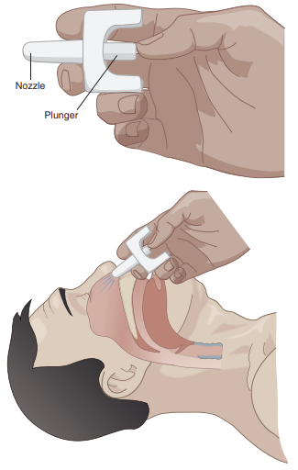
Opioid Overdose: What to Do (3 of 6)
To administer a prefilled, single-dose naloxone nasal spray (Narcan):
Place the person flat on their back, with the head tilted back.
Administer the spray into one nostril.
If there is no recovery within 2–3 minutes and another nasal spray device is available, repeat the dose in the other nostril.
FIGURE 6-5 Nasal spray naloxone administration
© Jones & Bartlett Learning.

Slide 34
Opioid Overdose: What to Do (4 of 6)
To administer prefilled, single-dose naloxone auto-injector (Evzio):
Pull the device out of the case.
Once activated, the device provides voice directions (similar to automated defibrillators).
Inject into the person’s outer thigh (similar to an epinephrine auto-injector).
It can be given through clothing (eg, pants, jeans) if necessary.
If the electronic voice directions do not work, the device can still deliver the naloxone dose.
If there is no recovery within 2–3 minutes and there is another auto-injector available, repeat the dose.

Slide 35
Opioid Overdose: What to Do (5 of 6)
If naloxone has been given and the person becomes responsive and breathing, monitor breathing and if breathing stops, begin CPR. Be sure to stay with the person until EMS arrives. The person should receive medical care, even if they have recovered.
If naloxone is not available, stay with the person until EMS arrives. Place the person on their side (recovery position) to keep the airway open. Monitor breathing and if breathing stops, begin CPR.
If possible to do quickly and safely, try to identify the drug. Look for medicine bottles or ask bystanders.

Slide 36
Opioid Overdose: What to Do (6 of 6)
Important:
The effects of the opioid often outlast the effect of naloxone and a second dose may be required.
Some opioids are strong and might require multiple doses of naloxone.
Anyone who is taking opioids or is at risk of an overdose should carry naloxone in case of emergencies.
All 50 states allow the purchasing of naloxone with a physician’s prescription.
Most states allow behind-the-counter (without a prescription) purchasing of naloxone.

