Slide 1
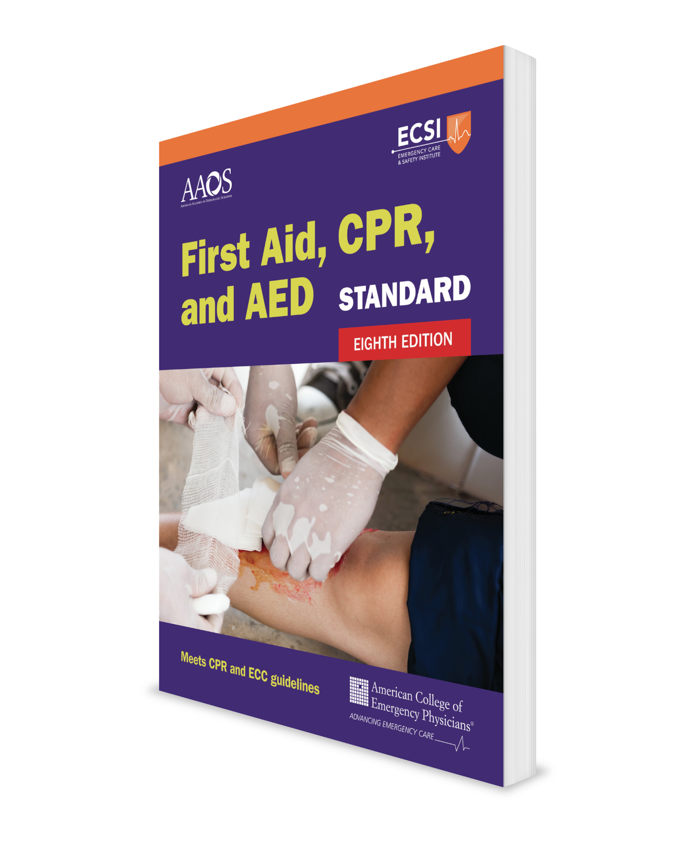
Sudden Illnesses Core Course + Infants
CHAPTER 5
Notes:
Standard First Aid, CPR, and AED, Eighth Edition

Slide 2
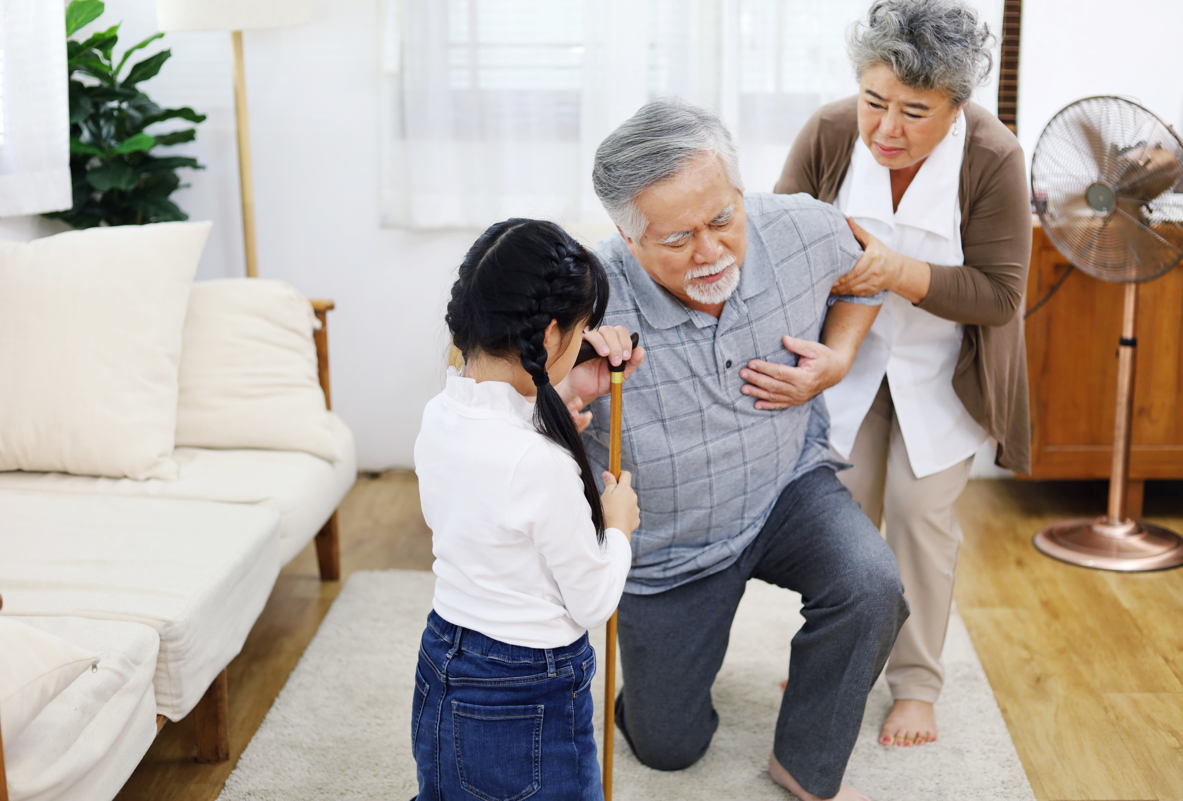
Support Materials
Lecture Outline
Worksheet
Videos
Skill Sheets
Skill Checkoff Sheets
CHAPTER 5 Opener photo.
© PLotulitStocker/Shutterstock.

Slide 3
Asthma
People with asthma have highly sensitive airways that become inflamed easily.
Asthma episodes, or attacks, occur when something bothers their airways.
The same substances (called allergens) that cause allergy symptoms can trigger an asthma attack.
Two types of asthma medicines
Quick-relief
Long-term

Slide 4
Asthma: What to Look For
Frequent coughing
Wheezing
Breathing difficulty
Unable to speak in complete sentences without stopping to breathe
Sitting in the tripod position (leaning forward with hands on knees or other support, trying to breathe)

Slide 5
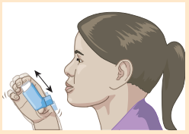
Asthma: What to Do (1 of 9)
Help a person experiencing an asthma attack use their physician-prescribed inhaler without a spacer.
Take the cap off the inhaler and make sure the mouthpiece and spray hole are clean.
Shake the inhaler 10–15 times.
SKILL SHEET 5-1 Using an Inhaler Without a Spacer. Step 2.
© Jones & Bartlett Learning.

Slide 6
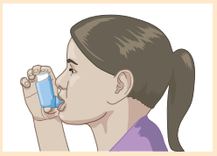
Asthma: What to Do (2 of 9)
Without the inhaler, ask the person to take a deep breath in and then breathe out all the way.
Have the person hold the inhaler upright and between their index finger and thumb.
Have the person put the mouthpiece of the inhaler in their mouth, above their tongue and between their teeth, and then close their lips around it.
SKILL SHEET 5-1 Using an Inhaler Without a Spacer. Step 5.
© Jones & Bartlett Learning.

Slide 7
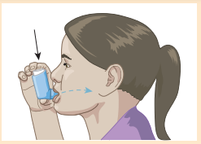
Asthma: What to Do (3 of 9)
Have the person start breathing in slowly, then press down on the inhaler once while breathing in all the air they can.
Then tell them to hold their breath for 5–10 seconds with their mouth closed.
SKILL SHEET 5-1 Using an Inhaler Without a Spacer. Step 5.
© Jones & Bartlett Learning.

Slide 8
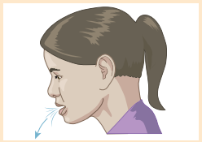
Asthma: What to Do (4 of 9)
When the 5–10 seconds are up, tell the person to open their mouth and breath out slowly.
If the person needs another dose of medicine, wait 1 minute before repeating these steps.
SKILL SHEET 5-1 Using an Inhaler Without a Spacer. Step 6.
© Jones & Bartlett Learning.

Slide 9
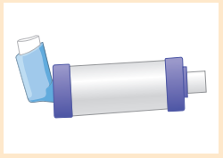
Asthma: What to Do (5 of 9)
Help a person experiencing an asthma attack use their physician-prescribed inhaler with a spacer.
Take the cap off the inhaler and make sure the mouthpiece and spray hole are clean.
Shake the inhaler 10–15 times.
Insert the inhaler mouthpiece into the end of the spacer.
SKILL SHEET 5-2 Using an Inhaler With a Spacer. Step 3.
© Jones & Bartlett Learning.

Slide 10
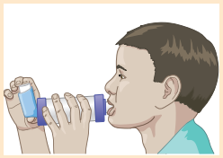
Asthma: What to Do (6 of 9)
Have the person hold the inhaler and spacer between their index finger and thumb.
Then, without the inhaler, ask the person to take a deep breath in and then breathe out all the way.
Have the person put the mouthpiece of the spacer in their mouth, above their tongue, and then close their lips around the spacer.
SKILL SHEET 5-2 Using an Inhaler With a Spacer. Step 5.
© Jones & Bartlett Learning.

Slide 11
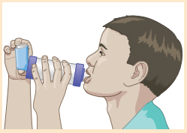
Asthma: What to Do (7 of 9)
Have the person tip their head back slightly toward the ceiling and press the top of the inhaler to spray one dose of medicine.
Tell the person to slowly breathe in all the air they can and hold for 5–10 seconds with their mouth closed.
SKILL SHEET 5-2 Using an Inhaler With a Spacer. Step 6.
© Jones & Bartlett Learning.

Slide 12
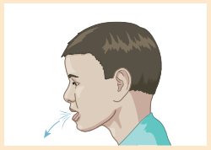
Asthma: What to Do (8 of 9)
When the 5–10 seconds is up, tell the person to open their mouth, move the inhaler away from their mouth, and breathe out slowly.
If the person needs another dose of medicine, wait 1 minute before repeating these steps.
SKILL SHEET 5-2 Using an Inhaler With a Spacer. Step 7.
© Jones & Bartlett Learning.

Slide 13
Asthma: What to Do (9 of 9)
Call 9-1-1 immediately if:
The person is struggling to breathe, talk, or stay awake.
They are unable to speak more than one to two words in one breath.
Their lips or fingernails turn blue.
The person asks for professional medical care.
There is no improvement after using their quick-relief inhaler or they do not have a rescue inhaler.
Repeated attacks occur.
A severe and prolonged attack occurs.

Slide 14
Anaphylaxis
When the body overreacts to allergy triggers and releases chemicals to protect itself, a severe allergic reaction occurs called anaphylaxis.
Epinephrine is a medication that can stop a severe allergic reaction.
It is available through a physician’s prescription and can be self-administered via an epinephrine auto-injector.
Most allergic reactions do not require epinephrine, but a small portion of reactions can progress to life-threatening anaphylaxis.

Slide 15
Anaphylaxis: What to Look For
Mouth: swelling of the lips, tongue, mouth, nose
Throat: swelling, itching, difficulty swallowing and speaking
Skin: swelling around the eyes, flushing, severe itching
Breathing: trouble breathing, coughing, or wheezing
Abdomen: cramps, nausea, vomiting
Unresponsiveness
Medical identification tag

Slide 16
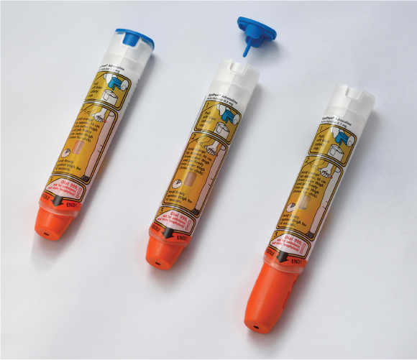
Anaphylaxis: What to Do (1 of 4)
Call 9-1-1 immediately.
The effects of epinephrine from an auto-injector will wear off.
Ask about any previous severe allergic reactions.
Look for or ask about a medical identification tag.
FIGURE 5-2 Left, EpiPen auto-injector intact before use. Center, blue safety cap removed. Right, after injection, the orange cover automatically extends to ensure the needle is never exposed. Several other brands of epinephrine auto-injectors are also available.
© Jones & Bartlett Learning.

Slide 17
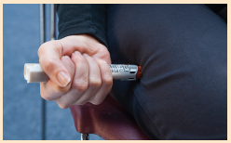
Anaphylaxis: What to Do (2 of 4)
If the person has their own medically prescribed epinephrine auto-injector, they will usually know when and how to use it.
If the person asks for help and your state law allows giving an injection, use their prescribed auto-injector.
Stay with the person until EMS arrives.
SKILL SHEET 5-3 Using Epinephrine Auto-Injector. Step 3.
© Jones & Bartlett Learning.

Slide 18
Anaphylaxis: What to Do (3 of 4)
DO NOT inject another dose of epinephrine immediately after the first one. Wait 5 to 10 minutes.
If the person does not get better 5 to 10 minutes after the first dose or the EMS arrival will exceed 5 to 10 minutes, consider giving a second dose if you have a second injector.
About 20% of people receiving a first dose will require a second dose.
When in doubt, administer a second dose.
If there are no signs of breathing, call 9-1-1 if not already done and begin cardiopulmonary resuscitation (CPR).

Slide 19
Anaphylaxis: What to Do (4 of 4)
If there is not an epinephrine auto-injector available:
Use an asthma inhaler or nasal decongestant spray
If the person can swallow, give an antihistamine (eg, Benadryl) as directed on the label.
These are not lifesaving because they take too long to work, but they can help prevent further reactions.
Monitor until professional medical care arrives.

Slide 20
Mild Allergic Reaction
What to look for:
Red, itchy eyes
Itchy, sneezing, stuffy or runny nose
Rash on skin, itching, usually on one part of body
What to do:
Self-administer their asthma rescue inhaler
and/or
Give an antihistamine

Slide 21
Heart Attack
A heart attack happens when the blood supply to the heart muscle is suddenly reduced or blocked.
If the blocked artery is not reopened quickly, the part of the affected heart begins to die.
The longer a person goes without treatment, the greater the damage to the heart muscle.

Slide 22
Heart Attack: What to Look For (1 of 2)
Though sometimes difficult to determine, symptoms of a heart attack can include:
Chest discomfort that feels like pressure, squeezing, or fullness, usually in the center
Sweating
Lightheadedness or dizziness
Nausea or vomiting
Numbness, aching, or tingling in an arm (most often the left arm)
Shortness of breath
Weakness or fatigue, especially in older adults

Slide 23
Heart Attack: What to Look For (2 of 2)
Women and older adults are more likely than men to have milder symptoms of a heart attack that can extend over many hours, days, or weeks leading up to the heart attack:
Shortness of breath
Nausea or vomiting
An ache in the chest
Sore jaw
Strange feeling in arm
Upper back pain
Flu-like symptoms
Dizziness

Slide 24
Heart Attack: What to Do (1 of 2)
Have the person sit, with knees raised, and lean against a stable but comfortable support (eg, wall, tree trunk, fence post).
DO NOT allow the person to walk. Doing so can put more stress on the heart.
Try to keep the person calm.
Call 9-1-1 immediately. DO NOT drive the person to a medical facility; wait for EMS to arrive.

Slide 25
Heart Attack: What to Do (2 of 2)
While waiting for EMS to arrive:
Loosen any tight clothing.
Ask if the person takes any chest pain medication (eg, nitroglycerin) for a known heart condition, and if so, help them take it.
If the person is alert, able to swallow, not allergic to aspirin, and has no signs of a stroke, help the person take one adult aspirin (325 mg) or two to four low-dose aspirins (81 mg each).
Pulverize or have the person chew them with their teeth before swallowing for faster results.
Monitor breathing. If the person becomes unresponsive and stops breathing, begin CPR. If they are unresponsive and are breathing, place them on their side (recovery position).

Slide 26
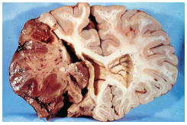
Stroke
A stroke happens when a blood vessel in the brain bursts or is clogged.
Without oxygen, brain cells in the affected area begin dying within minutes.
Because brain cells are not replaced, the devastating effects of a stroke can be permanent.
Strokes are a leading cause of death.
FIGURE 5-4 Rupture of a blood vessel in the brain.
© American Academy of Orthopaedic Surgeons.

Slide 27
Stroke: What to Look For
Use the acronym FAST as an assessment tool:
F = Face droops. Ask the person to smile.
It is abnormal for one side of the face not to move well compared with the other side.
A = Arm weakness. Ask the person to close their eyes and raise both arms with the palms up for a count of 10 seconds.
It is abnormal if one arm drifts downward when held extended.
S = Speech difficulty. Ask the person to repeat a simple phrase.
It is abnormal if the person slurs words, uses the wrong words, or cannot speak at all.
T = Time to call 9-1-1 if any of the preceding signs occur.
The presence of one or more of these signs is associated with a high risk of stroke

Slide 28
Stroke: What to Do (1 of 2)
Call 9-1-1 immediately.
Monitor responsiveness and breathing:
If the person is unresponsive and not breathing, begin CPR.
If they are unresponsive and breathing or have fluid or vomit in their mouth, place them on their side (recovery position).
This will allow any fluids to drain out of their mouth.
If they are alert, allow them to find a comfortable position with the head and shoulders above the body.
DO NOT give the person anything to eat or drink.
The throat can be paralyzed, which restricts swallowing and causes choking.

Slide 29
Stroke: What to Do (2 of 2)
Loosen tight clothing (eg, shirt collars, ties).
Record the time that the stroke may have occurred and give it to the EMS personnel.

Slide 30
Seizures
Seizures result from a disturbance of the electrical activity in the brain, causing uncontrollable muscle movements.
Causes include epilepsy, head injury, brain tumor, stroke, heat stroke, poisoning (including alcohol or drugs), diabetic emergency, and high fever.

Slide 31
Seizures: What to Look For
A sudden cry or scream
A sudden loss of responsiveness
Rigid body followed by jerky movement with arching of back (convulsions)
Foaming at mouth
Drooling from mouth
Grinding of teeth
Blue face and lips
Eyes rolling upward
Loss of bladder or bowel control

Slide 32
Seizures: What to Do (1 of 3)
Move nearby objects to avoid injury.
Place something soft under the head such as a rolled towel.
DO NOT use a soft pillow.
DO NOT hold the person down.
DO NOT put anything between the person’s teeth or give anything by mouth.
Doing so may cause dental damage or inhalation of the object.
Time the seizure from start to finish.
Most seizures do not require professional medical care and end in 1 to 2 minutes.
Keep bystanders away.

Slide 33
Seizures: What to Do (2 of 3)
Call 9-1-1 for any of the following:
Seizure lasting longer than 5 minutes
Series of seizures following one another
The person has breathing difficulties after the seizure
The person has diabetes or is pregnant
Seizure happened in water
This is the person’s first known seizure
The seizure is injury-related
Slow recovery

Slide 34
Seizures: What to Do (3 of 3)
After the seizure:
Keep the airway open by placing the person on their side and head on a rolled towel.
Provide breathing control if the person bit their tongue during the seizure.
Monitor breathing and if it stops, give CPR.
Allow the person to sleep.
Stay with the person until they are alert.

Slide 35
Diabetic Emergencies (1 of 3)
Insulin is a hormone produced in the pancreas that helps sugar (glucose) enter the body’s cells.
Diabetes is a disease in which the body’s ability to produce or respond to insulin is impaired.
Some people do not produce insulin from a young age.
Some people lose the ability to produce an ample supply of insulin later in life.
Diabetes can be a troublesome disease leading to an altered level of responsiveness and long-term circulatory and neurologic problems.

Slide 36
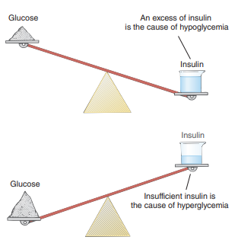
Diabetic Emergencies (2 of 3)
Two types of diabetic emergencies:
Hypoglycemia (low blood sugar)
Hyperglycemia (high blood sugar).
Giving sugar helps the person with hypoglycemia, but not the person with hyperglycemia.
Sugar will cause no harm in either condition.
FIGURE 5-5 Diabetic emergencies are caused by either too much or too little insulin.
© Jones & Bartlett Learning.

Slide 37
Diabetic Emergencies (3 of 3)
Ask the person with diabetes two questions:
“Have you eaten today?”
“Have you taken your insulin today?”
If the person with diabetes has taken their insulin but has not eaten, suspect hypoglycemia.
If the person with diabetes has eaten but has not taken insulin, suspect hyperglycemia.

Slide 38
Diabetic Emergencies (Hypoglycemia): What to Look For
Shaky, trembling
Cold, clammy, or moist skin
Confused
Lightheaded or dizzy
Sudden hunger
Nauseated
Tingling or numbness in the lips, tongues, or cheeks
Heavy sweating

Slide 39
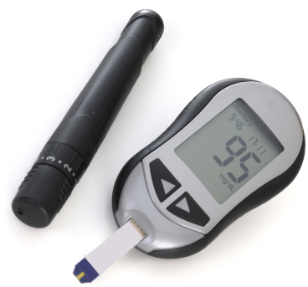
Diabetic Emergencies (Hypoglycemia): What to Do (1 of 5)
A responsive person may be able to tell what is wrong and what to do.
If the person has a blood glucose monitor and is capable, have them check their blood glucose level—it’s the only sure way to know if a person is experiencing low blood sugar.
FIGURE 5-6 Blood glucose monitor with lancing device.
© Luciano de la Rosa/Shutterstock

Slide 40
Diabetic Emergencies (Hypoglycemia): What to Do (2 of 5)
For hypoglycemia, use the following procedure only when:
Testing is not possible and low blood sugar is suspected.
Testing shows a low blood sugar (glucose) level (below 70 mg/dL).
Profuse sweating or shaking occurs in a person known to have diabetes.

Slide 41
Diabetic Emergencies (Hypoglycemia): What to Do (3 of 5)
The procedure is as follows (if the person can swallow):
Have the person eat 15 to 20 grams of sugar.
If available, three to five glucose tablets is preferred (as directed on the label).
If glucose tablets are not available, give any form of sugar, such as:
Glucose gel tube (as directed on label)
4 ounces (one-half cup) of fruit juice (eg, orange, apple)
4 ounces (one-half cup) of regular soda (not diet)
3 to 5 teaspoons of table sugar or honey
Hard candies, jellybeans, or gumdrops (check the food label for how many to consume).

Slide 42
Diabetic Emergencies (Hypoglycemia): What to Do (4 of 5)
Wait 10 to 15 minutes for the sugar to get into the blood.
Recheck the blood glucose level or, if there is no monitor, look for improvement.
If it is still low or no monitor was used and the person still has symptoms of low blood sugar, give the person an additional 15 g of sugar.
If there is no improvement or unable to give sugar, call 9-1-1 immediately.

Slide 43
Diabetic Emergencies (Hypoglycemia): What to Do (5 of 5)
Notes about children:
Young children usually need less than 15 g of carbohydrates to fix a low blood sugar level (eg, infants, 6 g; toddlers, 8 g, small children, 10 g).
For a suspected hypoglycemic and uncooperative child who rejects swallowing a form of glucose, glucose placed under the tongue (sublingual) can be attempted.
Many people may want to eat as much as they can until they feel better. This can cause blood sugar levels to shoot way up.
Using the procedure previously mentioned can help avoid this (high blood sugar levels)

Slide 44
Diabetic Emergencies (Severe Hypoglycemia): What to Look For
Staggering, slurred speech, and now following simple commands
Unable to swallow
Seizures
Unresponsiveness

Slide 45
Diabetic Emergencies (Severe Hypoglycemia): What to Do
Call 9-1-1 immediately.
If not breathing, begin CPR.
If breathing, roll them onto their side (recovery position) and monitor breathing.
DO NOT give food or fluids.
If unsure which diabetic condition (low blood sugar or high blood sugar) exists, give sugar. DO NOT give insulin.

Slide 46
Diabetic Emergencies (Severe Hyperglycemia): What to Look For
Drowsiness
Extreme thirst
Very frequent urination
Warm, flushed, dry skin
Vomiting
Fruity breath odor (has also been described to be like nail polish remover)
Heavy breathing
Eventual unresponsiveness

Slide 47
Diabetic Emergencies (Severe Hyperglycemia): What to Do (1 of 2)
Give frequent, small sips of water if the person with diabetes can swallow.
If possible, have a family member check their blood sugar level.
If uncertain whether the person with diabetes has a high or low blood glucose level, and if they are responsive and able to swallow, use the procedures for giving sugar, as previously described.
The extra sugar will not cause significant harm in a person experiencing hyperglycemia.

Slide 48
Diabetic Emergencies (Hyperglycemia): What to Do (2 of 2)
DO NOT give insulin unless the person with diabetes can self-administer it.
Call 9-1-1 as soon as possible.

