Slide 1
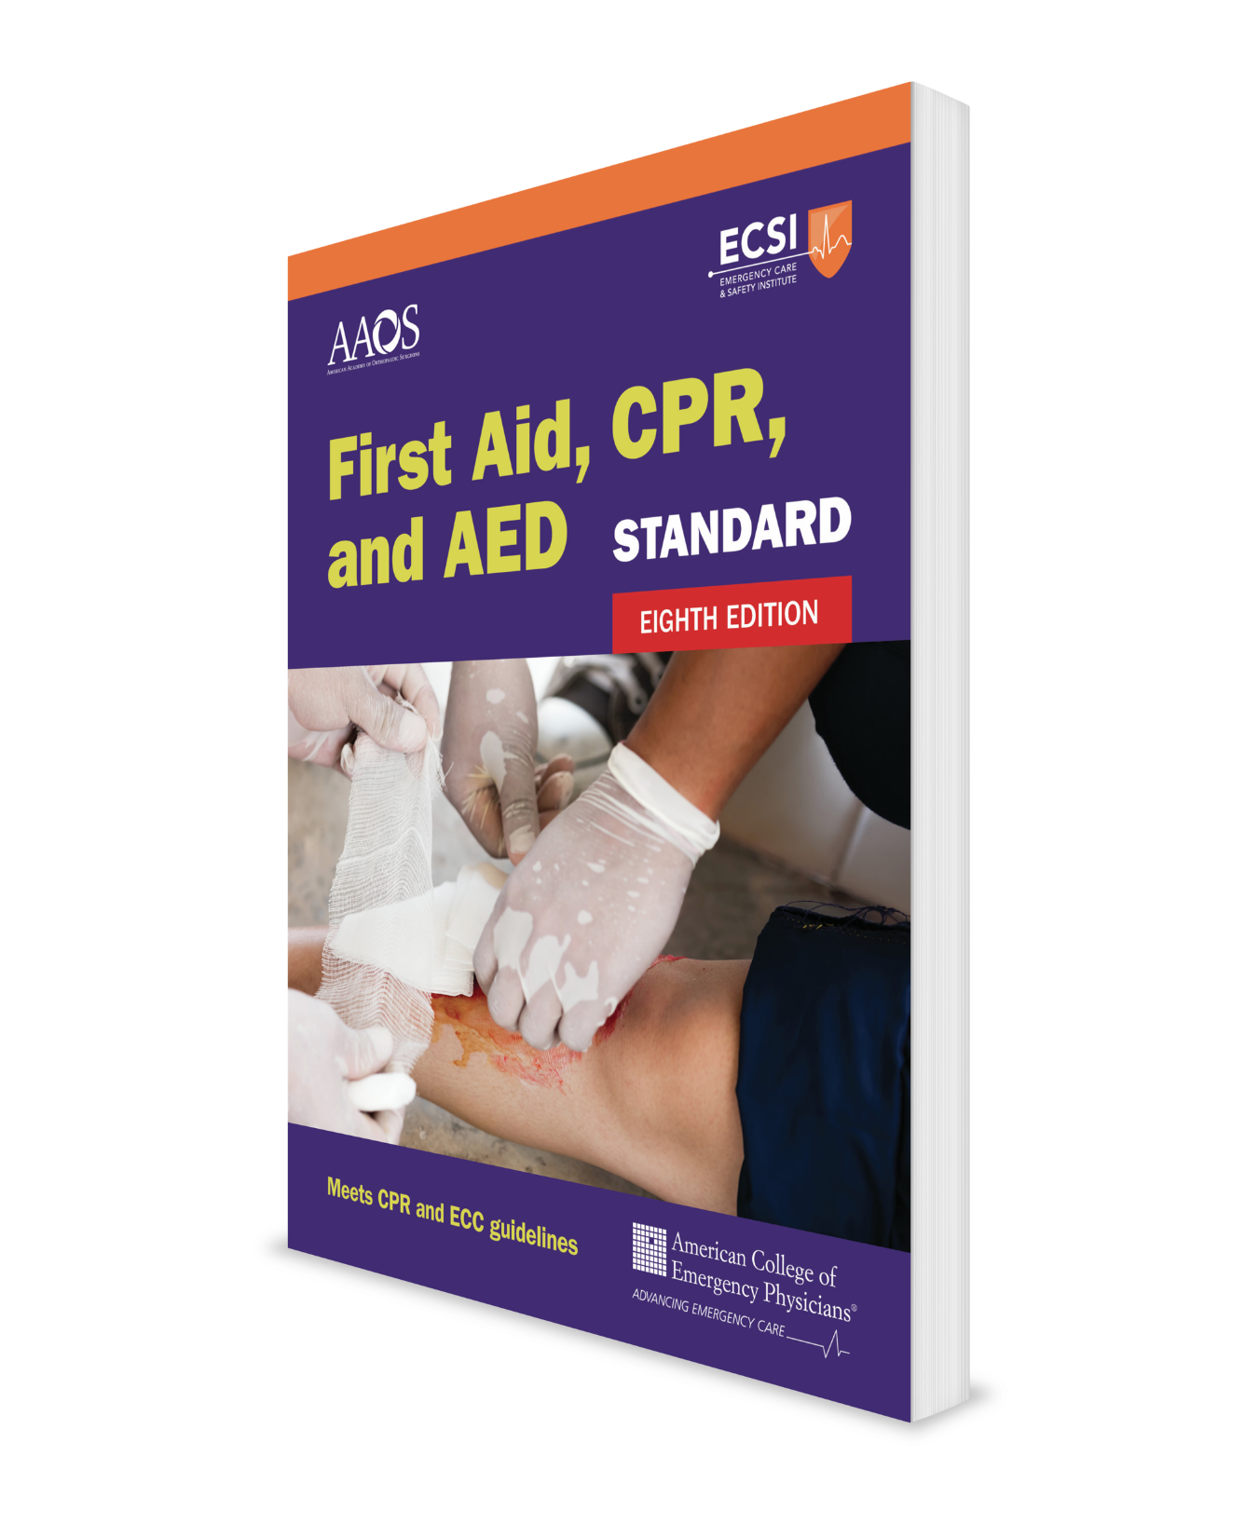
Injury Emergencies Core Course + Infants
CHAPTER 4
Notes:
Standard First Aid, CPR, and AED, Eighth Edition

Slide 2
Support Materials
Lecture Outline
Worksheet
Videos
Skill Sheets
Skill Checkoff Sheets
CHAPTER 4 Opener photo.
Courtesy of Rhonda Hunt.

Slide 3
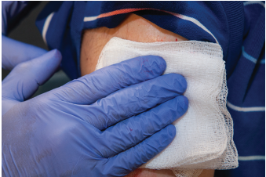
Bleeding Control: Bandages and Dressings
Use dressings and bandages to control non-life-threatening bleeding.
A dressing directly touches and covers an open wound.
A bandage holds a dressing in place.
Use a tourniquet to control massive bleeding (hemorrhage).
FIGURE 4-1: Dressing.
© Jones & Bartlett Learning.

Slide 4
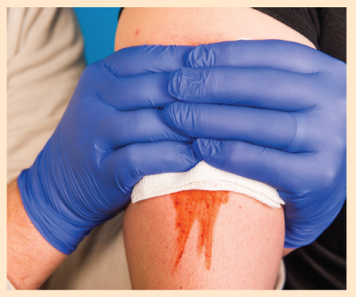
Bleeding Control (1 of 4)
Put on disposable latex-free gloves and expose the wound.
Cover the wound with a sterile or clean dressing and apply direct pressure until the bleeding stops.
If the bleeding is not a massive, life-threatening hemorrhage and direct pressure does not stop it within 5–10 minutes, add more dressings onto the first one and press harder over a wider area.
SKILL SHEET 4-1: Bleeding Control. Step 2.
© Jones & Bartlett Learning.

Slide 5
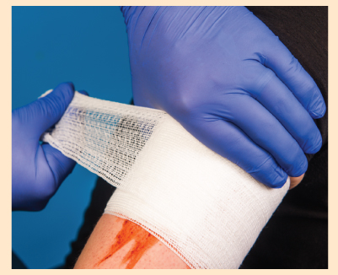
Bleeding Control (2 of 4)
When bleeding has stopped or you are unable to keep pressure on the wound, apply a bandage firmly over the dressing to maintain pressure on the wound and hold the dressing in place.
SKILL SHEET 4-1: Bleeding Control. Step 4.
© Jones & Bartlett Learning.

Slide 6
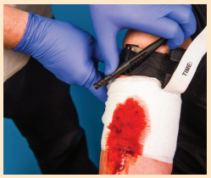
Bleeding Control (3 of 4)
If direct pressure fails to immediately stop bleeding from an arm or leg, apply a tourniquet (discussed later).
For other body areas where a tourniquet placement is impossible or when a tourniquet is ineffective or not available, insert a hemostatic gauze dressing directly into the wound (discussed later).
SKILL SHEET 4-1: Bleeding Control. Step 5.
© Jones & Bartlett Learning.

Slide 7
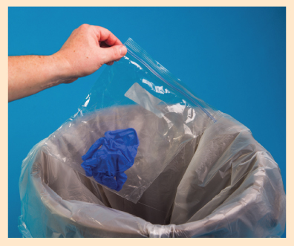
Bleeding Control (4 of 4)
After the bleeding stops:
Care for the wound.
Properly dispose of the gloves and any blood-contaminated clothing.
Wash your hands.
If needed, seek professional medical care for cleaning, sutures, or a tetanus immunization. For massive, life-threatening bleeding call EMS.
SKILL SHEET 4-1: Bleeding Control. Step 6.
© Jones & Bartlett Learning.

Slide 8
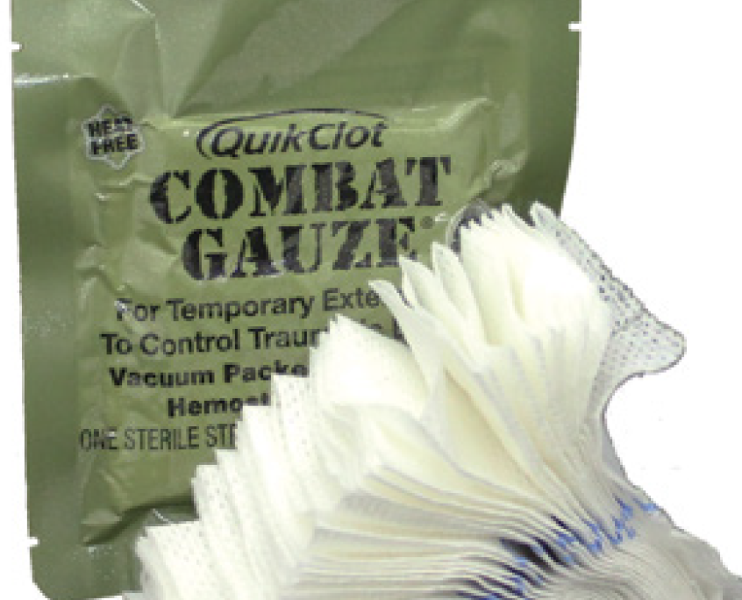
Hemostatic Dressings
Apply a hemostatic dressing if:
Direct pressure is not effective in controlling bleeding.
A manufactured tourniquet is not available, is ineffective, or cannot be applied.
Apply a hemostatic dressing in combination with direct pressure followed by a pressure bandage.
If still bleeding, consider using an improvised tourniquet.
FIGURE 4-3 Hemostatic dressings are gauze-style dressings saturated with an agent that stops bleeding.
Courtesy of Z-Medica

Slide 9
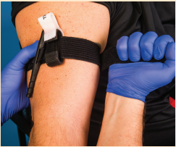
Applying a Manufactured Tourniquet (1 of 5)
If direct pressure fails to control bleeding on an arm or a leg, apply a manufactured tourniquet about 2 inches (5 cm) above the wound.
DO NOT apply anywhere other than an arm or leg
DO NOT apply over a joint
If applying a tourniquet 2 to 3 inches above the wound places it over a joint, place the tourniquet even higher.
SKILL SHEET 4-2: Massive Bleeding Control: Applying a Manufactured Tourniquet. Step 1.
© Jones & Bartlett Learning.

Slide 10
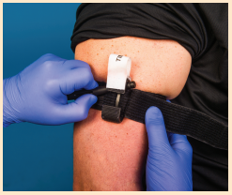
Applying a Manufactured Tourniquet (2 of 5)
Tighten the tourniquet by twisting the rod in one direction until bleeding stops.
Secure the twisting rod using the Velcro or holder so that the rod does not unwind.
SKILL SHEET 4-2: Massive Bleeding Control: Applying a Manufactured Tourniquet. Step 3.
© Jones & Bartlett Learning.

Slide 11
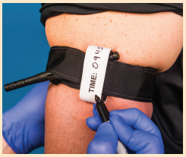
Applying a Manufactured Tourniquet (3 of 5)
Write the time the tourniquet was applied on the tourniquet’s tag.
If a tag is not available, write “TQ” or “TK” (for tourniquet) and the time it was applied on a piece of tape and stick it on the person’s forehead.
DO NOT cover, release, or remove the tourniquet.
SKILL SHEET 4-2: Massive Bleeding Control: Applying a Manufactured Tourniquet. Step 4.
© Jones & Bartlett Learning.

Slide 12
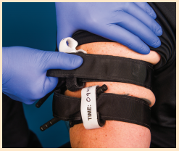
Applying a Manufactured Tourniquet (4 of 5)
If massive hemorrhage continues, the tourniquet is not tight enough.
Tighten the tourniquet.
If still ineffective, apply a second tourniquet near the first, above it, if possible.
A second tourniquet is rarely needed.
SKILL SHEET 4-2: Massive Bleeding Control: Applying a Manufactured Tourniquet. Step 5.
© Jones & Bartlett Learning.

Slide 13
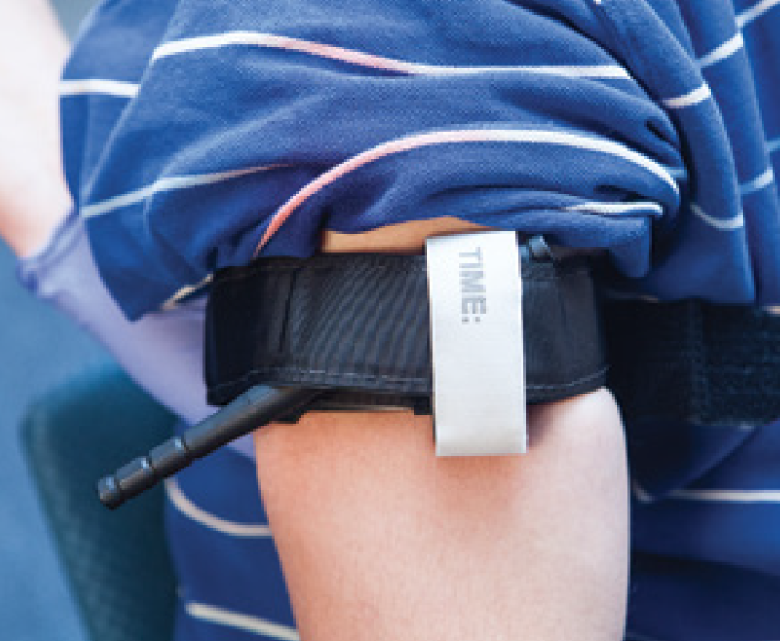
Applying a Manufactured Tourniquet (5 of 5)
DO NOT cover, release, or remove a tourniquet.
Manufactured tourniquets are preferred over improvised tourniquets that often fail to stop the bleeding.
Manufactured tourniquets are designed to be applied with one hand, if necessary, for self-rescue.
FIGURE 4-2 A tourniquet is a device wrapped tightly around an extremity to stop blood flow.
© Jones & Bartlett Learning.

Slide 14
Applying an Improvised Tourniquet (1 of 5)
Improvise a tourniquet to save a life when direct pressure cannot stop the bleeding and a manufactured tourniquet or a hemostatic dressing is not available or is ineffective.

Slide 15
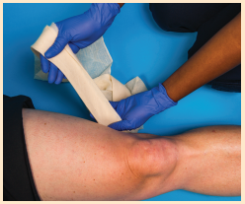
Applying an Improvised Tourniquet (2 of 5)
Expose the wound.
Use a folded triangle bandage, wide roller bandage, or similar cloth folded into a long band about 2 inches (5 cm) wide and several layers thick.
DO NOT use narrow materials, elastic materials, or bungee-type devices.
SKILL SHEET 4-3: Massive Bleeding Control: Applying an Improvised Tourniquet. Step 1.
© Jones & Bartlett Learning.

Slide 16
Applying an Improvised Tourniquet (3 of 5)
Wrap the folded band twice above the wound, about 2 to 3 inches (5 to 8 cm) and tie an overhand knot.
DO NOT apply it anywhere other than the arm or leg.
DO NOT apply it over a joint.
SKILL SHEET 4-3: Massive Bleeding Control: Applying an Improvised Tourniquet. Step 2.
© Jones & Bartlett Learning.

Slide 17
Applying an Improvised Tourniquet (4 of 5)
Place a short, rigid object (eg, screwdriver, stick) on top of the knot.
Tie a square knot over the rigid object with the ends of the cloth band.
Twist the rigid object in one direction until the bleeding stops.
Secure the rigid object in place with another cloth band or tape.
SKILL SHEET 4-3: Massive Bleeding Control: Applying an Improvised Tourniquet. Step 4.
© Jones & Bartlett Learning.

Slide 18
Applying an Improvised Tourniquet (5 of 5)
Write on a piece of tape “TQ” or “TK” for tourniquet and the time applied, and stick it on the person’s forehead.
If massive hemorrhage continues, the tourniquet is not tight enough.
Tighten the tourniquet.
If still ineffective, apply a second tourniquet near the first, above it, if possible.
A second tourniquet is rarely needed.

Slide 19
A Note on Tourniquets
The following can warrant placing a tourniquet as quickly as possible:
Unsafe conditions (eg, active shooter, military combat)
Inability to see the wound (eg, darkness)
Large-scale events involving more than one person needing care (eg, natural disasters, explosions, motor vehicle and air crashes)
Placing a tourniquet in a “high and tight” location (near armpit for an arm and near the groin for the leg) allows for fast evacuation and caring for life-threatening injuries.

Slide 20
Common Tourniquet Mistakes
Not using a tourniquet when you should
Using a tourniquet for minimal bleeding
Placing the tourniquet on too far from the bleeding site
Not making the tourniquet tight enough to effectively stop bleeding
Not using a second tourniquet if needed
Using anything narrow such as rope, wire, string, cords, or belt
Waiting too long to put the tourniquet on
Periodically loosening the tourniquet to allow blood flow to the injured extremity
Not monitoring its effectiveness

Slide 21
Sliver (Splinter): What to Do
Remove with tweezers (you may need to use a sterile needle to tease the sliver into a better position for removal).
Wash the area with soap and water.
Apply antibiotic ointment.
Apply an adhesive bandage.

Slide 22
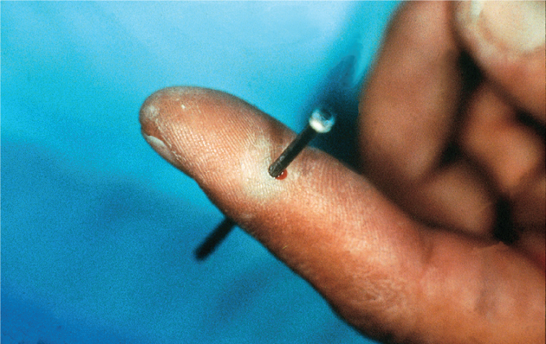
Large Impaled Object: What to Do (1 of 2)
DO NOT remove or move the object.
Stabilize the object with bulky dressings or padding placed around the base of the object to keep it from moving.
If bleeding, apply direct pressure around the base of the object.
FIGURE 4-11 Impaled (embedded) object
© American Academy of Orthopaedic Surgeons.

Slide 23
Large Impaled Object: What to Do (2 of 2)
DO NOT apply pressure on the object or on the skin next to the sharp edges of the object.
If necessary, reduce the length or weight of the object by cutting or breaking it.
Call 9-1-1.

Slide 24
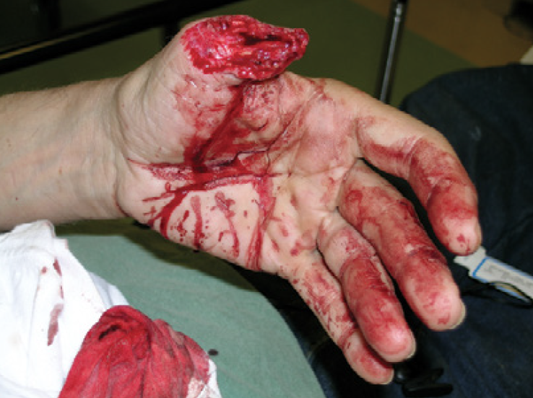
Amputations: What to Do (1 of 2)
Call 9-1-1.
Control the bleeding by using direct pressure.
If unsuccessful, apply a tourniquet or a hemostatic dressing, if available.
FIGURE 4-12 Amputation
© E. M. Singletary, M.D. Used with permission.

Slide 25
Amputations: What to Do (2 of 2)
Care for the amputated part:
Wrap the severed part in a sterile gauze or a clean cloth that has been wet with water or saline (make sure the excess water has been squeezed out).
Put the wrapped part in a waterproof container (eg, plastic bag, plastic wrap).
Keep the part cool by placing the wrapped part in a container of ice. DO NOT bury the part in ice or allow it to touch the ice. DO NOT submerge it in water.
If the amputated part was not found, ask others to search for it and, if located, to take it to the medical facility where the injured person is going.

Slide 26
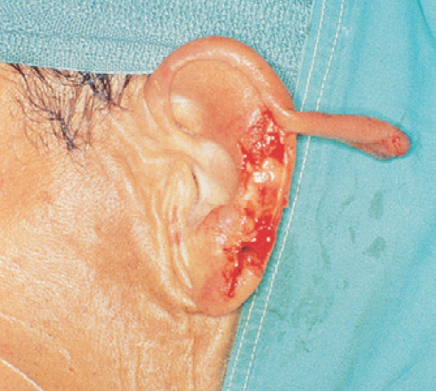
Avulsions: What to Do
Gently move the skin back to its normal position.
Cover with a sterile or clean dressing.
Control bleeding.
FIGURE 4-13 Avulsion
© American Academy of Orthopaedic Surgeons.

Slide 27
Head Injuries
Suspect a spinal cord injury in a person with a head injury.
Head injuries can vary in severity from a small cut or bruise to serious brain injury.
Includes any damage to the scalp, skull, or brain.

Slide 28
Scalp Wound: What to Do (1 of 2)
Control bleeding by pressing on wound.
Replace any skin flap to its original position and apply pressure.
Another option is applying an ice pack or instant cold pack to control bleeding.
Press on the edges of the wound to help control bleeding.
If you suspect a skull fracture, DO NOT apply excessive pressure.
This may push bone pieces into the brain.
Apply a dry, sterile or clean dressing.
Keep the head and shoulders raised if no spinal injury is suspected.

Slide 29
Scalp Wound: What to Do (2 of 2)
If bleeding continues, DO NOT remove the first blood-soaked dressing; instead, add another dressing over it.
Call 9-1-1 if:
The wound is extensive.
There is significant facial damage.
Signs of concussion occur (eg, nausea and vomiting, headache, drowsiness).

Slide 30
Skull Fracture: What to Look For
Pain
Skull deformity
Bleeding from an ear or the nose
Leakage of clear, watery fluid from an ear or the nose
Discoloration around the eyes or behind the ears that appears several hours after the injury
Unequal-sized pupils of the eye
Heavy scalp bleeding (skull and/or brain tissue may be exposed)
Penetrating or impaled object

Slide 31
Skull Fracture: What to Do (1 of 2)
Apply a sterile or clean dressing over the wound and hold it in place with gentle pressure.
Control bleeding by pressing on the edges of the wound and gently on the center of it to avoid pressing bone pieces into the brain. A doughnut-shaped pad is useful in applying pressure around the edges of a suspected skull fracture.
Call 9-1-1.

Slide 32
Skull Fracture: What to Do (2 of 2)
Cautions:
DO NOT move the head, neck, or spine.
DO NOT clean the wound.
DO NOT remove an embedded object.
DO NOT stop blood or clear fluid that is draining from an ear or the nose.
DO NOT press on the fractured area.

Slide 33
Brain Injury (Concussion): What to Look For
A concussion is considered a mild traumatic brain injury and is caused by a bump, blow, or jolt to the head that can change the way the brain normally works.
Recognition of a concussion is difficult.
Signs of concussion or mild traumatic brain injury, which may worsen over minutes or hours include:
Thinking/remembering symptoms
Physical symptoms
Emotional/mood symptoms
Sleep disturbance symptoms

Slide 34
Brain Injury (Concussion): What to Do (1 of 3)
If unresponsive, check for breathing.
If breathing is absent, call 9-1-1 and give cardiopulmonary resuscitation (CPR).
If a neck injury is suspected, or if the person is unresponsive:
DO NOT move the head, neck, or spine.
Tell the person to remain as still as possible.
Call 9-1-1.

Slide 35
Brain Injury (Concussion): What to Do (2 of 3)
Seek professional medical care as soon as possible if the person:
Looks very drowsy or cannot be awakened
Has one pupil (the black part in the middle of the eye) that is larger than the other
Has a seizure
Cannot recognize people or places
Becomes more and more confused, restless, or agitated
Exhibits unusual behavior
Becomes unresponsive
Has a headache that gets worse and/or does not go away
Has repeated vomiting or nausea
Has slurred speech

Slide 36
Brain Injury (Concussion): What to Do (3 of 3)
Following the injury, the person should:
Get plenty of sleep at night and rest during the day.
Avoid visual and sensory stimuli (eg, video games and loud music).
Ease into normal activities slowly, not all at once.
Avoid strenuous physical activities that increase the heart rate or require a lot of concentration.
Avoid driving, cycling, operating machinery, or playing sports until assessed by a health care provider.
Avoid anything that could cause another blow to the head or body.
Use acetaminophen for postconcussion headaches.
DO NOT use aspirin or anti-inflammatory medications

Slide 37
Spinal Injuries: What to Look For
Suspect a spinal injury if a person:
Was in a motor vehicle crash involving ejection, a rollover, high speeds, or pedestrians
Was involved in other types of motorized vehicle crashes (eg, motorcycle, scooter, all-terrain vehicle, snowmobile)
Was involved in a bicycle or skateboard crash
Fell greater than their standing height, especially if older
Dove into shallow water
Received a hit or blow to the head

Slide 38
Spinal Injuries: What to Do (1 of 3)
Test for sensation and movement in all four extremities:
Pinch several fingers/toes while the person has their eyes closed, and ask, “Can you feel this?” and “Which finger/toe am I touching?”
Ask, “Can you wiggle your fingers/toes?”
Have the person squeeze your hand/push and pull a foot against your hand.

Slide 39
Spinal Injuries: What to Do (2 of 3)
Call 9-1-1.
Wait for trained rescuers with proper equipment to move the person.
DO NOT attempt to move the person.
Leave the person in the position in which found.
Tell the person to remain as still as possible.
Consider moving a person only for the following:
To provide CPR
To open a blocked airway
To control life-threatening bleeding
To reach a safe location

Slide 40
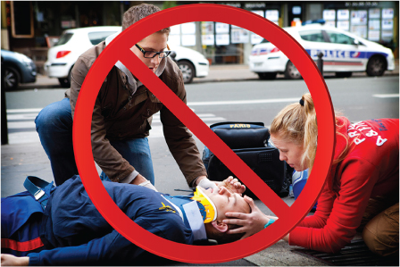
Spinal Injuries: What to Do (3 of 3)
DO NOT apply a cervical (neck) collar.
Cover with a blanket or coat to prevent heat loss.
FIGURE 4-14 Do not place a cervical collar on a person with a suspected spinal injury.
© BSIP SA/Alamy Stock Photo

Slide 41
Thermal Burns: What to Do (1 of 3)
Stop the burning!
If clothing is on fire, have the person roll on the ground using the “stop, drop, and roll” method.
Smother the flames with a blanket or douse the person with water.
Remove clothing and all jewelry, especially rings, from the burn area.
Check and monitor breathing if the person inhaled heated air or was in an explosion.
Determining the depth of the burn will help determine what first aid to give.

Slide 42
Thermal Burns: What to Do (2 of 3)
Determine the size of the burn by using the Rule of the Hand.
The person’s hand (including the palm, closed fingers, and thumb) equals about 1% of their total body surface area (TBSA).
Determine which parts of the body are burned.
Burns on the face, hands, feet, and genitals are more severe than burns on other body parts.

Slide 43
Thermal Burns: What to Do (3 of 3)
Seek professional medical care or call 9-1-1 for the following:
Burns on the face, neck, hands, feet, or genitals
Breathing difficulty
Blistering or broken skin
Large area burned (eg, back, trunk)
All third- and large second-degree burns
Other concerns (eg, coughing, wheezing, hoarse voice, or carbon monoxide exposure)

Slide 44
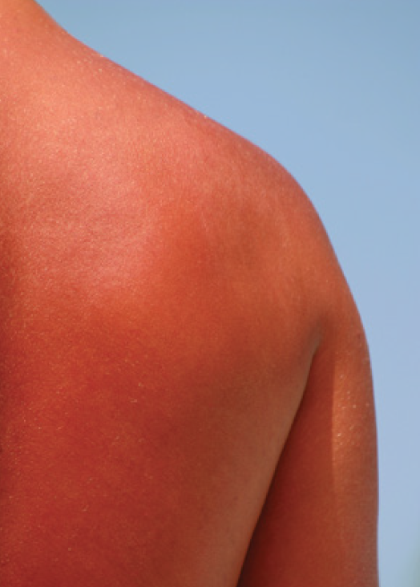
First-Degree Burns: What to Look For
Redness
Mild swelling
Tenderness
Pain
FIGURE 4-26 First-degree burn.
© Suzanne Tucker/ShutterStock.

Slide 45
First-Degree Burns: What to Do (1 of 2)
Immerse the burned area in cool or cold water, place it under running cold water, or apply a wet, cool, or cold compress for at least 10 minutes as soon as possible.
If cold water is unavailable, use any other available cold liquid.
DO NOT apply ice, ice water, or salt water.
Give ibuprofen (for children and teenagers, give acetaminophen).

Slide 46
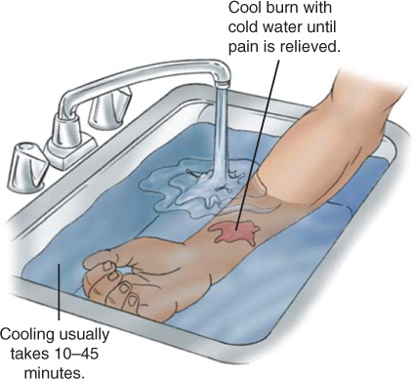
First-Degree Burns: What to Do (2 of 2)
Have the person drink as much water as possible without becoming nauseated.
Keep the burned arm or leg raised and remove any jewelry.
After burn has been cooled, apply aloe vera gel or an inexpensive skin moisturizer.
First-degree burns do not need to be covered.
FIGURE 4-27 Run the burned area under water to cool the burn.
© Jones & Bartlett Learning.

Slide 47
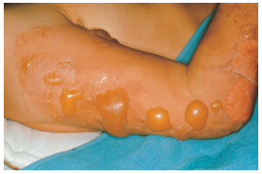
Second-Degree Burns: What to Look For
Blisters
Swelling
Weeping of fluids
Severe pain
FIGURE 4-28 Second-degree burn.
© American Academy of Orthopaedic Surgeons.

Slide 48
Second-Degree Burns: What to Do (1 of 2)
Small second-degree burns:
Follow Steps 1 through 4 for first-degree burns, with the following additions:
After burn has been cooled, apply a thin layer of antibacterial ointment.
Cover the burn with a loose, dry, nonstick, sterile or clean dressing.
DO NOT break any blisters.

Slide 49
Second-Degree Burns: What to Do (2 of 2)
Large second-degree burns
Follow Steps 1 through 4 for first-degree burns, with the following additions:
Apply cold, but monitor, as it may cause hypothermia.
DO NOT break any blisters.
Call 9-1-1.

Slide 50
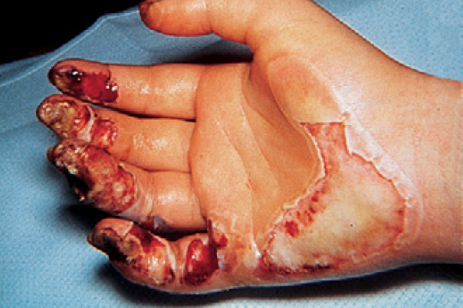
Third-Degree Burns: What to Look For
Dry, leathery, gray-colored, or charred skin
FIGURE 4-29 Third-degree burn
© American Academy of Orthopaedic Surgeons.

Slide 51
Third-Degree Burns: What to Do
Cover the burn with a dry, nonstick, sterile or clean dressing.
DO NOT apply cold.
DO NOT apply gel or ointment to the burn.
Call 9-1-1.

Slide 52
Electrical Burns When Still in Contact With Electricity: What to Do
Call 9-1-1 to have the electricity turned off or wires cut.
DO NOT touch or move power lines or the person.
DO NOT try to move electrical wires or devices with a wooden pole, rope, or any other item.
Keep people away from the area.

Slide 53
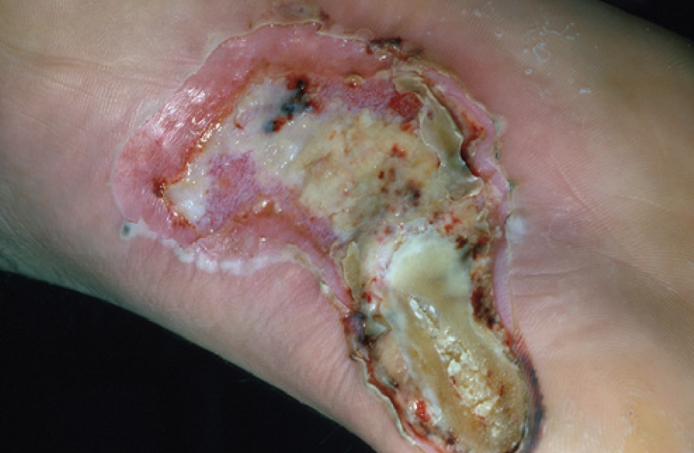
Electrical Burns: What to Look For
Burn wound, which might appear small
Entrance and exit wounds
Multiple burns
Most electrical burns are third-degree burns
Absent breathing/pulse
Electricity can cause a person’s breathing or heart to stop
FIGURE 4-30 Electrical burn
© Charles Stewart MD, EMDM, MPH

Slide 54
Electrical Burns: What to Do
Once the area is safe:
Check breathing of any motionless and unresponsive person, and if absent, begin CPR.
Call 9-1-1 immediately. Every person who has been electrocuted needs professional medical care.
If the person fell, check for broken bones and a spinal injury.
Most electrical burns are third-degree burns, so cover all burn wounds with sterile dressings. Treat as you would a third-degree burn.

Slide 55
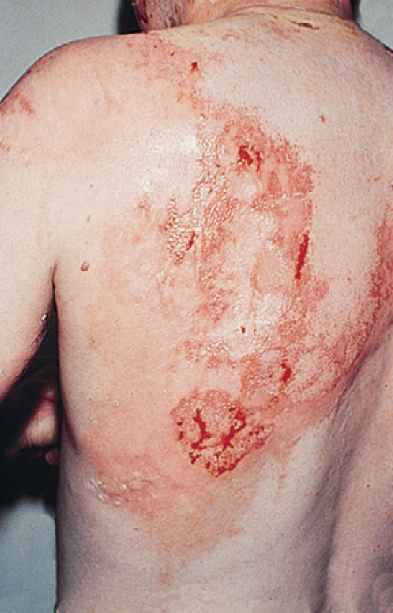
Chemical Burns: What to Look For
Pain
Burning
Breathing difficulty
Eye pain or vision changes
© American Academy of Orthopaedic Surgeons.
FIGURE 4-31 Chemical burn
© American Academy of Orthopaedic Surgeons.

Slide 56
Chemical Burns: What to Do
Once the area is safe:
Brush a dry or powder chemical off the skin with a gloved hand or piece of cloth before flushing with water.
Flush the burn with large amounts of cool running water for at least 20 minutes or until EMS arrives.
Call 9-1-1 immediately for all chemical burns.
DO NOT try to neutralize the chemical.
For a chemical in an eye:
Tip the head so the affected eye is below the nose
Wash the eye with warm water (which is tolerated in the eye better than cold water) from the nose out to the side of the face for at least 20 minutes.

Slide 57
Shock
Shock happens when body tissues do not get enough oxygen-rich blood.
Do not confuse shock with an electrical shock or “being shocked,” as in scared or surprised.
Shock is life-threatening.

Slide 58
Shock: What to Look For
Massive external or internal bleeding
A severe infection
Multiple severe broken bones
Signs of a heart attack
Abdominal or chest injury
Severe allergic reaction

Slide 59
Shock: What to Do (1 of 2)
For a person in shock who is responsive and breathing normally:
Keep the person flat (horizontal) on their back.
If there is no sign of a leg injury and it does not cause pain then feet can be raised 6 to 12 inches (15 to 30 cm).
DO NOT give anything to eat or drink unless medical help is delayed over 1 hour, in which case, sips of water can be given if fluids do not cause nausea and/or vomiting.
FIGURE 4-33A Shock positions. If responsive and breathing normally, keep the person flat on their back.
© Jones & Bartlett Learning.

Slide 60
Shock: What to Do (2 of 2)
For a person in shock who is unresponsive and breathing:
Place the person on their side (recovery position).
DO NOT move them if there is a neck, back, hip, or pelvic injury; leave in the position found unless it is unsafe.
Call 9-1-1.
Prevent heat loss by putting blankets or coats under and over the person.

