Slide 1
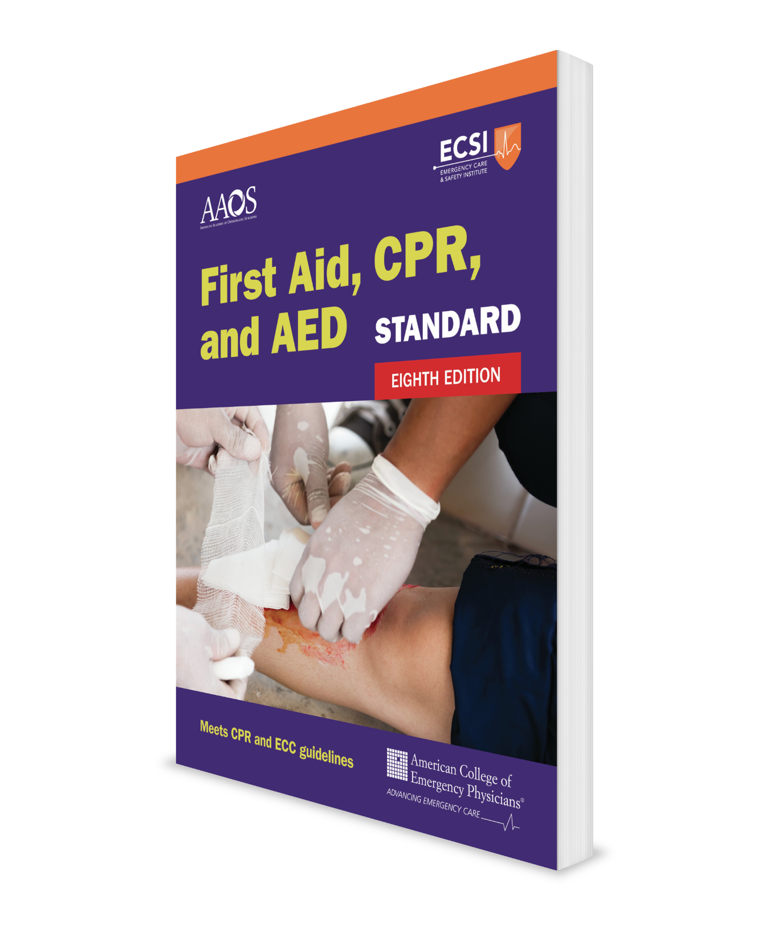
Your Role as a First Aid Provider Core Course + Infants
CHAPTER 1
Notes:
Standard First Aid, CPR, and AED, Eighth Edition

Slide 2
Support Materials
Lecture Outline
Flowchart
CHAPTER 1 Opener photo.
© David L. Ryan/The Boston Globe/Getty Images.

Slide 3
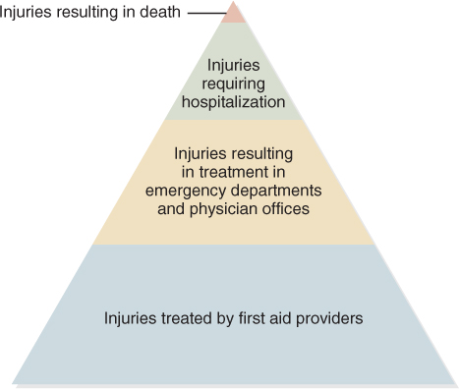
Understanding Injuries and Illnesses
Most injuries and sudden illnesses do not result in death, but rather result in:
Hospitalization
Treatment in an emergency department or physician’s office
Treatment from a first aid provider
FIGURE 1-1 The injury pyramid
© Jones & Bartlett Learning.

Slide 4
The Importance of First Aid
It is better to know first aid and not need it than to need it and not know it.
Goals of first aid:
Preserving life
Alleviating suffering
Preventing further illness or injury
Promoting recovery

Slide 5
Role of the First Aid Provider (1 of 5)
Recognize the emergency.
Factors that help a first aid provider recognize an emergency include the following:
The severity of the injury or illness
How close you are to the emergency scene and the length of time you are at an emergency scene
A person’s distressed appearance or panic­-stricken behavior
Previously knowing and recognizing the injured or ill person
Scene conditions (eg, sights, smells, sounds)

Slide 6
Role of the First Aid Provider (2 of 5)
Decide to help.
Excuses some people use for not helping:
It is harmful (eg, “I could be injured, infected with a disease, or sued. I could hurt the person.”)
Obstacles are in the way (eg, “I don’t know how to help. The scene is unsafe. I don’t like smelling or seeing blood, vomit, or burned skin.”)

Slide 7
Role of the First Aid Provider (3 of 5)
Before helping, take the appropriate actions.
Size up the scene.
Ask if you may help.
Protect against disease transmission.

Slide 8
Role of the First Aid Provider (4 of 5)
Determine what is wrong with the person.
Before giving first aid, you must determine what is wrong with the person—“find it, fix it.”
Most cases involve checking only a person’s chief complaint (symptoms).

Slide 9
Role of the First Aid Provider (5 of 5)
Give first aid.
Based upon what you found, give first aid until one of the following events occurs:
Emergency medical services (EMS) takes over.
You take the person to a medical facility.
It is determined the person needs only first aid and home care.

Slide 10
First Aid Competencies
Recognizing, assessing, and prioritizing the need for first aid
Providing care by using appropriate knowledge, skills, and behaviors
Recognizing limitations and seeking additional care when needed
FIGURE 1-2 The first step in providing first aid is to recognize an emergency exists.
Courtesy of Shane MacKichan

Slide 11
Deciding to Help (1 of 2)
At some time, everyone will have to decide whether to help another person or not.
People are more likely to promptly get involved at the time of an emergency if they have previously considered the possibility of helping others.

Slide 12
Deciding to Help (2 of 2)
To develop such a helping attitude:
Understand the importance of helping.
Feel confident about helping, even if someone else is present.
Be willing to take the time to help.
Be able to put the potential risks of helping in perspective.
Feel comfortable about taking charge, if needed, at an emergency scene.
Feel comfortable about seeing a person who is bleeding or vomiting or who appears dead.

Slide 13
Communicating Calmly (1 of 3)
Provide comfort and reassurance to the person you are helping.
Use these guidelines for establishing a relationship with a responsive person that has an injury or illness:
Use the person’s name while providing first aid.
Your first words to a person are very important because they set the tone of your interaction.
Avoid negative statements that could add to a person’s distress and anxiety.

Slide 14
Communicating Calmly (2 of 3)
Do not ask unnecessary questions unless it aids treatment or satisfies the person’s need to talk.
Give realistic answers to the person’s questions, but try to be positive. Do not make a promise you cannot keep.
For example, instead of saying, “You will not have any pain,” say, “The worst is over.”
Do not deny the obvious.
For example, instead of saying, “There is nothing wrong,” say, “You have had quite a fall and probably do not feel too well, but we are going to look after you.”

Slide 15
Communicating Calmly (3 of 3)
Discuss the person’s condition calmly and honestly.
Explain what you are doing and why you are doing it.
Encourage the person to express their feelings.
Listen, but do not judge.
Tears and/or laughter can be normal. Let the person know this if such responses seem to make them feel embarrassed.

Slide 16
Providing Competent Care (1 of 4)
The level of care required of a first aid provider is referred to as the standard of care.
When providing first aid, you must do the following to meet the standard of care:
Do what is expected of someone with first aid training and experience, working under similar conditions.
Treat the person to the best of your ability.

Slide 17
Providing Competent Care (2 of 4)
Medicine is constantly changing.
People who trained decades ago or who remember a home remedy might use outdated and unproven first aid procedures.
DO NOT use these outdated procedures:
Putting butter on a burn
Giving syrup of ipecac for a swallowed poison
Using suction for a venomous snakebite
Putting an object between the teeth of a person experiencing a seizure
Using pressure points to control bleeding

Slide 18
Providing Competent Care (3 of 4)
People trained decades ago may not know some of these more recent procedures taught to first aiders:
Applying a tourniquet
Applying a hemostatic dressing
Storing a knocked-out tooth
Leaving an open chest wound exposed without a dressing or seal
Injecting a dose of epinephrine for a severe allergic reaction
Instructing a person with low blood sugar on how to use oral glucose
Advising a person having a heart attack on when to take aspirin
Knowing a method to check for a stroke

Slide 19
Providing Competent Care (4 of 4)
Knowing the side-lying recovery position for an unresponsive and normally breathing person
Knowing how to avoid fainting
Giving naloxone for an opioid drug overdose

