Slide 1
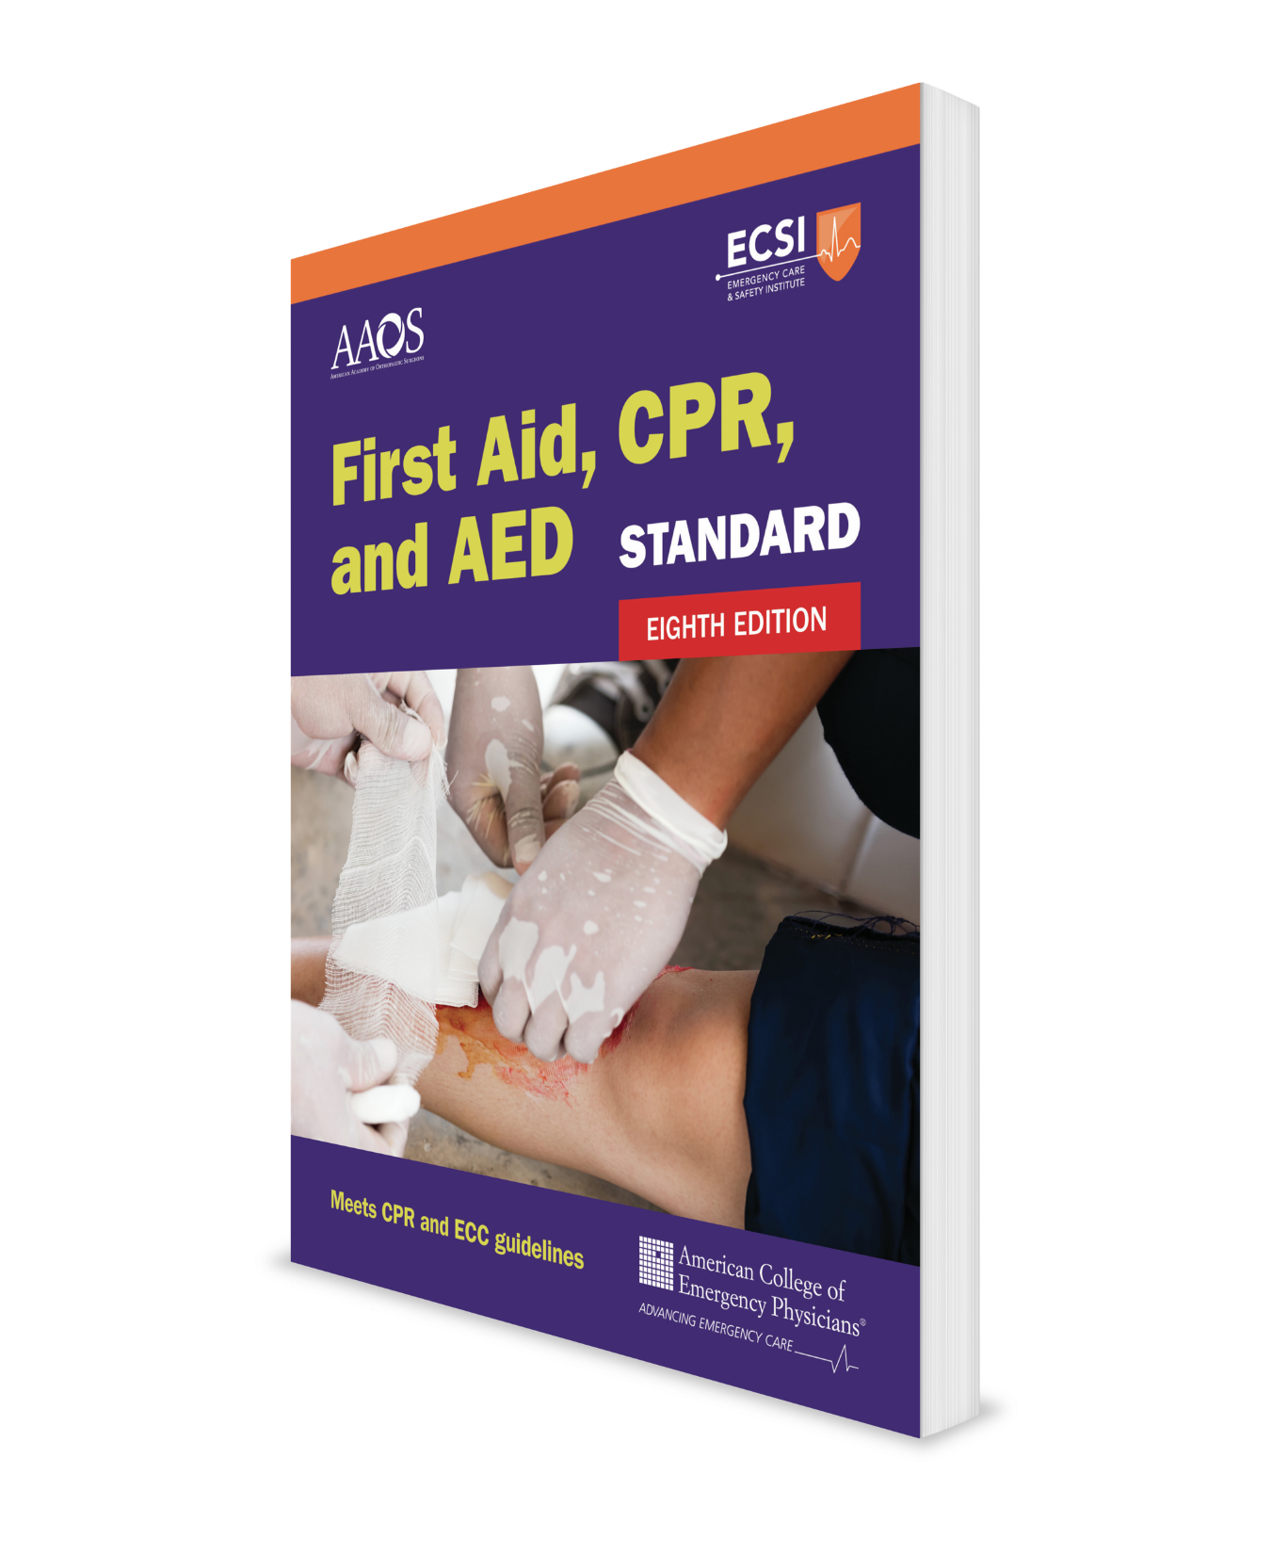
CPR and AED Comprehensive Course
CHAPTER 7
Notes:
Standard First Aid, CPR, and AED, Eighth Edition

Slide 2
Support Materials
Lecture Outline
Worksheet
Videos
Skill Sheets
Skill Checkoff Sheets
CHAPTER 7 Opener photo.
© Al Diaz/Miami Herald/AP Photo.

Slide 3
Heart Attack and Cardiac Arrest
Heart attack
A heart attack happens when the blood supply to the heart muscle is suddenly reduced or blocked.
If the blocked artery is not reopened quickly, the part of the affected heart begins to die.
The longer a person goes without treatment, the greater the damage and can lead to a cardiac arrest.
Cardiac arrest
A cardiac arrest happens when the heart stops beating or when it suddenly develops a rapid irregular rhythm (ventricular fibrillation).
Cardiac arrest is one of the leading causes of death.

Slide 4
Cardiopulmonary Resuscitation (CPR) (1 of 2)
Cardiopulmonary resuscitation (CPR) is the set of skills necessary to help a person in cardiac arrest until emergency medical services (EMS) arrives to take over.
CPR for a child is similar to that given for an adult, with a few key differences.
An automated external defibrillator (AED) is an electronic device that analyzes the heart rhythm and if necessary prompts the rescuer to deliver an electric shock, known as defibrillation, to the heart of a person in cardiac arrest.

Slide 5
Cardiopulmonary Resuscitation (CPR) (2 of 2)
For a life-threatening condition (cardiac arrest), doing something is always better than doing nothing!
Use RAB-CAB mnemonic to remember the sequence of what to do when providing adult or child CPR:
R = Responsiveness?
A = Activate EMS and get an AED
B = Breathing?
C = Compressions
A = Airway
B = Breaths

Slide 6
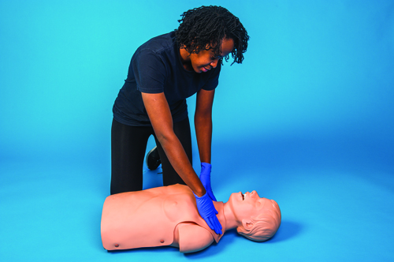
Adult and Child CPR (1 of 12)
R = Responsive?
Tap the person on the shoulder and shout, “Are you okay?”
If the person responds, ask SAMPLE history questions and look for and ask about DOTS.
If the person does not respond, continue to the next step, Activate.
SKILL SHEET 7-1: Adult and Child CPR. Step 1
© Jones & Bartlett Learning.

Slide 7
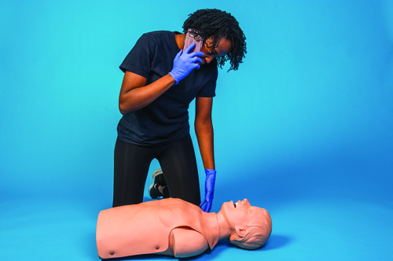
Adult and Child CPR (2 of 12)
A = Activate EMS and get an AED
Shout for nearby help.
If someone responds, have them call 9-1-1 and get an AED while you provide care.
SKILL SHEET 7-1: Adult and Child CPR. Step 2.
© Jones & Bartlett Learning.

Slide 8
Adult and Child CPR (3 of 12)
A = Activate EMS and get an AED (cont.)
If no one comes and you are alone with an adult, call 9-1-1 and put the phone on speaker mode.
Prepare to follow the dispatcher's instructions.
If a phone is not available, leave the person to locate a phone and get an AED.
If no one comes and you are alone with a child, give 5 sets of 30 chest compressions and 2 breaths before calling 9-1-1.

Slide 9
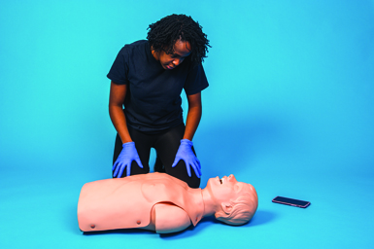
Adult and Child CPR (4 of 12)
B = Breathing?
Place the person face up on a flat, firm surface.
Take 5 to 10 seconds to observe the person from the neck to waist for movement (rise and fall).
If the person is not breathing or is only gasping, continue to the next step, Compressions.
SKILL SHEET 7-1: Adult and Child CPR. Step 3.
© Jones & Bartlett Learning.

Slide 10
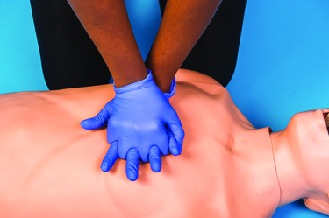
Adult and Child CPR (5 of 12)
C = Compressions. Provide chest compressions:
Move enough clothing to locate the correct hand position for compressions and where to apply an AED when it arrives on the scene.
SKILL SHEET 7-1: Adult and Child CPR. Step 4.
© Jones & Bartlett Learning.

Slide 11
Adult and Child CPR (6 of 12)
C= Compressions (cont.)
For an adult:
Place the heel of one hand on the center of the person’s chest and on the lower half of their breastbone (sternum).
Place your other hand on top of the first one with your fingers interlocked. Hold your fingers off the person’s chest and point them directly away from you; DO NOT cross your hands.
For a child:
Use one hand; however, depending upon the child’s size and your size, using two hands may be necessary.
Keep your arms straight and elbows locked, with your shoulders positioned directly over your hands.

Slide 12
Adult and Child CPR (7 of 12)
C= Compressions (cont.)
Push hard and straight down on the breastbone (sternum), at least 2 inches (5 cm) for an adult and about one-third the depth of the chest for a child. Use your upper body’s weight to compress the chest. DO NOT rock back and forth.
Push fast: 100 to 120 compressions per minute. It may be easier to push to the beat to the Bee Gees song “Stayin’ Alive” or the beat from a CPR smartphone app that was previously installed and is quickly accessible.
Push smoothly: DO NOT bounce or jab and DO NOT stop at the top or bottom of a compression.
Allow the chest to fully recoil after each compression. DO NOT lean on the chest.

Slide 13
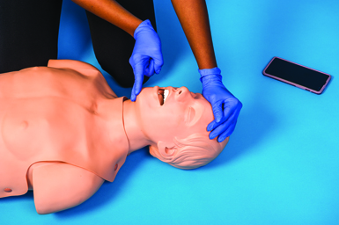
Adult and Child CPR (8 of 12)
A = Airway. Open the person’s airway:
Take your hand which is nearest to the person’s head and place it on their forehead; apply pressure to tilt the head back.
Place two fingers of your other hand under the bony part of the person’s jaw (near the chin) and lift. Avoid pressing on soft tissues under the jaw.
Tilt the head backward.
SKILL SHEET 7-1: Adult and Child CPR. Step 5.
© Jones & Bartlett Learning.

Slide 14
Adult and Child CPR (9 of 12)
B = Breaths. Give two breaths, using a mouth-to-barrier device when possible:
Pinch the person’s nose shut and make a tight seal with your mouth on the mouth-to-barrier device or the person’s mouth. If unwilling or unable to give breaths, give compression-only CPR instead.
SKILL SHEET 7-1: Adult and Child CPR. Step 6.
© Jones & Bartlett Learning.

Slide 15
Adult and Child CPR (10 of 12)
B = Breaths (cont.)
Give two breaths, each lasting 1 second. DO NOT blow too forcefully or for too long. (Take a normal breath for yourself after each breath.)
Watch for chest rise to determine if your breaths go in.
Allow for chest deflation after each breath.
If you see chest rise after the 2 breaths, give 30 chest compressions.
If the first breath does not make the chest rise, retilt the person’s head and give a second breath. If the second breath does not make the chest rise, begin CPR (30 compressions and 2 breaths). Each time before giving the first of the two breaths, open the mouth and look for an object; if seen, remove it.

Slide 16
Adult and Child CPR (11 of 12)
Continue cycles of 30 chest compressions and 2 breaths until an AED arrives.
If a bystander is present, they could help by giving chest compressions while you perform rescue breathing, or vice versa.
SKILL SHEET 7-1: Adult and Child CPR. Step 7.
© Jones & Bartlett Learning.

Slide 17
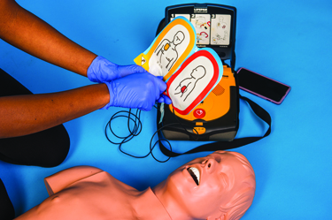
Adult and Child CPR (12 of 12)
When an AED becomes available, use it as soon as possible.
Follow the manufacturer’s directions for pad placement.
SKILL SHEET 7-1: Adult and Child CPR. Step 8.
© Jones & Bartlett Learning.

Slide 18
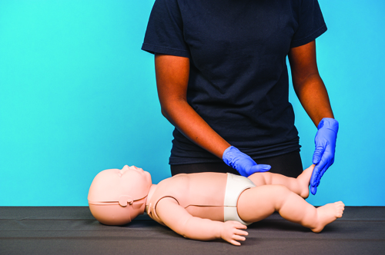
Infant CPR (1 of 9)
R = Responsive?
Tap the bottom of the infant’s foot and shout their name. Take 5 to 10 seconds to check for no breathing or only gasping.
SKILL SHEET 7-2: Infant CPR. Step 1.
© Jones & Bartlett Learning.

Slide 19
Infant CPR (2 of 9)
A = Activate EMS and get an AED
Shout for nearby help.
If someone responds, have them call 9-1-1 and get an AED while you start CPR.
If you are alone, call 9-1-1, perform CPR (30 chest compressions and 2 breaths for 5 cycles), and then get an AED.
If a phone is not available, perform CPR and get an AED.
SKILL SHEET 7-2: Infant CPR. Step 2.
© Jones & Bartlett Learning.

Slide 20
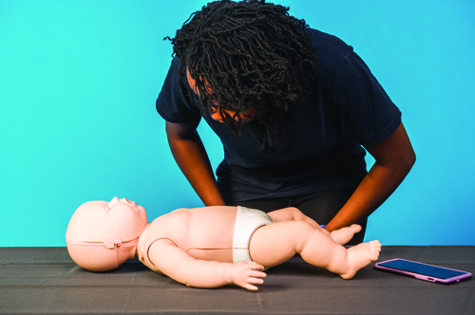
Infant CPR (3 of 9)
B = Breathing?
Take 5 to 10 seconds to check for breathing or only gasping by observing the infant’s face and chest movement.
If the infant is not breathing or only gasping, continue to the next step, Compressions.
SKILL SHEET 7-2: Infant CPR. Step 3.
© Jones & Bartlett Learning.

Slide 21
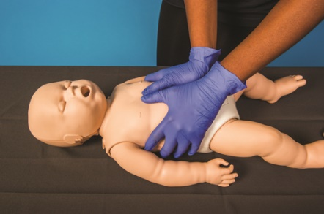
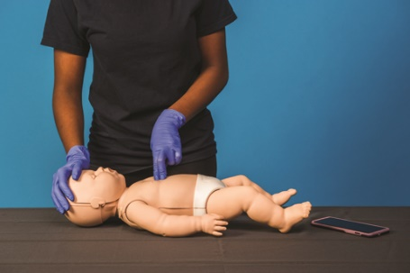
Infant CPR (4 of 9)
C = Compressions
Place the infant faceup on a flat, firm surface.
If possible, use an elevated surface (eg, table, cabinet top).
Single rescuers can use either the encircling thumbs technique or the two-finger technique.
If the rescuer cannot physically encircle the infant’s chest, use the two-finger technique.
SKILL SHEET 7-2: Infant CPR. Step 4.
© Jones & Bartlett Learning.

Slide 22
Infant CPR (5 of 9)
C = Compressions (cont.)
Encircling thumbs technique:
Place both thumbs on the lower third of the breastbone (sternum), both touching the imaginary nipple line and the fingers encircling around the infant’s back and chest.
Give 30 chest compressions:
Push hard: about 1.5 inches (4 cm) straight down.
Push fast: to the beat of the Bee Gees song “Stayin’ Alive.”
At the end of each compression, let the infant’s chest come back up to its normal position.

Slide 23
Infant CPR (6 of 9)
C = Compressions (cont.)
Two-finger technique:
Place the pads of two fingers on the infant’s breastbone (sternum), with one touching and both below the imaginary nipple line.
Give 30 chest compressions:
Push hard: about 1.5 inches (4 cm) straight down (at least one-third of the chest’s diameter). If unable tot he achieve the appropriate depth, use the heel of one hand instead of two fingers.
Push fast: to the beat of the Bee Gees song “Stayin’ Alive.”
At the end of each compression, let the infant’s chest come back up to its normal position.

Slide 24
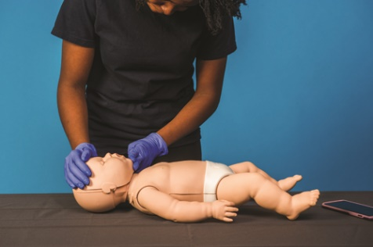
Infant CPR (7 of 9)
A = Airway
Open the infant’s airway using the head tilt–chin lift maneuver.
DO NOT tilt the head back too far (less than for an adult or child).
SKILL SHEET 7-2: Infant CPR. Step 5.
© Jones & Bartlett Learning.

Slide 25
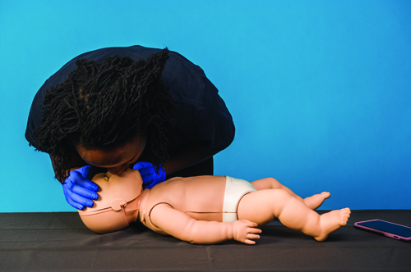
Infant CPR (8 of 9)
B = Breaths
Cover the infant’s mouth with a mouth-to-barrier device if possible. If not possible, cover the infant's mouth and nose with your mouth and make an airtight seal. If this does not work, try either mouth-to-mouth or mouth-to-nose breaths.
Give two breaths, each lasting 1 second, to make the infant’s chest rise.
SKILL SHEET 7-2: Infant CPR. Step 6.
© Jones & Bartlett Learning.

Slide 26
Infant CPR (9 of 9)
B = Breaths (cont.)
Take a breath between each breath.
Continue CPR until one of the following occurs:
The infant begins breathing.
EMS arrives and takes over.
You become physically exhausted and unable to continue.
If another person is available, trade off about every 5 sets of CPR (2 minutes).

Slide 27
Compression-Only CPR (1 of 3)
Compression-only CPR, or hands-only CPR, is CPR without breaths.
It intends to increase bystander involvement when CPR is needed for a person in cardiac arrest.
It may be used with adults or children, but not infants.
It is important to note that breaths are an important part of CPR with infants.
Compression-only CPR can be detrimental for infants.

Slide 28
Compression-Only CPR (2 of 3)
A bystander who is unable or unwilling to make mouth-to-mouth contact or unable to perform CPR can:
Ask another person to call 9-1-1 or an emergency response number.
Place the person faceup on a flat, firm surface.
Push the center of the chest hard and fast (faster than 1 per second) or use the beat of the Bee Gees song “Stayin’ Alive,” the beats from a smartphone app that was previously installed and is quickly accessible, or a dispatcher's directions heard over a mobile phone's speaker.
Continue chest compressions without stopping until help arrives or as long as possible. If another person is available, trade off about every 2 minutes.

Slide 29
Compression-Only CPR (3 of 3)
COVID-19 is an illness caused by a virus that can spread from person to person.
A person can become infected from respiratory droplets when an infected person coughs, sneezes, or speaks.
This presents a dilemma for a first aid provider who is concerned about compromising their own health and yet wants to give CPR.
If a person known to be infected with the COVID-19 virus is in cardiac arrest, perform compression-only CPR with the addition of covering the person’s nose and mouth with a cloth or face mask and the first aid provider wearing a mask to cover their own nose and mouth.

Slide 30
CPR Performance Mistakes (1 of 2)
Rescue breathing mistakes:
Failing to ensure adequate head tilt–chin lift (airway will be closed)
Failing to pinch the nose shut in a child and adult or not covering mouth and nose in an infant
Failure to give slow breaths (lasting 1 second each)
Providing breaths that are too fast or too forceful
Failing to watch the person's chest rise and fall
Failing to maintain a tight seal around the mouth or barrier device

Slide 31
CPR Performance Mistakes (2 of 2)
Chest compression mistakes:
Pivoting at knees instead of hips (eg, rocking motion)
Using the wrong compression site (eg, too high or too low on the chest)
Bending elbows (arms should be kept straight with elbows locked)
Failing to place shoulders above sternum (arms should be vertical)
Touching your fingers to the person's chest
Providing quick, stabbing compressions
Failing to allow the chest to fully recoil (eg, leaning on the chest)
Failing to keep your hand in contact with the person's chest between each compression

Slide 32
Airway Obstruction (1 of 3)
Signs of mild airway obstruction (choking):
Good air exchange is present
Able to make forceful coughing efforts in an attempt to relieve the obstruction
What to do for mild airway obstruction (choking):
Encourage continued coughing
Monitor the person until they improve
Signs of complete airway obstruction:
Difficulty breathing
Unable to cough forcefully
Unable to talk
Skin, fingernail beds, or lips turn blue or gray
Appears panicky and desperate
Pointing to their mouth or grasps at their throat

Slide 33
Airway Obstruction (2 of 3)
The American Heart Association (AHA) recommends providing abdominal thrusts for dislodging a severe airway obstruction (choking) in a responsive adult or child older than 1 year.
The International Liaison Committee on Resuscitation (ILCOR) recommends a combination of back blows and abdominal thrusts (five back blows followed by five abdominal thrusts) for airway obstruction.
An airway obstruction is a life-threatening event, so it is a good idea to know several procedures that can be taken if others have failed.

Slide 34
Airway Obstruction (3 of 3)
Before administering back blows or abdominal thrusts to a person who is responsive and shows signs of complete airway obstruction:
DO NOT ask them if they are okay. Instead, ask them if they are choking and if you can help them. If they nod “yes,” tell them you are going to help.
Have someone to call 9-1-1.

Slide 35
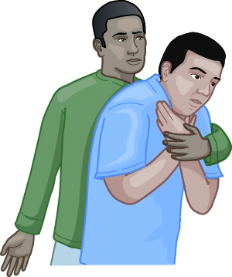
Adult and Child Choking: Back Blows (1 of 3)
Stand behind the person and slightly to one side.
Place the palm of one hand high on the person’s upper chest, leaving your other hand free.
SKILL SHEET 7-3: Adult or Child Choking: Back Blows. Step 1.
© Jones & Bartlett Learning.

Slide 36
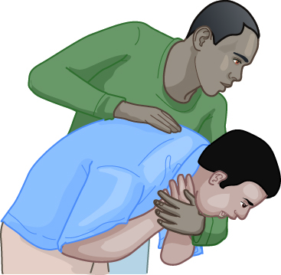
Adult and Child Choking: Back Blows (2 of 3)
Have the person bend over at the waist to a 90º angle (their upper body should be parallel to the ground or floor).
DO NOT keep them in an upright or a vertical position. If they are not bending over when the jolt of the back blow dislodges the object, the dislodged object may become stuck deeper in the airway.
SKILL SHEET 7-3: Adult or Child Choking: Back Blows. Step 2.
© Jones & Bartlett Learning.

Slide 37
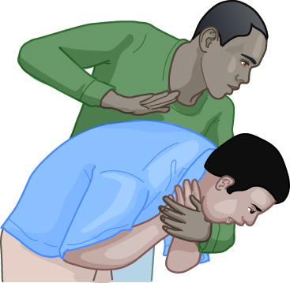
Adult and Child Choking: Back Blows (3 of 3)
With your fingertips up, use the heel of your hand to firmly strike the person between their shoulder blades.
If 5 back blows do not dislodge the object, give up to 5 abdominal thrusts
SKILL SHEET 7-3: Adult or Child Choking: Back Blows. Step 3.
© Jones & Bartlett Learning.

Slide 38
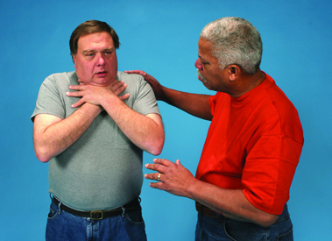
Adult and Child Choking: Abdominal Thrusts (1 of 6)
If the 5 back blows do not dislodge the object or the person is still unable to speak, give up to 5 abdominal thrusts.
SKILL SHEET 7-4: Adult or Child Choking: Abdominal Thrusts. Step 1.
© Jones & Bartlett Learning.

Slide 39
Adult and Child Choking: Abdominal Thrusts (2 of 6)
Stand behind an adult; stand or kneel behind a child.
If the person is a lot taller than you, have them kneel or sit.
Wrap your arms around the person’s waist.
Locate the person’s navel with a couple of fingers (right-handed people will usually use their left hand).
SKILL SHEET 7-4: Adult or Child Choking: Abdominal Thrusts. Step 2.
© Jones & Bartlett Learning.

Slide 40
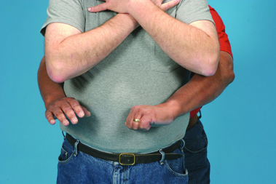
Adult and Child Choking: Abdominal Thrusts (3 of 6)
Make a fist with the other hand (right-handed people will usually use their right hand) and place the thumb side of that hand just above the person’s navel and below the tip of the breastbone (sternum).
SKILL SHEET 7-4: Adult or Child Choking: Abdominal Thrusts. Step 3.
© Jones & Bartlett Learning.

Slide 41
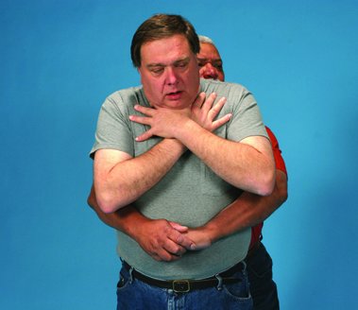
Adult and Child Choking: Abdominal Thrusts (4 of 6)
Grasp the fist with the other hand.
Thrust the fist into the person’s abdomen with a quick upward motion.
Each thrust should be a separate and distinct effort to dislodge the object.
SKILL SHEET 7-4: Adult or Child Choking: Abdominal Thrusts. Step 4.
© Jones & Bartlett Learning.

Slide 42
Adult and Child Choking: Abdominal Thrusts (5 of 6)
If the obstruction is not dislodged and still in place, repeat alternating between back blows and abdominal thrusts until:
The person can cough forcefully, breathe, or speak, or
The person becomes unresponsive, or
EMS or someone with more advanced training takes over.

Slide 43
Adult and Child Choking: Abdominal Thrusts (6 of 6)
If the person becomes unresponsive or a person is found unresponsive, then look in the mouth for an object. If seen, remove the object, then provide cardiopulmonary resuscitation (CPR) by doing the following:
Give 30 chest compressions.
Give two breaths. If the first breath does not cause the chest to rise, retilt the head and attempt a second breath.
Continue sets of 30 chest compressions and 2 breaths. Each time before giving the first of the two breaths, look into the mouth for an object; if seen, remove it.

Slide 44
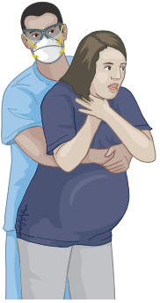
Adult and Child Choking: Chest Thrusts
If the person is pregnant or very large, or if you are small, provide chest thrusts:
Position yourself behind the person.
Put your arms under the person’s armpits and your hands on the lower half of the breastbone (sternum).
Pull your hands straight back into the chest.
FIGURE 7-2: Chest thrusts are similar to CPR chest compressions, but are sharper and delivered at a slower rate. Hands are placed on the lower half of the breastbone (sternum).
© Jones & Bartlett Learning.

Slide 45
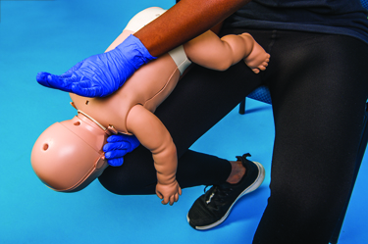
Infant Choking (1 of 5)
Give up to five separate and distinct back blows.
Support the infant’s head with your hand.
Lay the infant facedown over your forearm, with he head lower than their chest.
SKILL SHEET 7-5: Infant Choking. Step 1.
© Jones & Bartlett Learning.

Slide 46
Infant Choking (2 of 5)
Brace your forearm and the infant against your thigh. (If holding the infant with your right hand and forearm, brace them against your right thigh; if using the left hand and arm, brace them against your left thigh.)
Give five back blows between the infant’s shoulder blades with the heel of your other hand.
If the object does not come out, turn the infant onto their back while supporting the head.

Slide 47
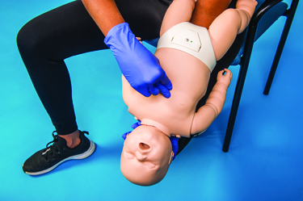
Infant Choking (3 of 5)
Give up to five separate and distinct chest thrusts.
Support the infant’s head with your hand.
Lay the infant faceup over your forearm, tilting your arm down so the infant’s head is lower than their chest.
SKILL SHEET 7-5: Infant Choking. Step 2.
© Jones & Bartlett Learning.

Slide 48
Infant Choking (4 of 5)
Brace your forearm and the infant against your thigh.
Place two fingers of your other hand in the same location as giving CPR compressions.
Give the thrusts 1 second apart—this is not as fast as CPR compressions.

Slide 49
Infant Choking (5 of 5)
Continue alternating the five back blows and five chest thrusts without interruption until the infant stops responding or can breathe, cough, or cry, or until EMS or a person who is trained takes over.
If the infant is found or becomes unresponsive:
Give 30 chest compressions.
Look into the infant’s mouth for an object; if seen, remove it.
Give 2 breaths.

Slide 50
Automated External Defibrillators (AEDs) (1 of 2)
An automated external defibrillator (AED) analyzes the heart rhythm to determine if an electric shock, or defibrillation, is necessary. If it is, the AED will prompt the rescuer to deliver the shock to the heart of a person in cardiac arrest.
The purpose of this shock is to correct an abnormal electrical disturbance and reestablish a heart rhythm that will result in normal electrical and pumping function.
Using an AED as soon as possible increases the person’s chance of survival.

Slide 51
Automated External Defibrillators (AEDs) (2 of 2)
Many different AED models exist. The principles for use are the same for each, but the displays, controls, and options vary slightly.
Don’t let this intimidate you because most have voice prompts or visual displays to guide usage.

Slide 52
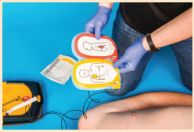
Using an AED (1 of 4)
Turn on the AED.
Attach the pads to the person’s bare, dry chest, as shown on the pads. If needed, plug the cables into the AED.
SKILL SHEET 7-6: Using an AED. Step 2.
© Jones & Bartlett Learning.

Slide 53
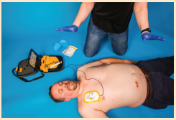
Using an AED (2 of 4)
Stay clear of the person. Make sure no one, including yourself, is touching the person and say “Clear!”
Allow the AED to analyze the heart.
SKILL SHEET 7-6: Using an AED. Step 3.
© Jones & Bartlett Learning.

Slide 54
Using an AED (3 of 4)
The AED will prompt one of two actions:
Stay clear and press the shock button if advised to deliver a shock.
Do not shock but give CPR, starting with chest compressions with the pads staying in place.

Slide 55
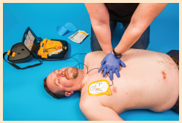
Using an AED (4 of 4)
After any one of the two actions, give five sets of CPR (approximately 2 minutes) unless the person moves, begins to breathe, or wakes up. Even if the person wakes up, leave AED pads on until EMS arrives.
Repeat Clearing the person and allowing the AED to analyze the heart until the person begins to breathe or until EMS takes over.
SKILL SHEET 7-6: Using an AED. Step 4.
© Jones & Bartlett Learning.

