Slide 1
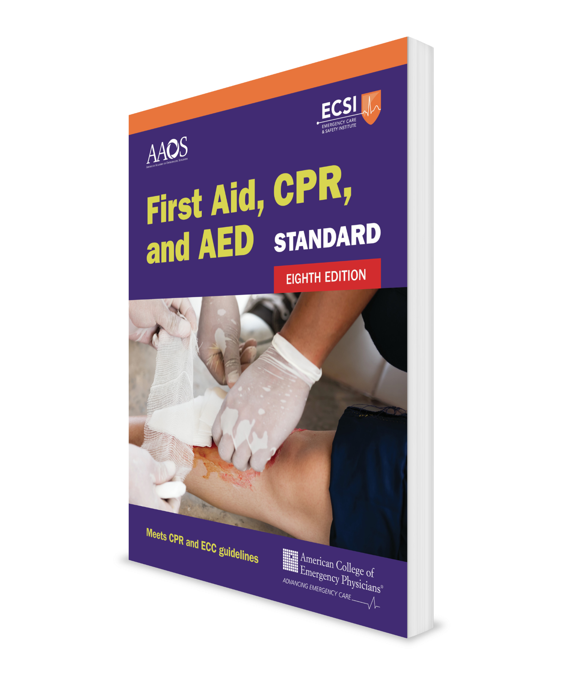
Checking an Injured or Ill Person
Comprehensive Course
CHAPTER 3
Notes:
Standard First Aid, CPR, and AED, Eighth Edition

Slide 2
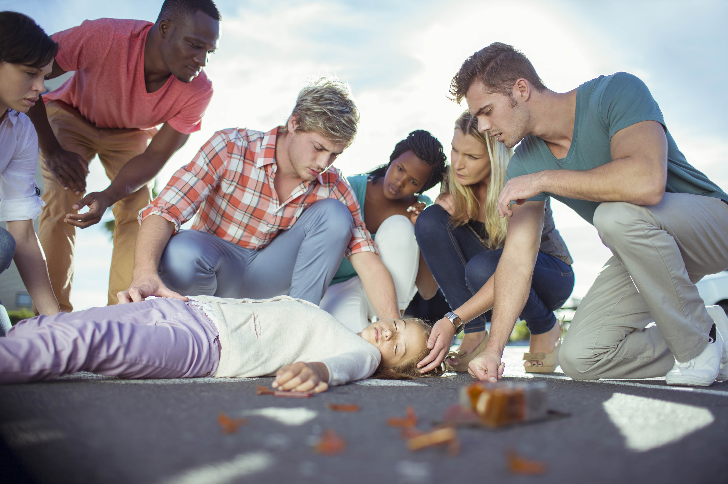
Support Materials
Lecture Outline
Flowchart
Worksheet
Skill Checkoff Sheets
CHAPTER 3 Opener photo.
© Caiaimage/Paul Bradbury/Phototake.

Slide 3
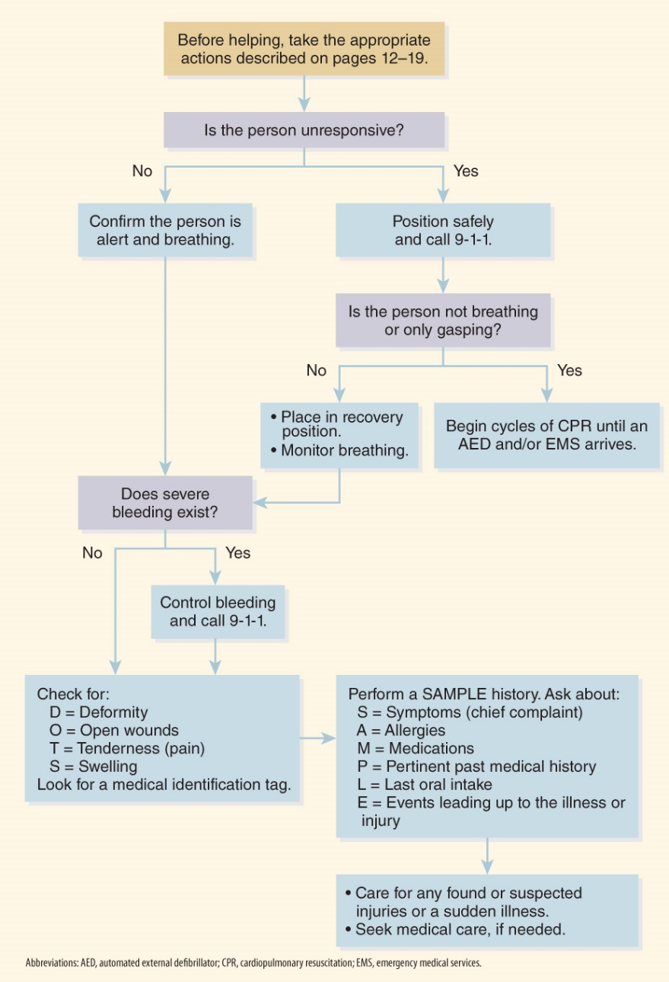
Checking an Injured or Ill Person
During emergency situations, it is critical that you know what to do and what not to do.
  FLOWCHART 3-1 Finding What Is Wrong

Slide 4
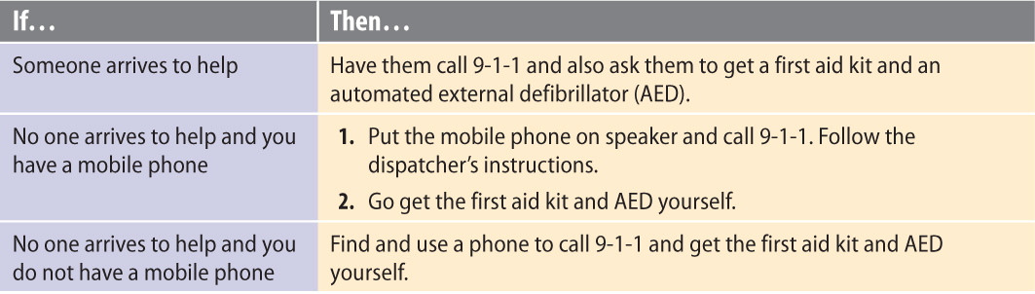
Checking a Person Appearing to Be Unresponsive (1 of 3)
To treat an unresponsive person, follow these steps:
  Tap the person’s shoulder and shout “Are you okay?”
  If they do not respond, shout for help.

Slide 5
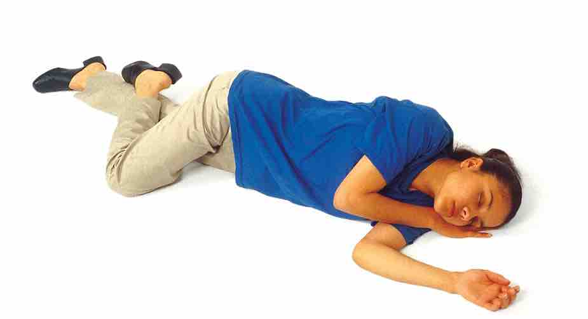
Checking a Person Appearing to Be Unresponsive (2 of 3)
  Check for breathing.
    If the person is breathing normally:
      Place them on their side in the recovery position
      Call 9-1-1
      Stay with the person until EMS arrives
    If the person is not breathing normally:
      Call or have someone call 9-1-1
      Begin CPR and use an AED
FIGURE 3-1 Recovery position. Keep the top hand under the cheek to cushion it. To keep the airway open and allow fluids to drain, extend the chin and point the mouth slightly downward. DO NOT move a person with a suspected spinal injury.
© Jones & Bartlett Learning.

Slide 6
Checking a Person Appearing to Be Unresponsive (3 of 3)
  Look for flowing or spurting blood. If found, control immediately.
  Look for a medical identification tag.
    This tag may be on the person or on their mobile phone.

Slide 7
Checking a Responsive Person (1 of 3)
To treat a responsive person, follow these steps:
  Ask the person, “Are you okay?”
  If they respond, introduce yourself.
      Ask for the person’s name and use it when speaking to them.
      Tell them that you are trained in first aid.
  Obtain their consent to give care by asking if you can help them.

Slide 8
Checking a Responsive Person (2 of 3)
  Ask the person where they are now and for the current day or date—not being able to recall basic facts can reflect their
  mental status.
  Quickly check for any breathing difficulty.
  Scan the person for massive bleeding. If a wound has blood flowing or spurting, control it.
  If any life-threatening conditions are found or suspected, then
  treat them.

Slide 9
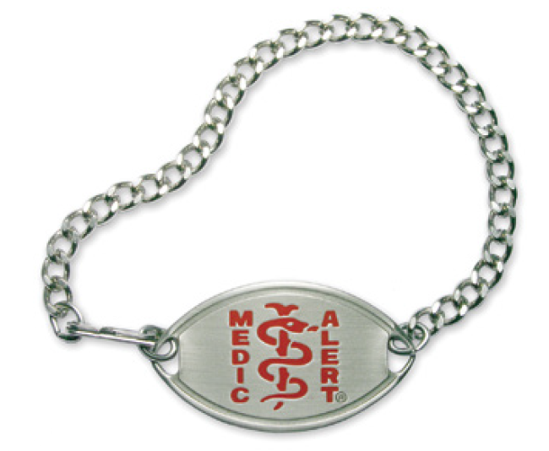
Checking a Responsive Person (3 of 3)
  Shout for help.
    If someone arrives to help, have them call 9-1-1 and get a first aid kit.
    If no one arrives to help and you have mobile phone, treat life-threatening conditions while simultaneously calling 9-1-1 and following the dispatcher’s instructions.
  Look for or ask about a medical identification tag.
FIGURE 3-2 Medical identification tag.
Courtesy of the MedicAlert Foundation®. © 2006, All Rights Reserved. MedicAlert® is a federally registered trademark and service mark.

Slide 10
Interviewing an Injured or Ill Person
Gather information using the mnemonic SAMPLE:
  S = Symptom (main or chief complaint)?
  A = Allergies?
  M = Medications?
  P = Pertinent past medical history?
  L = Last food or drink?
  E = Events leading up to the illness or injury?
    Injury: Ask, “How did you get hurt?”
    Illness: Ask, “Do you know why you are feeling ill?

Slide 11
Physical Exam (Head-to-Toe Check) (1 of 3)
As you examine a person from head to toe, look for and ask about DOTS:
  D = Deformity
  O = Open wound
  T = Tenderness
  S = Swelling

Slide 12
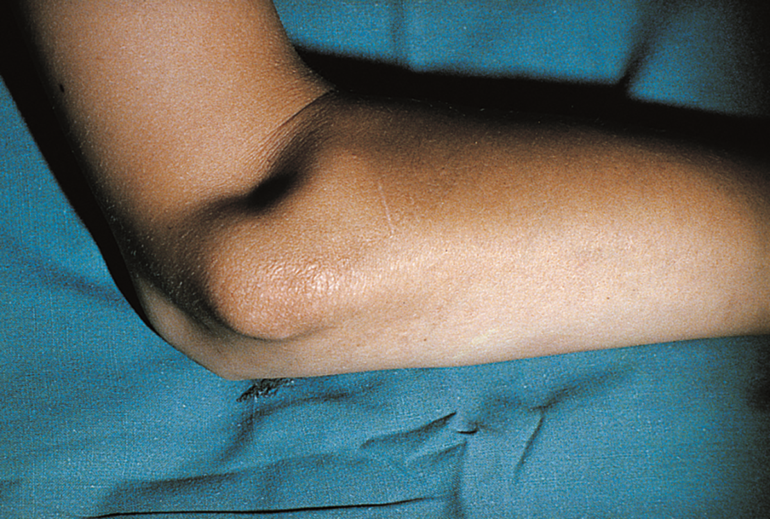
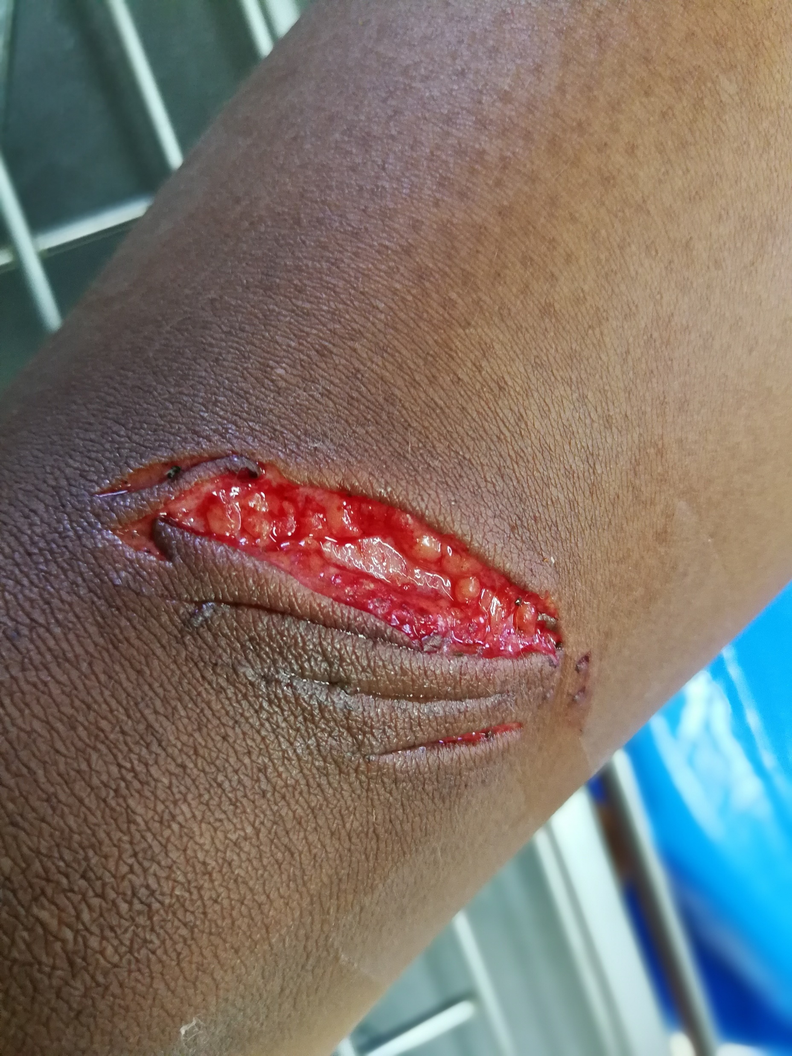
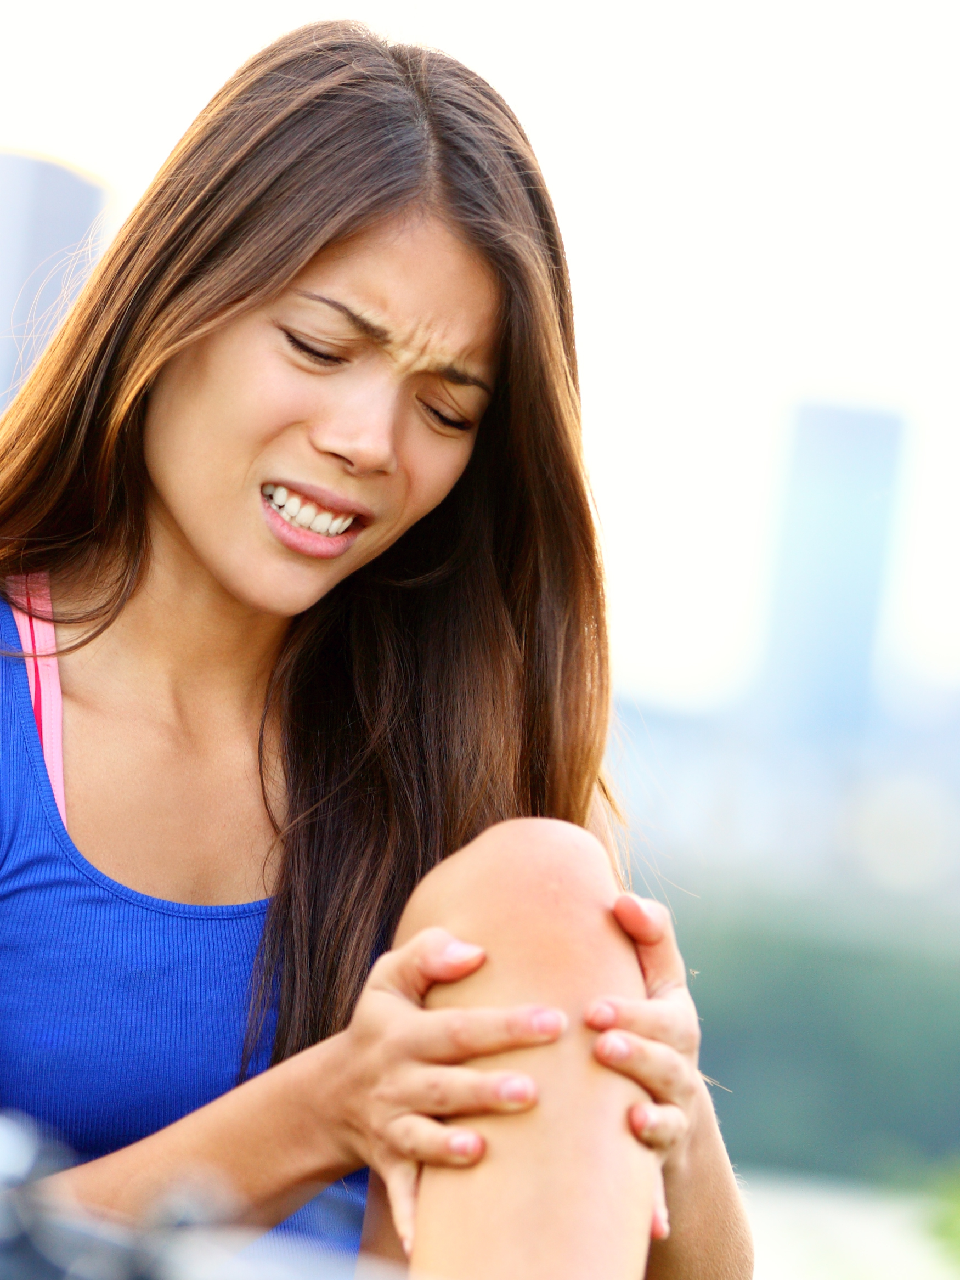
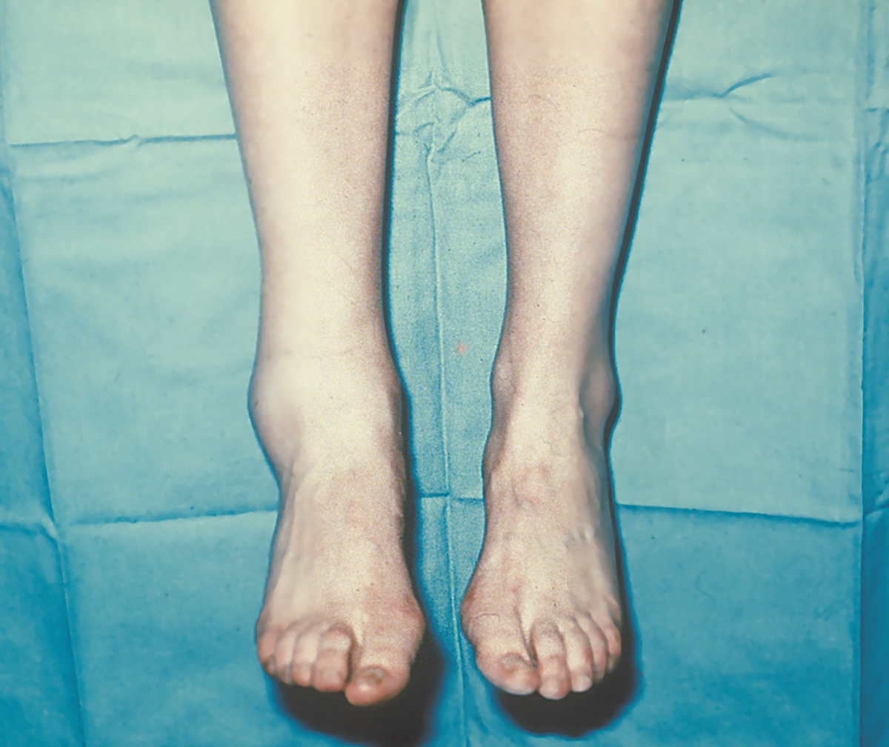
Physical Exam (Head-to-Toe Check) (2 of 3)
A
D
B
C
FIGURE 3-3 Check the person head to toe, looking for and asking about DOTS:
A. Deformities. B. Open wounds. C. Tenderness (pain), and D. Swelling.
A, D. © American Academy of Orthopaedic Surgeons. B. © Talay and Pupha/Shutterstock. C. © Maridav/Shutterstock.

Slide 13
Physical Exam (Head-to-Toe Check) (3 of 3)
Check the body area in the following sequence:
  Head and neck
  Shoulders
  Chest and abdomen
      Hips
      Legs and feet
      Arms and hands
If you find a significant problem during the assessment, stop and provide treatment.
For a complaint involving a sudden illness, you will not always be able to determine the exact cause. Instead, determine if it is serious enough to require professional medical care.

