Slide 1
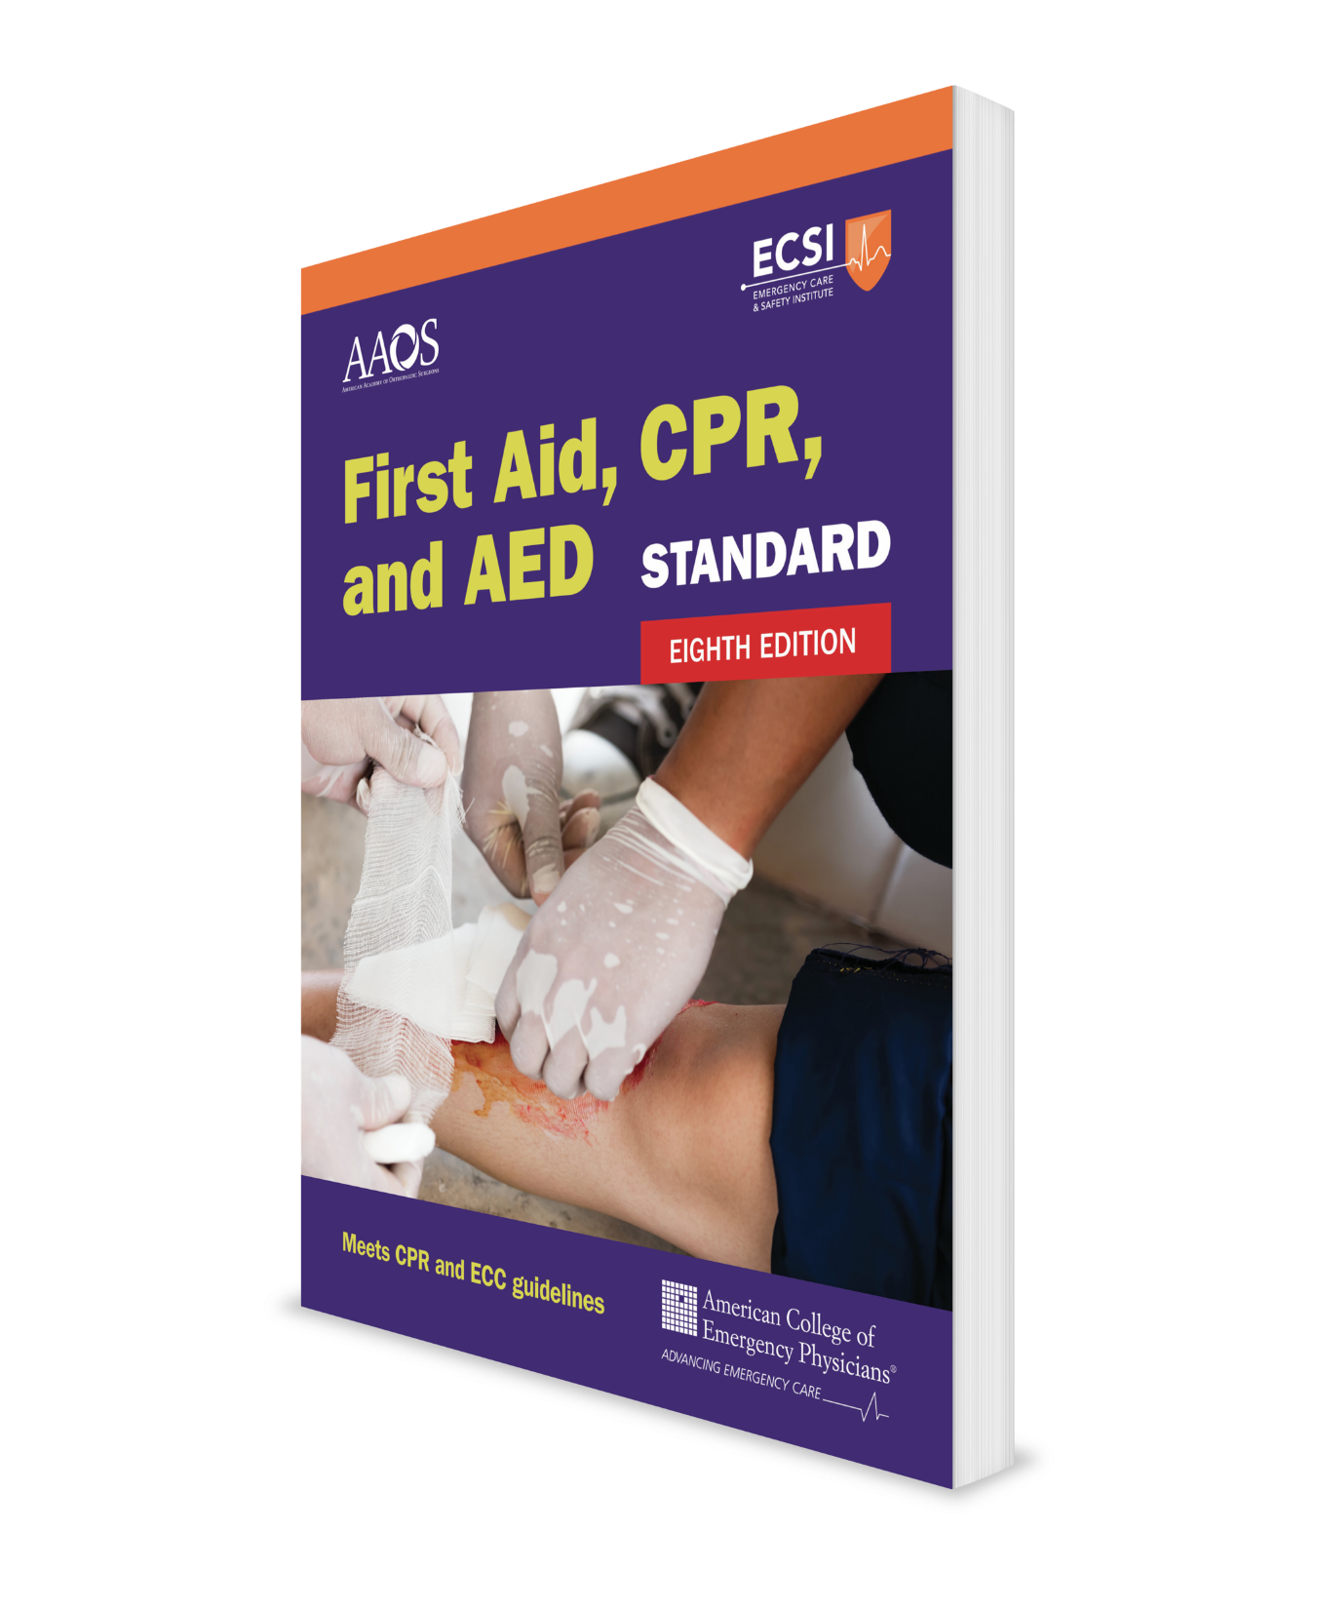
Actions to Take Before Helping Comprehensive Course
CHAPTER 2
Notes:
Standard First Aid, CPR, and AED, Eighth Edition

Slide 2
Support Materials
Lecture Outline
Worksheet
Video
Skill Sheet
Skill Checkoff Sheet
CHAPTER 2 Opener photo.
© oneinchpunch/Shutterstock.

Slide 3
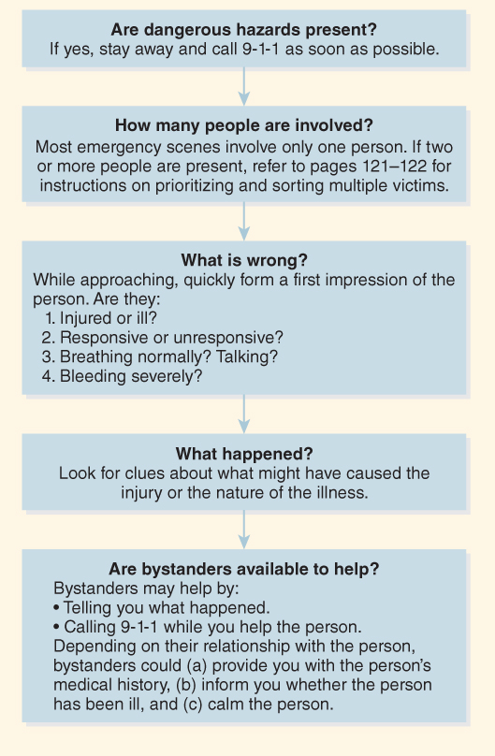
Scene Size-Up
Perform a scene size-up every time you respond to an emergency.
FLOWCHART 2-1 Scene Size-Up

Slide 4
When to Call 9-1-1 (1 of 4)
According to the American College of Emergency Physicians (ACEP), you should call 9-1-1 for help if you answer “yes” to any of the following questions:
Is the condition life threatening?
Could the condition get worse on the way to the hospital?
If you move the person, will it cause further injury?
Does the person need the skills or equipment of EMS?
Would distance or traffic cause a delay in getting the person to the hospital?

Slide 5
When to Call 9-1-1 (2 of 4)
ACEP also recommends that 9-1-1 should be called immediately for people with the following conditions so that they can be brought to the hospital by ambulance to get professional medical care:
Difficulty breathing or shortness of breath
Chest or upper abdominal pain or pressure lasting 2 minutes or more
A fast heartbeat at rest
Fainting (passing out) or unresponsiveness
Difficulty speaking, or numbness or weakness in any part of the body
Sudden dizziness

Slide 6
When to Call 9-1-1 (3 of 4)
Confusion or changes in mental status, unusual behaviors, or difficulty walking
Sudden blindness or vision changes
Bleeding form any wound that will not stop with direct pressure
Broken bones visible through an open wound, or a broken leg
Drowning
Severe burn
Extremely high or low body temperatures
Allergic reaction, especially if there is any difficulty breathing

Slide 7
When to Call 9-1-1 (4 of 4)
Unusual belly pain
Poisoning or drug overdose
Loss of responsiveness
Spinal cord, head, or brain injury
Severe headache
Any sudden or severe pain
Severe or persistent vomiting or diarrhea
Coughing or vomiting of blood
Choking
Psychological, emotional, or behavioral emergencies (threatening to hurt or kill themselves or someone else)

Slide 8
How to Call for Professional Medical Care (1 of 2)
When calling 9-1-1, be sure to speak slowly and clearly.
Be ready to give the dispatcher the following information:
The person’s location
The phone number you are calling from and your name
A brief account of what happened
Number of people needing help and any special conditions at the scene
A description of a person’s condition and what is being done

Slide 9
How to Call for Professional Medical Care (2 of 2)
Listen to what the dispatcher tells you to do.
If necessary, write down the instructions.
Do not hang up until the dispatcher tells you to.
Stay with the person needing help until EMS arrives.

Slide 10
Legal Aspects of First Aid (1 of 3)
While you may not be legally required to help another person, most people believe helping others is the right thing to do.
You must help when you have a legal duty to act:
Employment requires it (eg, job description)
Preexisting relationships exist (eg, parent–child, teacher–student, driver–passenger)

Slide 11
Legal Aspects of First Aid (2 of 3)
Lay responders must be extremely cautious about revealing information that was learned while caring for someone.
The law recognizes that people have the right to privacy.
Do not discuss what you know with anyone other than those who have a medical need to know.
The exception to this rule is when state laws require the reporting of certain incidents, such as rape, abuse, and gunshot wounds.

Slide 12
Legal Aspects of First Aid (3 of 3)
Good Samaritan laws provide reasonable protection against lawsuits and encourage people to help others during an emergency.
Laws are different from state to state but in general, the following conditions must be met:
You are acting with good intentions.
You are providing care without expectation of compensation.
You are acting within the scope of your training.
You are not acting in a grossly negligent (reckless) manner.

Slide 13
Negligence
Negligent actions include:
Giving substandard care
Withholding care when you have a legal duty to act
Causing injury or harm
Exceeding your level of training
Abandoning the person (starting the care and then stopping or leaving without ensuring that a rescuer with the same or higher level of training will continue to care for the person)

Slide 14
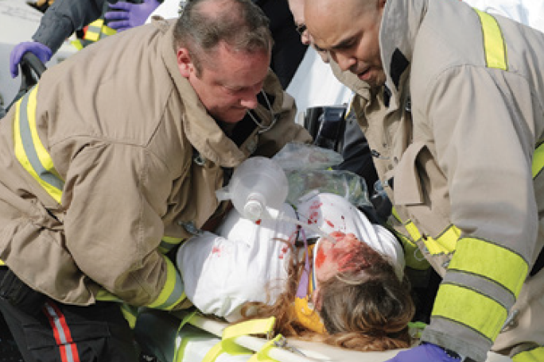
Consent (1 of 2)
Always obtain consent (permission) before giving first aid.
FIGURE 2-2 Duty to act
© Spiritartist/iStock.

Slide 15
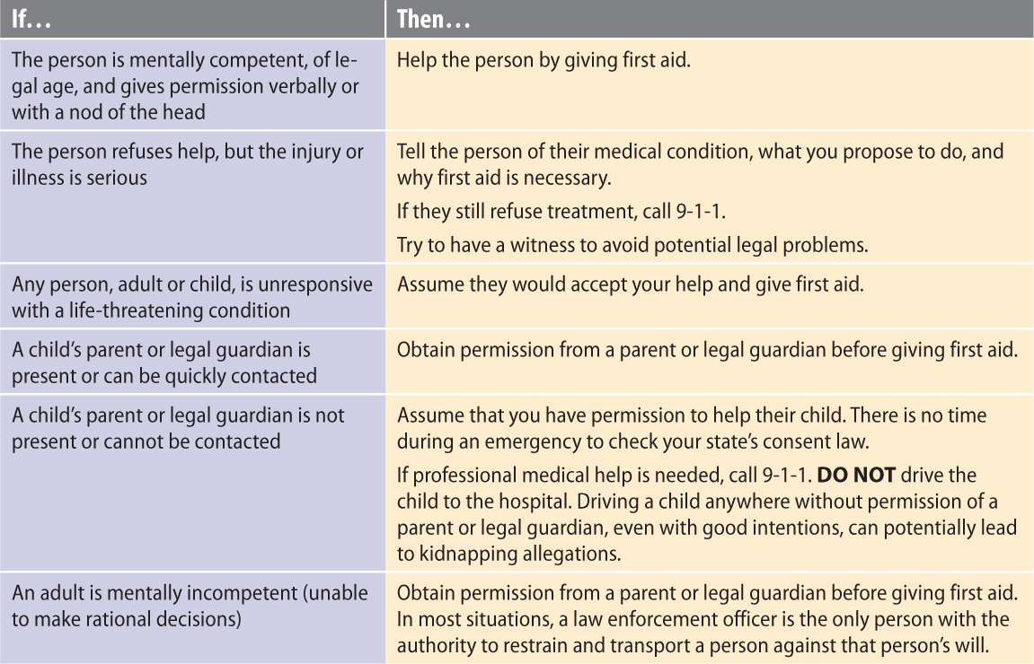
Consent (2 of 2)

Slide 16
Personal Protective Equipment (1 of 5)
Avoid contact with blood and other body fluids by putting on personal protective equipment (PPE), which includes:
Disposable medical exam gloves
Use latex-free gloves, if possible
Nitrile gloves recommended
Eye protection (goggles or face shields)
Mouth-to-mouth barrier device (face mask or face shield) when giving CPR
Face covering (face mask or face shield) to prevent disease transmission.

Slide 17
Personal Protective Equipment (2 of 5)
FIGURE 2-4 Mouth-to-barrier devices. A. Masks. B. Face shields.
© Jones & Bartlett Learning. Courtesy of MIEMSS.
FIGURE 2-3 Disposable gloves.
© Jones & Bartlett Learning. Photographed by Kimberly Potvin.

Slide 18
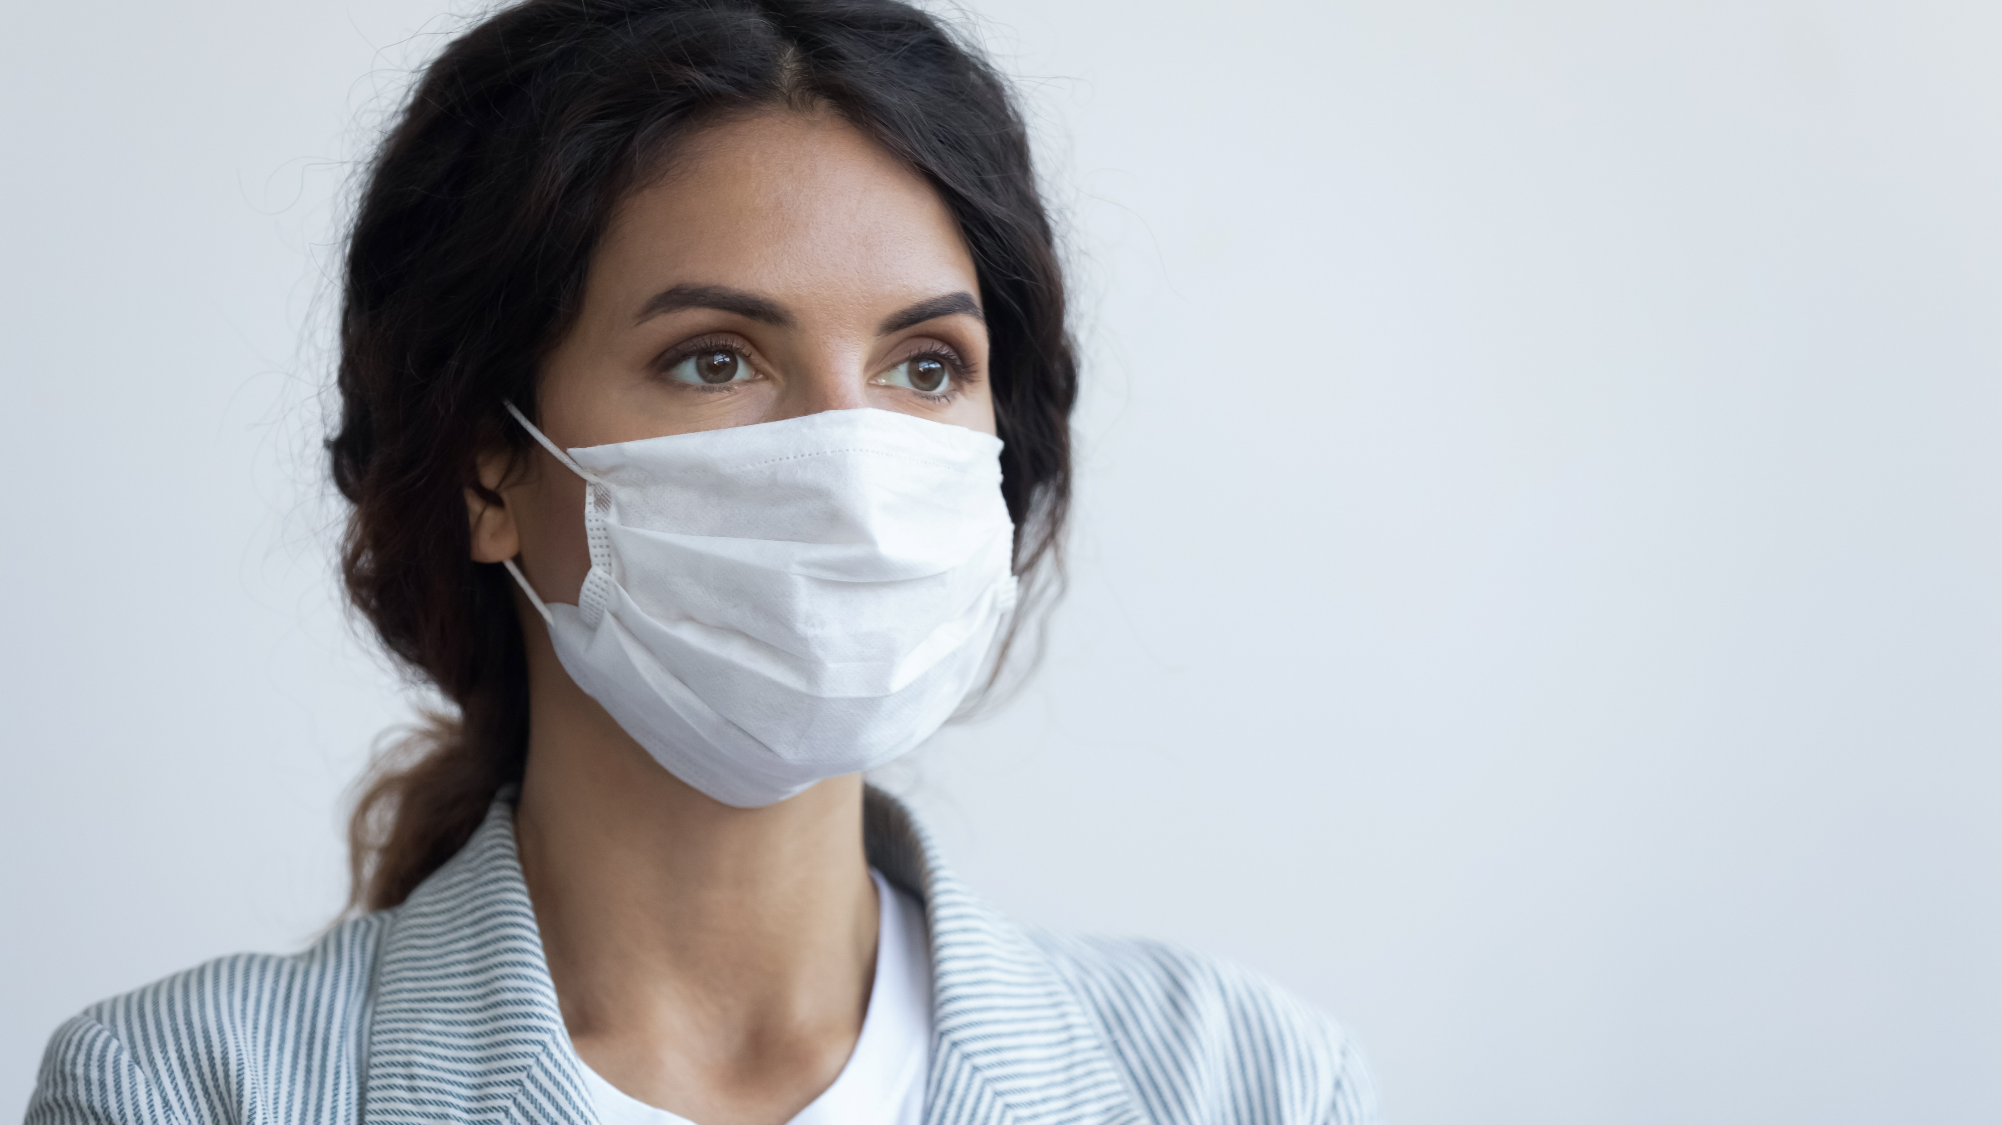
Personal Protective Equipment (3 of 5)
FIGURE 2-5 A. Face mask for public health. B. Face shields for public health.
A. © fizkes/Shutterstock; B. © pixfly/Shutterstock.

Slide 19
Personal Protective Equipment (4 of 5)
To correctly put on a face mask:
Wash your hands
Pick up the mask by the ear loops or around-the-head strings only.
Do not touch the front of the mask.
Using the ear loops or strings, pull the mask to your face, covering your nose and mouth.
Fit the mask snuggly against the side of your face and under your chin, and secure the ear loops or around-the-head strings.

Slide 20
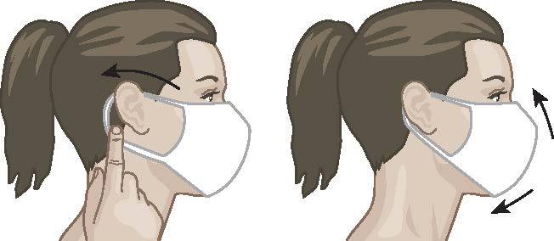
Personal Protective Equipment (5 of 5)
FIGURE 2-6 A correctly fitting mask should cover your nose and mouth and be secured around your ears or head.
© Jones & Bartlett Learning.

Slide 21
Cleaning Body Fluids
Wear PPE.
Wipe up body fluids with paper towels.
Spray or wash the area with 1 part liquid bleach in 10 parts water and let it air dry.
Dispose of materials in a biohazard container. If one is not available, double-bag in plastic bags.
When finished, wash your hands.

Slide 22
Washing Your Hands (1 of 2)
Wash your hands before and after giving first aid, even if gloves were worn:
Wet your hands with clean, running water and apply soap.
Lather by rubbing hands together. Be sure to get the backs of your hands, between all fingers, and under your nails.
Scrub all hand surfaces for at least 20 seconds.
FIGURE 2-7 Handwashing
© diy13/Shutterstock

Slide 23
Washing Your Hands (2 of 2)
Rinse off the soap completely with clean, running water.
With the water still running, dry your hands with a clean towel or paper towel.
Avoid touching the water faucet by using a towel to turn off the water.

